Slide 1

New York Intergovernmental
Renewable Energy Task Force
Garden City, New York
April 28, 2016
Notes:
Background slide for ASLM and DIR.

Slide 2


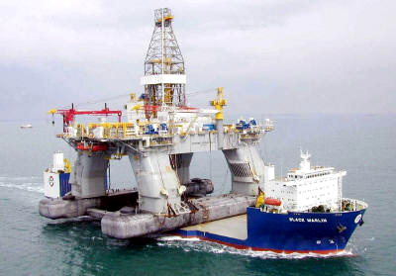
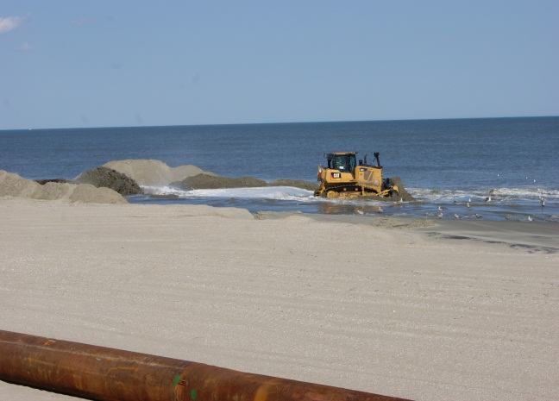

Department of the Interior
Bureau of Ocean Energy Management
James Bennett, Chief
Office of Renewable Energy Programs
New York Renewable Energy Task Force Meeting
April 28, 2016
Notes:
Jim Bennett slides begin here.
Slides Outline:
Meeting Objectives
Leasing Process: Four Phases
Atlantic Activities
New York, New York
Program Update: Call
Program Update: Area ID
Wind Energy Area
Questions

Slide 3
Meeting Objectives
Update on Task Force Progress
Discuss Draft Proposed Sale Notice (PSN)
Review Major leasing milestones
Engage with Task Force on next steps
Notes:
The last Task Force meeting here in New York was on September 26, 2013.
We’ve made a lot of progress since then.

Slide 4
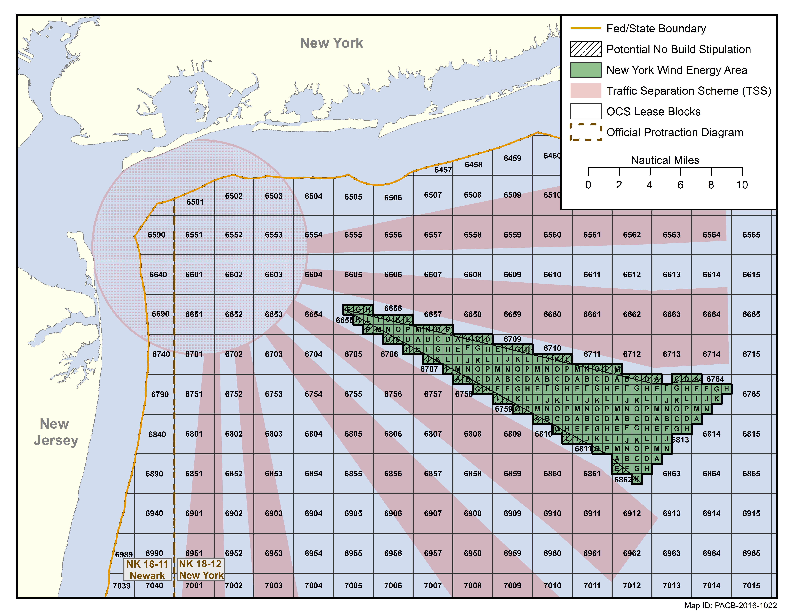

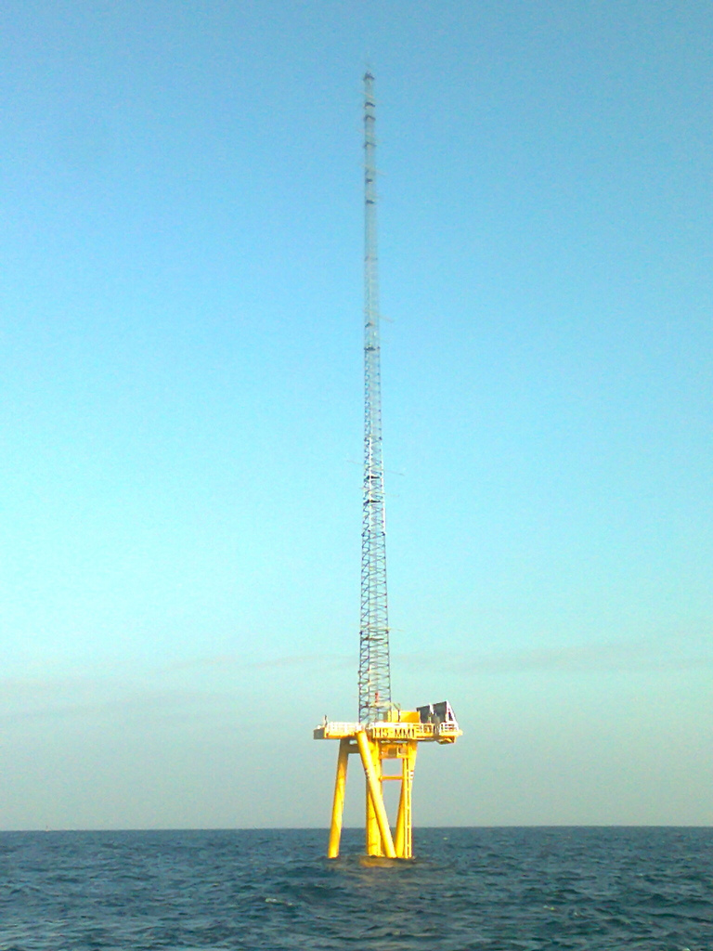
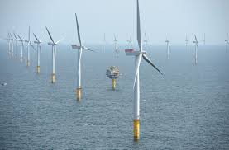
4-Stage Renewable Energy Authorization Process
Planning and Analysis
Leasing
Site Assessment
Construction and Operations
Intergovernmental Task Force
Request for Information (RFI)/Call for Information & Nominations (Call)
Area Identification
Environmental reviews
Publish leasing notices
Issue lease(s)
Site Characterization
Site Assessment Plan
(SAP)
Construction and Operations Plan (COP)
Facility Design Report & Fabrication and Installation Report
Decommissioning
Notes:
Planning and Analysis (~ 2 years)
The Planning and Analysis phase seeks to identify suitable areas for wind energy leasing consideration through collaborative, consultative, and analytical processes that engage stakeholders, tribes, and State and Federal government agencies. This is the phase when BOEM conducts environmental compliance reviews and consultations with Tribes, States, and natural resource agencies. THIS is the stage we’re in now with our New York Wind Energy Area. We’re about to enter the next phase…
Leasing (~ 2 years)
The Leasing phase results in the issuance of a commercial wind energy lease. Leases may be issued either through a competitive or noncompetitive process. A commercial lease gives the lessee the exclusive right to subsequently seek BOEM approval for the development of the leasehold. The lease does not grant the lessee the right to construct any facilities; rather, the lease grants the right to use the lease area to develop its plans, which must be approved by BOEM before the lessee can move on to the next stage of the process.
Site Assessment (~ 5 years)
The Site Assessment phase includes the submission of a site assessment plan (SAP), which contains the lessee's detailed proposal for the construction of a meteorological tower and/or the installation of meteorological buoys on the leasehold. The lessee’s SAP must be approved by BOEM before it conducts these "site assessment" activities on the leasehold. BOEM may approve, approve with modification, or disapprove a lessee's SAP. It is also during this phase that the lessee would conduct site characterization surveys and studies (e.g. , avian, marine mammal, archeological). Lessee has up to 5 years to conduct these activities.
Construction and Operations (~ 25 years)
The Construction and Operations phase consists of the submission of a Construction and Operations Plan (COP), which is a detailed plan for the construction and operation of a wind energy project on the lease. BOEM conducts environmental and technical reviews of the COP and decides whether to approve, approve with modification, or disapprove the COP. Prior to the end of the lease term, the developer must submit a plan to decommission facilities. Operations term is typically 25 years.

Slide 5
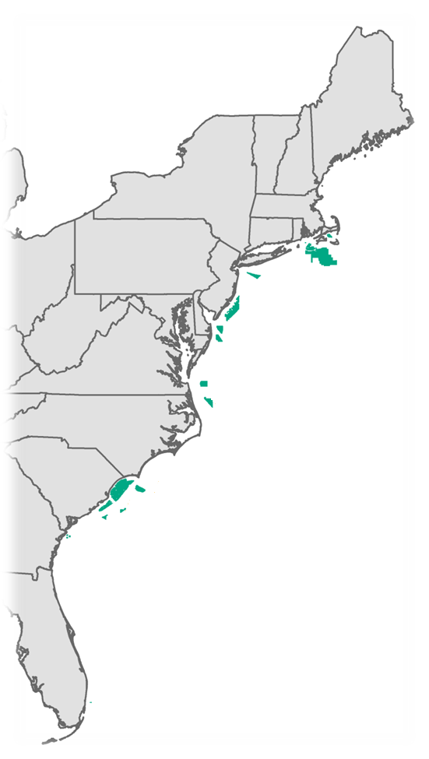
Atlantic Outer Continental Shelf (OCS) Activities
Maine: No Competitive Interest
New Hampshire: Shown Interest In Offshore Development
Massachusetts: 3 Commercial Leases (Cape Wind Associates, DONG Energy, Offshore MW)
Rhode Island/Massachusetts: 2 Commercial Leases (Deepwater Wind); ROW grant (The Narragansett Electric Company)
New York: Identified Wind Energy Area
New Jersey: 2 Commercial Leases (RES America, US Wind)
Delaware: Commercial Lease (Bluewater Wind)
Maryland: 2 Commercial Leases (US Wind)
Virginia: Commercial Lease (Dominion Power); VOWTAP (DMME)
North Carolina (Kitty Hawk): Publish Proposed Sale Notice
South Carolina: Published Call and NOI
Georgia: EA published April 2014; next step is to complete environmental review
Florida: IP Lease (FAU)
Notes:
Climate Change
Program-wide Activity: RFF –
As you can see, we are making significant progress off many Atlantic states.
As we are moving beyond the early stages of our program, we decided that now would be a good time to assess the strengths and weaknesses of our existing processes, and stakeholder feedback is critical to that effort.
To that end, we published a Request for Feedback in September 2015 for a 90-day comment period.
We received 57 comments in response to the RFF that cover many aspects of our program that could potentially be improved, from consideration of stakeholder information during area delineation, to increasing transparency during our plan reviews, to aligning our processes with state incentive programs.
We are closely considering all comments received (including those submitted by the City of New York!) and are planning on announcing some BOEM initiatives informed by the RFF comments in the DOE/DOI National Offshore Wind Strategy that we’re planning on announcing later this year.
RPBs – (This is a brief summary of the TPs Leann provided separately)
BOEM is very involved in the activities of the Regional Planning Bodies (RPBs). The Northeast and Mid-Atlantic RPBs are each in the process of developing an Ocean Action Plan (OAP), and both RPBs are incorporating action items that are directly in support of offshore ocean energy. These actions include: identifying, gathering, and using the best available data through the regional Portals, for example; and working earlier with developers, states, federal agencies, and tribes to identify and resolve areas of concern about project location and activities. BOEM is committed to informing, and being informed by, the activities and actions of these and other RPBs.
State Highlights (Janice will cover most of these)
Maine: Statoil (Norway) withdrew its lease request.
New Hampshire: State asked for example task force letter; no formal request for task force to date.
Massachusetts: In January 2015, BOEM held a competitive lease sale (its fourth) for wind energy development in Federal waters offshore Massachusetts. RES America Developments, Inc. (later assigned to DONG) and Offshore MW LLC as winners. SAPs are due for the lease areas on April 1, 2016 – both lessees have requested a 1-year extension of the preliminary term and OREP is evaluating those requests. Next step for Cape Wind is to receive a response to information request regarding decommissioning and process COP revision #2.
Rhode Island/Massachusetts: July 2013 - Deepwater Wind New England, LLC was the winner of both lease areas. The auction received $3,838,288 in high bids. Received SAP for North Lease Area on April 1. In December 2014, ROW grant was executed. Next step Sea2Shore (previously BITS) is to review FDR, FIR, and SMS.
New York: On Mar. 16, 2016, Area ID was completed and the NY WEA was established.
New Jersey: November 2015 –RES America Developments Inc., bid $880,715 for lease area OCS-A 0498 (transfer to DONG), and US Wind Inc., bid $1,006,240 for OCS-A 0499.
Delaware: December 2012 – Bluewater Wind. OREP is coordinating with BWW on next steps for processing the SAP in light of a potential lease assignment.
Maryland: August 2014 – U.S. Wind winner of both leases, for a total bid of $8,701,098 for about 80,000 acres. Next step is to process COP survey plan.
Virginia: September 2013 – Dominion Power winner of the nation’s second competitive lease sale, garnering $1.6M in high bids for 112,799 acres. Next step is to receive updated COP survey plan and process SAP.
March 2015- Executed the first wind energy research with DMME (VOWTAP). Finalized RAP decision March 2016.
North Carolina: August 2014 – identified 3 WEAs. A Task Force meeting was held in April to discuss the draft PSN.
South Carolina: Published Call & NOI in late November. Scoping meetings held in January 2016. Comment period for Call closed January 25, 2016 – two nominations received. OREP is currently processing the Call and next step is area identification. Task Force webinar scheduled for May 17.
Georgia: Next steps are to finalize revised EA and offer lease.
Florida: June 2014- 5 year IP lease FAU for MHK testing (next step is submittal of project plan). This is the first time a lease has been issued to test ocean current energy equipment in Federal waters.

Slide 6
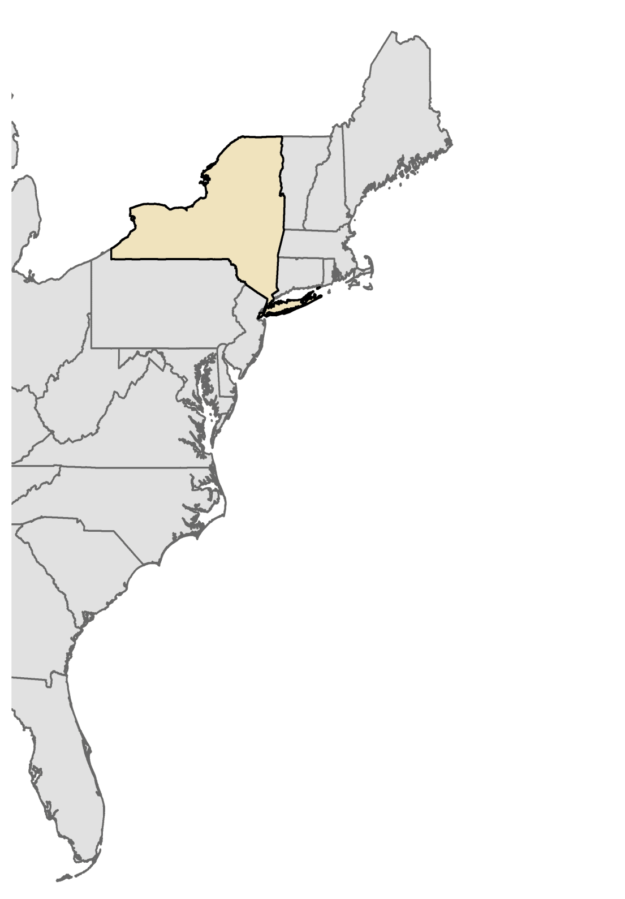
Atlantic Outer Continental Shelf
New York
Notes:
We are here today to discuss the New York WEA, shown here.
Background on New York WEA, which DIR should have covered (included here just in case):
As the Director mentioned, we’ve been engaged in New York planning for several years. It began with BOEM’s receipt of an unsolicited commercial nomination in 2011. That area was further refined and described in a Request for Interest on Jan. 4, 2013.
On May 28, 2014, BOEM published the New York Call for Information and Nominations and a Notice of Intent to prepare an Environmental Assessment in the Federal Register for a 45-day public comment period.
We gathered quite a bit of feedback and input in response to both the RFI and Call, which we considered carefully as we embarked on our next step of Area Identification.
Area Identification is the process by which BOEM establishes a Wind Energy Area (WEA). It involves careful consideration and analysis, not to mention balancing, of other uses of an area under consideration. Uses such as fishing, navigation, and recreation, to name a few.
As the Director mentioned, the New York WEA was announced March 16, 2016. We’re now proceeding with an Environmental Assessment and the leasing process.
The EA will analyze the impacts of issuing renewable energy leases, including reasonably foreseeable consequences associated with activities such as deployment of meteorological buoys and site characterization activities, such as geophysical, geotechnical, archeological, and biological surveys.
After the completion of the necessary environmental reviews and consultations, BOEM may publish a Proposed Sale Notice to describe the area offered for leasing and the proposed terms and conditions of a wind energy auction.
We’ve developed a draft PSN for your consideration today and over the next week, which we’ll walk through later in this agenda.

Slide 7
New York Update: Call
Publication of Call and NOI (May 28, 2014)
3 nominations, 59 comment submissions
Topics of interest:
  wildlife and socioeconomic impacts
  phased environmental review process
  multiple-use impacts, specifically, regional fisheries and navigation
Comments used to inform Area Identification
Notes:
At the last Task Force meeting in 2013, we were discussing the path forward, specifically, whether we would publish a Call for Information and Nominations prior to proceeding with Area Identification.
We decided to publish a Call as the next step in the process in order to gather more information and feedback about the area.
The New York Call for Information and Nominations and a Notice of Intent to prepare an Environmental Assessment were published in the Federal Register for a 45-day public comment period on May 28, 2014.
We gathered quite a bit of feedback and input in response to the RFI, Call, and NOI. Comments covered topic areas such as: wildlife and socioeconomic impacts; support for offshore wind due to job creation and climate change; phased environmental review process; multiple-use impacts, specifically, regional fisheries and navigation

Slide 8
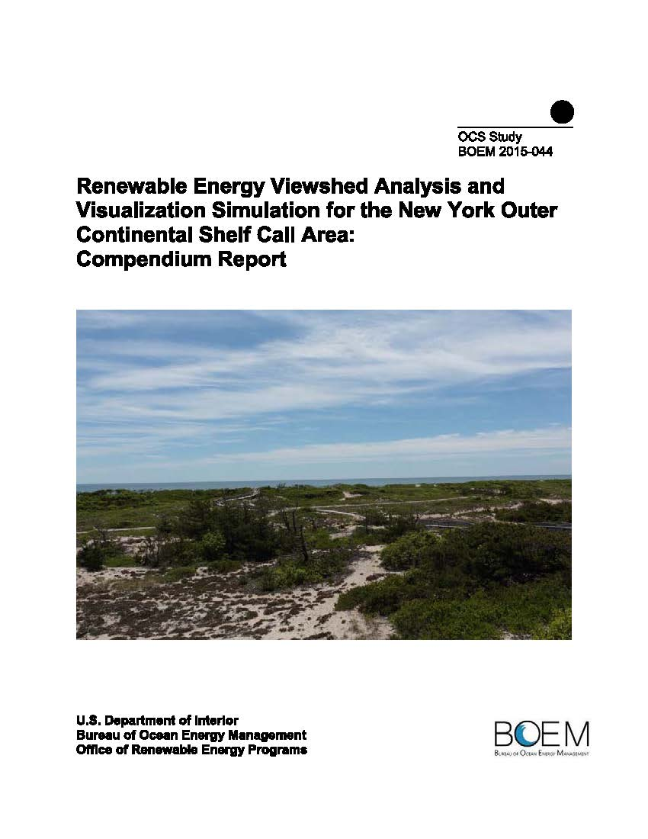
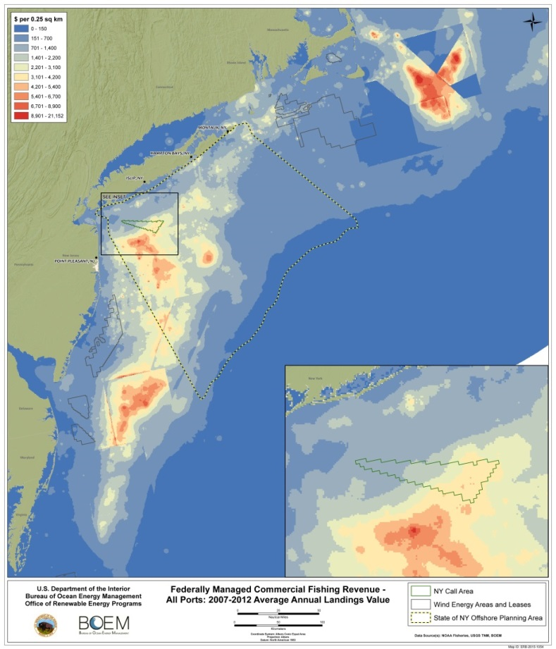
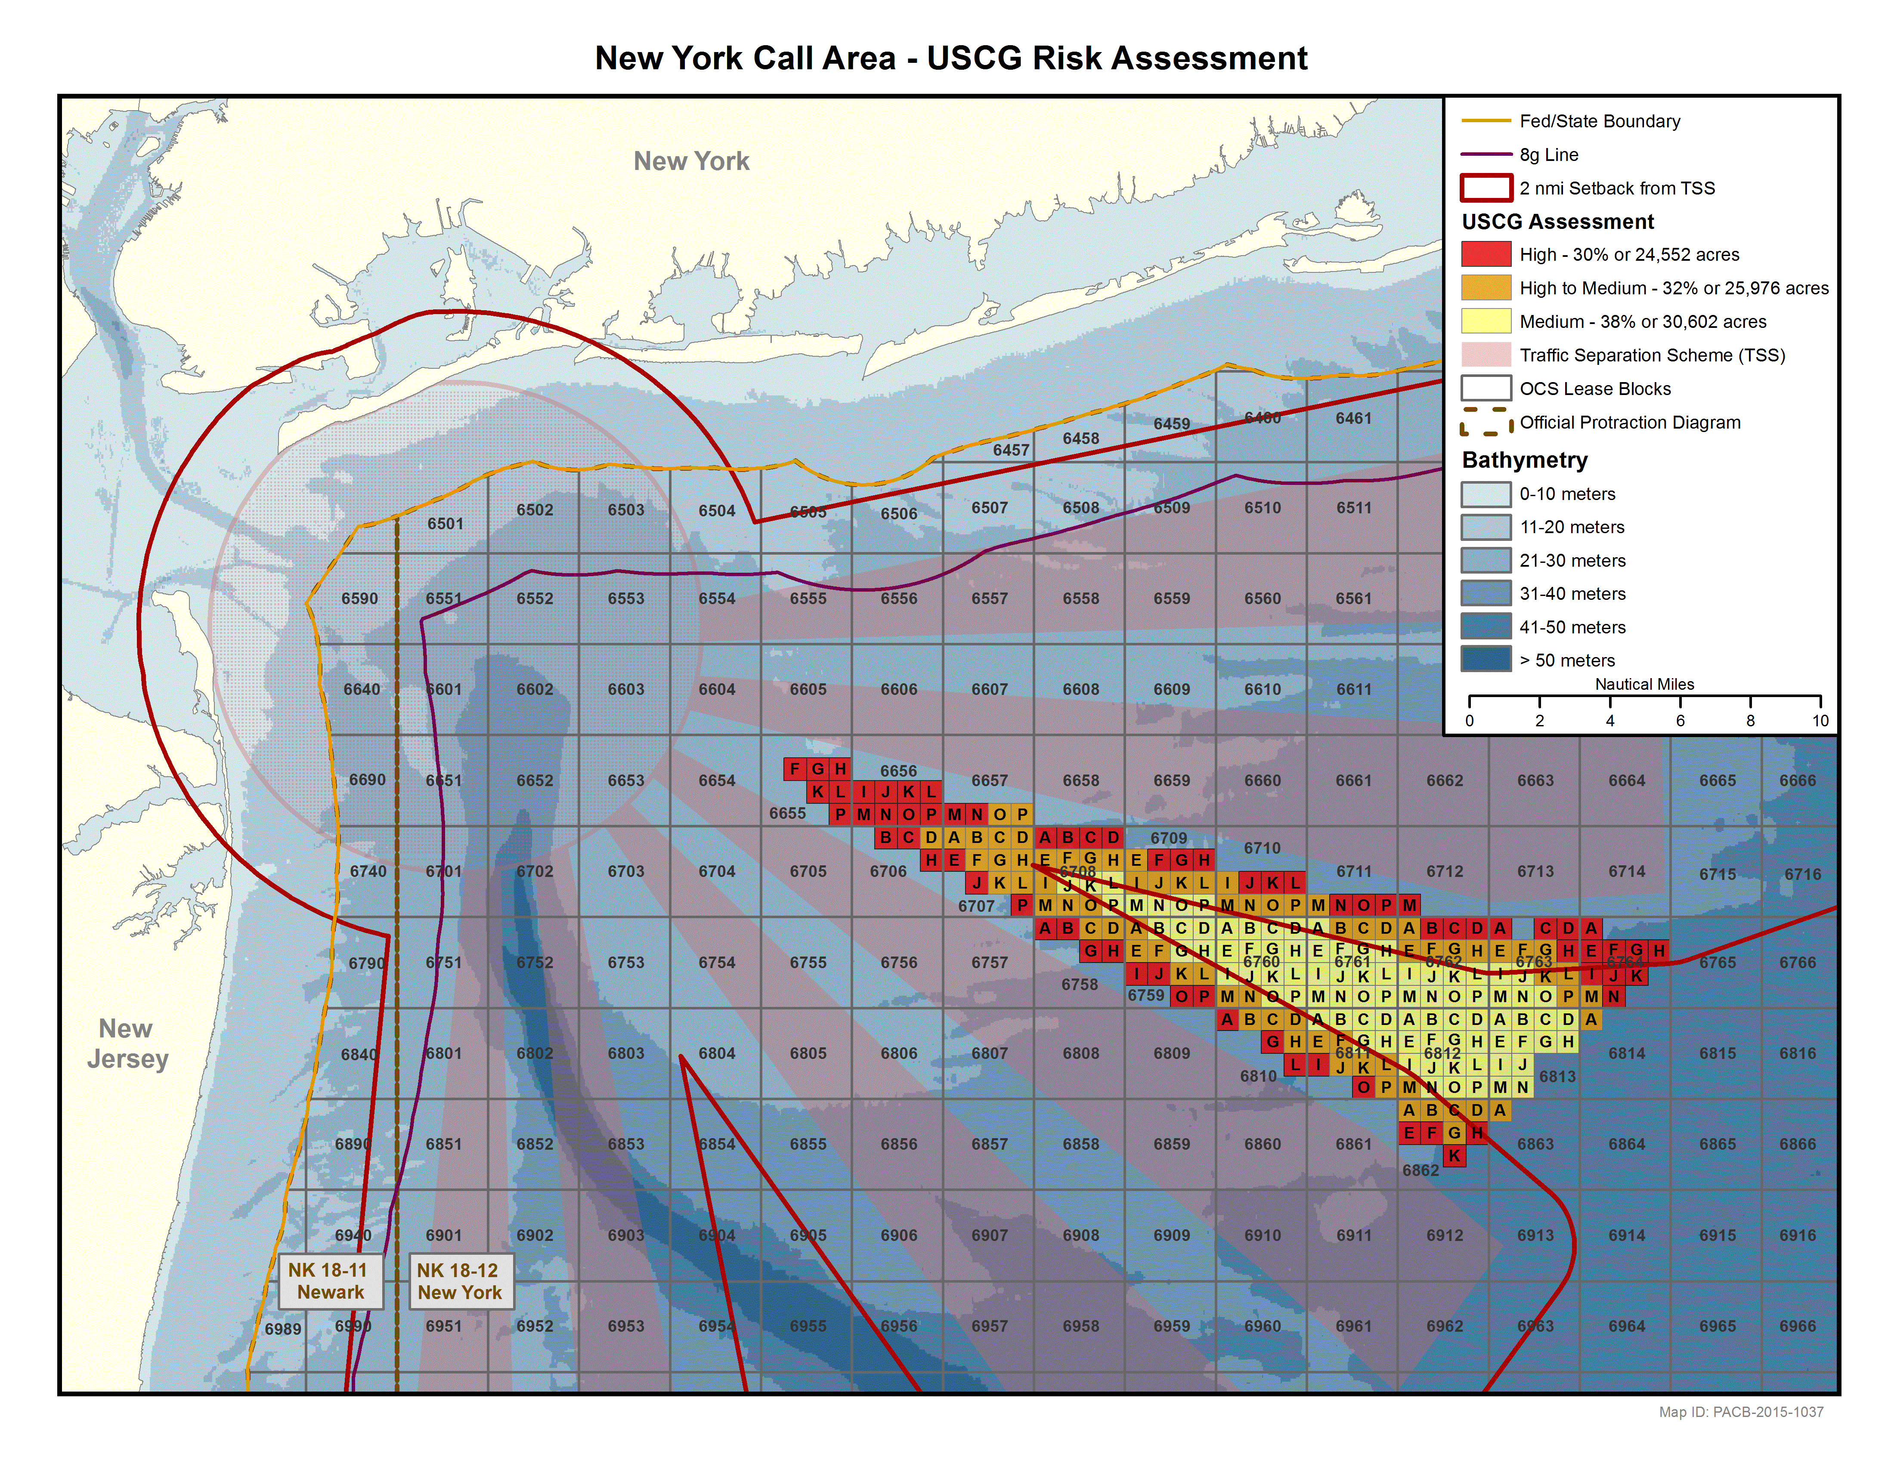
New York Update: Area ID
Area ID: March 15, 2016. Balances potential offshore wind development with other uses of the area and environmental concerns
3 key issues identified and analyzed:
  Commercial fishing
  Navigational safety
  Visual impacts
Notes:
After the close of the comment period for the Call and NOI, we began Area Identification to identify an area for leasing, which was informed by all relevant information received to date.
Area Identification is the process by which BOEM establishes a Wind Energy Area (WEA). It involves careful consideration and analysis, not to mention balancing, of other uses of an area under consideration. The three primary issues analyzed during this Area ID were potential impacts from commercial wind development on navigational safety, commercial fishing, and the viewshed.
This process involved extensive stakeholder outreach - most recently, fisheries outreach meetings in November 2015.

Slide 9
Wind Energy Area
Notes:
As the Director mentioned, the New York WEA was announced March 16, 2016. The area remained identical to the area included in the Call, and retains the 1nmi setback from the TSSs. We’re now proceeding with an Environmental Assessment and the leasing process.
The EA will analyze the impacts of issuing renewable energy leases, including reasonably foreseeable consequences associated with activities such as deployment of meteorological buoys and site characterization activities, such as geophysical, geotechnical, archeological, and biological surveys.
BOEM intends to publish a Proposed Sale Notice (PSN) to describe the area we may offer for leasing and the proposed terms and conditions of a wind energy auction. We’ve developed a draft PSN for your consideration today and over the next week, which we’ll walk through later in this agenda.

Slide 10
Questions?
Bureau of Ocean Energy Management
www.boem.gov
Renewable Energy Program
www.boem.gov/Renewable-Energy
State Activities
www.boem.gov/Renewable-Energy-State-Activities
Regulatory Information
www.boem.gov/Regulatory-Development-Policy-and-Guidelines

