Slide 1
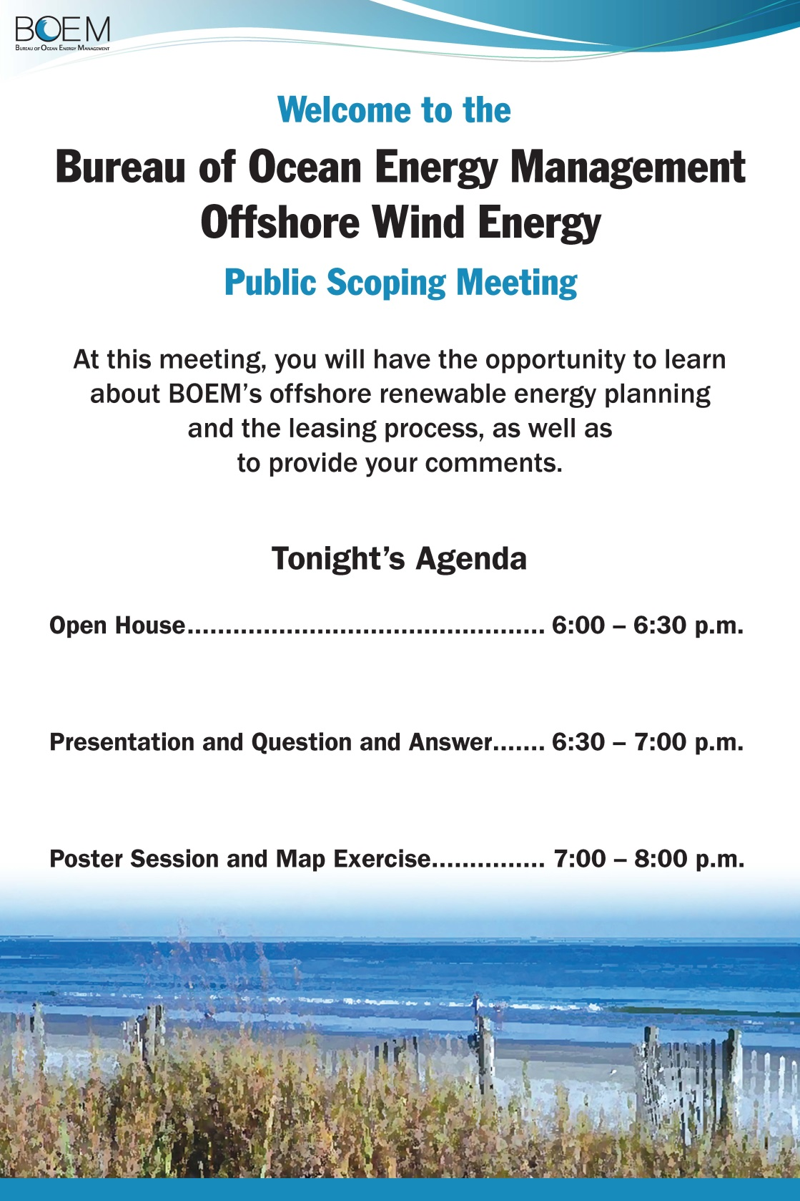

Slide 2
South Carolina Outer Continental Shelf Planning for Commercial Wind Leasing
Notice of Intent to Prepare an Environmental Assessment and Call for Information and Nominations
January 5-7, 2016
Brian Krevor, Environmental Protection Specialist
Office of Renewable Energy Programs
Bureau of Ocean Energy Management

Slide 3

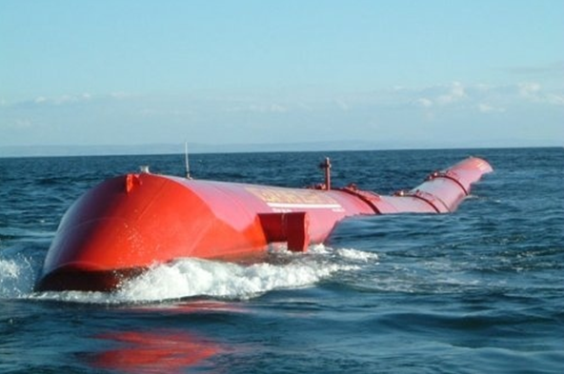

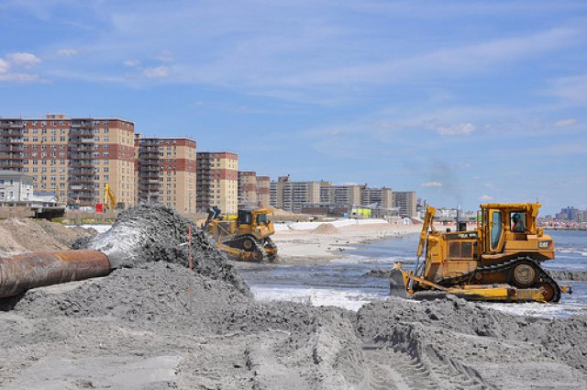
Bureau of Ocean Energy Management
Notes:
Ocean energy bureau within the U.S. Department of the Interior (DOI)
Manages the nation's natural gas, oil and other mineral and energy resources on the Outer Continental Shelf (OCS)

Slide 4
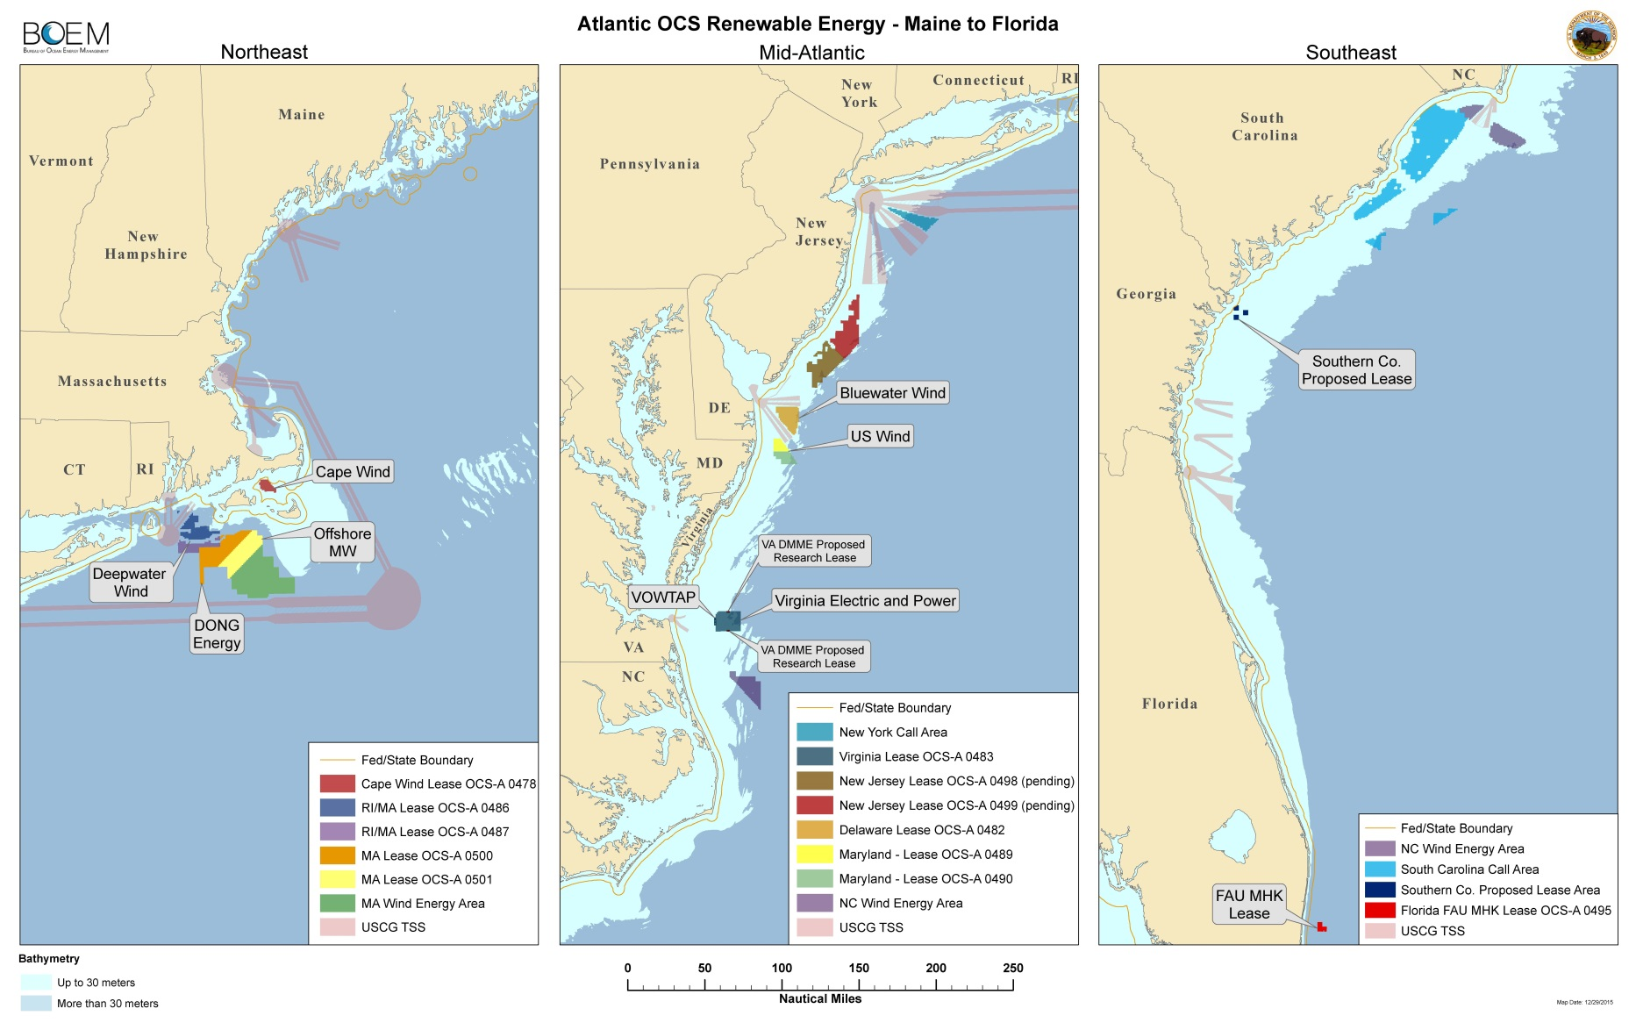
Atlantic Renewable Energy Activities

Slide 5
What is a Call?
Call for Information and Nominations
South Carolina Call Federal Register notice published November 25, 2015
Requests for information for BOEM to consider in the planning, analysis, and decision-making process
Requests for developers to nominate areas of interest for wind energy development
Not a decision to lease

Slide 6
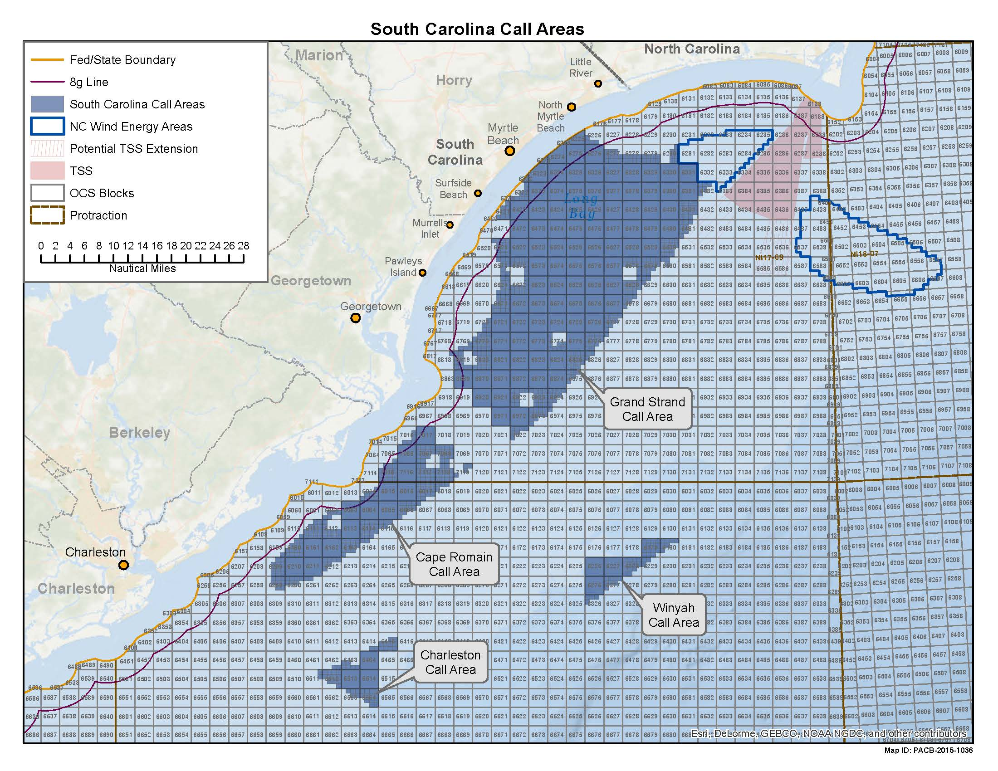

Slide 7
What is an NOI?
Notice of Intent to Prepare an Environmental Assessment
Begins environmental review process
South Carolina NOI published in the Federal Register on November 25, 2015
Informs the public and solicits input on:
  Important resources, issues, and data gaps
  Alternatives
Published concurrently with the Call

Slide 8
What is an Environmental Assessment (EA)?
An EA is a concise public document which:
  Briefly provides sufficient evidence and analysis for determining whether to prepare an Environmental Impact Statement (EIS);
  Aids an agency's compliance with NEPA when no EIS is necessary (better alternatives and mitigation measures) and;
  Facilitates preparation of an EIS when one is necessary.

Slide 9
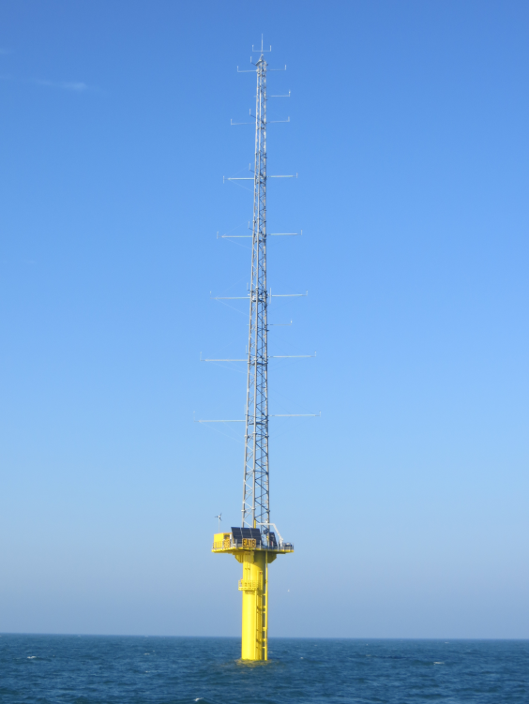
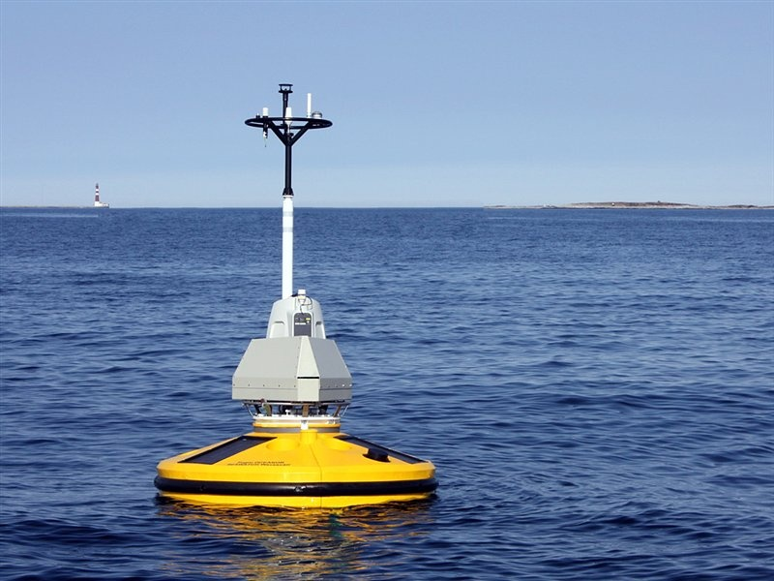
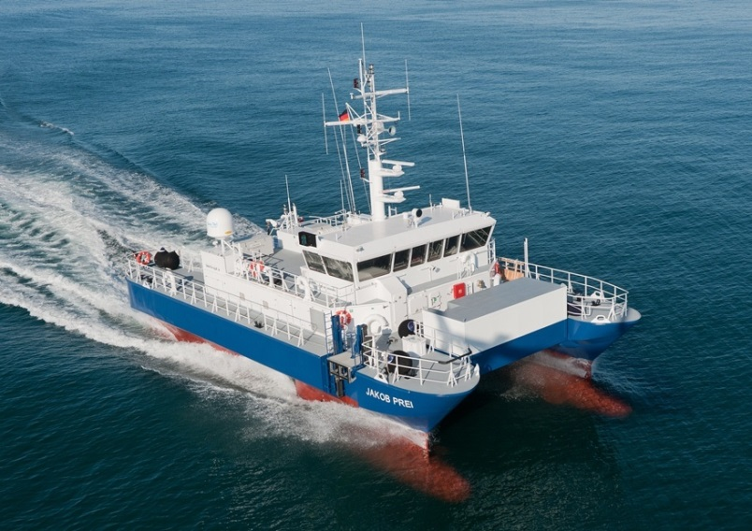
Proposed Action:
What will be considered
Lease Issuance
Associated site characterization surveys
Subsequent site assessment activities

Slide 10
Proposed Action:
What will NOT be considered
Installation, operation, and decommissioning of a commercial wind energy facility
If an eventual lessee were to submit a construction and operations plan, BOEM would conduct a project specific environmental analysis that would likely take the form of an EIS

Slide 11
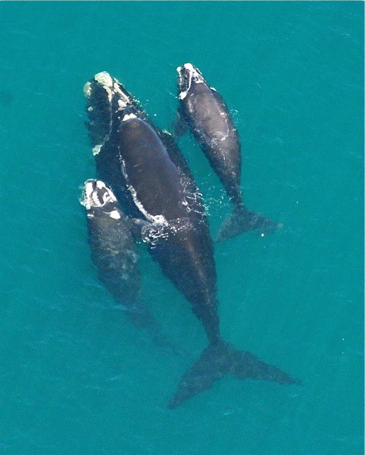
Examples of Alternatives that May be Analyzed
Geographic
Timing/Seasonal Restrictions
No Action

Slide 12
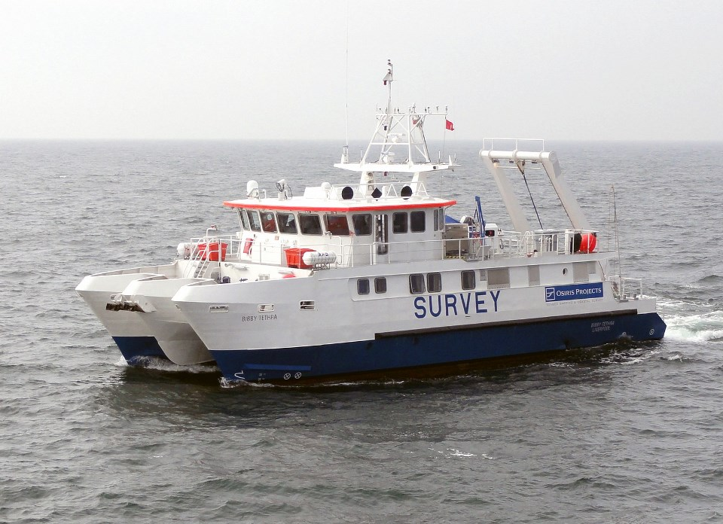
Impact Producing Factors
Vessel Traffic
Noise (Pile Driving, Surveys)
Vessel Collisions/Allisions
Bottom Disturbance
Emissions and Discharges
Lighting
Visual and Aesthetic Interference

Slide 13
Environmental and Socioeconomic Resources
Physical
  Air Quality
  Water Quality
Biological
  Marine Mammals
  Sea Turtles
  Fish and Essential Fish Habitat (EFH)
  Coastal Habitats
  Benthic Resources
  Avian and Bat Species
Socioeconomic
  Aesthetics and Visual Resources
  Commercial and Recreational Fishing
  Cultural Resources
  Military Uses
  Environmental Justice
  Land Use and Coastal Infrastructure
  Tourism and Recreation
  Demographics and Employment

Slide 14

Standard Operating Conditions
Developed to reduce or eliminate the potential for environmental risks
Generally have been based on consultations with NOAA NMFS, FWS, and other agencies
Part of the proposed action or “in place”
Enforced through lease stipulations and\or terms and conditions of plan approval

Slide 15
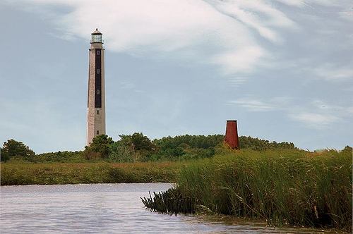
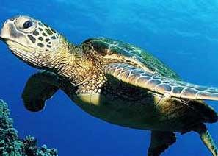
Consultations
National Historic Preservation Act (NHPA)
Coastal Zone Management Act (CZMA)
Endangered Species Act (ESA)
Magnuson-Stevens Fishery Conservation and Management Act (Essential Fish Habitat (EFH))
Gullah Geechee Cultural Heritage Corridor

Slide 16
Posters/Stations
BOEM Leasing Process
Avian Information
Marine Mammals and Sea Turtles
South Carolina Call Area Development
Survey and Site Assessment Equipment
Map Exercise
Court Reporter

Slide 17
Area Identification
Comments on Call and NOI will feed into Area Identification
Looking for information on resources such as:
  Proposed North Atlantic Right Whale Critical Habitat
  Visual Impacts
  Gullah Geechee Cultural Heritage Corridor
  Biological Resources

Slide 18
How to comment on Call and NOI
60-day public comment period ends January 25, 2016
In written form, deliver to:
Office of Renewable Energy Programs
Bureau of Ocean Energy Management
45600 Woodland Road (VAM-OREP)
Sterling, Virginia 20166
Electronically:
http://www.boem.gov/About-BOEM/Public-Engagement/Public-Engagement-Opportunities.aspx
Click on “Documents Open for Public Comment” and choose the “Open Comments Document” link. Please use the two documents dated 11/25/2015

Slide 19
Questions?
Brian Krevor, Environmental Protection Specialist
Brian.Krevor@boem.gov
703-787-1346

