Slide 1
Alaska Seabed Minerals
Marine Minerals Administration
Alaska OCS Region
October 2026

Slide 2
Leasing Steps: Regulatory Pathway and Projected Timeline
1
2
3
4
5
6
7
8
9
Applicant submits request to lease minerals. Alternatively, MMA can initiate.
MMA publishes Request for Interest (RFI)
MMA identifies location and size of lease area
MMA conducts environment & agency reviews
MMA issues proposed leasing notice
MMA receives comments submitted by governors of adjacent states
MMA considers governor’s comments and issues leasing notice
Applicants bid for minerals lease
MMA issues minerals lease
PUBLIC INVOLVEMENT
3 – 12 Months
1 – 3+ Years
6 – 12 Months
Total Process: 2 – 5+ Years
NOTES:
Minimum lease term is 20 years.
Minerals leasing is a competitive process (581.18(a)).
The leasing notice will specify the auction details (581.18 (b) and (c)).
MMA is currently engaged in updating and modernizing the existing regulatory framework.
Each action by MMA is subject to review and approval by the Secretary of the Interior (or their designee) before the process proceeds.

Slide 3
MMA Regulatory Pathway for
Alaska OCS Mineral Leasing
Current step in the process.
Request for Information and Interest (RFI) (Published in the Federal Register)
Identification of areas to be considered for leasing
National Environmental Policy Act (NEPA) review of areas for lease sale
Proposed Leasing Notice (Published in the Federal Register)
Leasing Notice (Published in the Federal Register)
Competitive Lease Sale
Request may ask for indications of interest in the leasing and/or specific information and comments
Size sufficiently large to allow for sufficient mineral recovery
Conducted on areas for potential leasing
Proposes sale procedures, lease stipulations, payments, and other items and conditions
Published 60 days prior to Leasing Notice
Finalizes bidding mechanism, auction details, and other terms and conditions
Published at least 30 days prior to Lease Sale
Tribal and community engagement occurs throughout the process

Slide 4
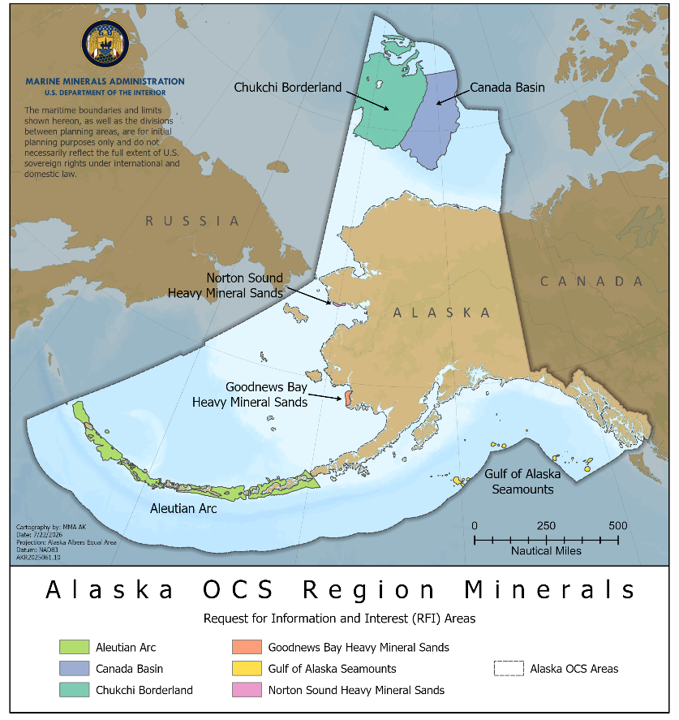
Background
Alaska OCS Marine Minerals
Manganese Platinum Cobalt Nickel | Silver Sand Gold Tin
Request for Information and Interest (RFI)
RFI: Commercial Leasing for Outer Continental Shelf Minerals Offshore Alaska was published Jan. 29, 2026.
6 RFI areas for Alaska OCS
Public Comments
Comment period ended April 1, 2026
Evaluating comments for Area ID

Slide 5
Request for Information and Interest
The RFI was published in the Federal Register on Jan. 29, 2026
The notice invited all parties — including the public, companies, governments, and Alaska Native tribes and organizations — to submit information about potential lease areas, uses and conflicts, and other factors that could inform MMA’s planning.
MMA sought input on minerals of interest, potential tract configurations and interactions with other ocean uses, including:
Biological and environmental information | Relative environmental sensitivity and marine productivity | Geological conditions, archaeological resources, or potential hazards | Information regarding commercial, Indigenous, and recreational fisheries | Socioeconomic information for communities potentially affected by OCS mineral leasing

Slide 6
Area Identification
Based on interest received during the RFI, MMA announces areas to be considered for potential leasing.
Tract Selection
MMA will select tracts to be considered for offering.
Environmental Review
The selected tracts will be considered in the environmental analysis for the proposed lease offering.
Consider Resources, Data & Public Input
The Area ID considers the available OCS mineral resources and environmental data and information, including the input received during the RFI comment period.
30 CFR 581.14
describes the area identification (Area ID) process.

Slide 7
National Environmental Policy Act (NEPA)
NEPA is a procedural law intended to ensure that federal agencies consider the environmental impacts of their actions in the decision-making process.
Environmental Review
MMA will conduct an Environmental Assessment to review potential impacts associated with lease issuance and authorization of preliminary activities. Preliminary activities include bathymetric, geological, geophysical, mapping, and other surveys necessary to develop a comprehensive Delineation, Testing, or Mining Plan; and are activities which have no significant adverse impact on the natural resources of the OCS (see 30 CFR 582).
Regulatory Consultations
MMA’s review includes consultations under National Historic Preservation Act (NHPA), Endangered Species Act (ESA), Marine Mammals Protection Act (MMPA), and Essential Fish Habitat (EFH).
Tribal Consultation
MMA will conduct Tribal Consultation.

Slide 8
Proposed Leasing Notice
The Proposed Leasing Notice (PLN) describes the sale location and terms.
PLN Publication
MMA will publish a PLN in the Federal Register at least 60 days prior to the publication of a leasing notice.
Lease Offering
The PLN will describe the areas that MMA intends to offer for leasing.
Environmental Measures
The lease stipulations will include measures to mitigate potentially adverse impacts on the environment.
Lease Terms
The PLN will describe the rental, royalty, and other terms and conditions that MMA may prescribe in the leasing notice.

Slide 9
Leasing Notice
The Leasing Notice (LN) is the final notice describing the sale terms.
LN Publication
If MMA decides to proceed with a lease sale, the bureau will publish a LN in the Federal Register at least 30 days before the date of the lease sale.
Bidding Process
The LN will state whether oral or sealed bids; the place, date, and time at which sealed bids will be filed; and the place, date, and time at which sealed bids will be opened and/or oral bids received.
Lease Details
The LN will contain or reference a description of the tract(s) to be offered for lease; specify the mineral(s) to be offered for lease (if less than all OCS minerals are being offered); specify the period of time the primary term of the lease will cover; and contain any stipulation(s), term(s), and condition(s) of the offer to lease.
Award & Payment
Additionally, the LN will include a reference to the OCS mineral lease form that will be issued to successful bidders and specify the terms and conditions governing the payment of the winning bid.

Slide 10
Lease Sale
Companies can submit bids on blocks throughout the specified time period.
Bid Submission & Evaluation
MMA will offer the lease area(s) through a competitive, cash bonus bidding process under terms and conditions specified in the LN.
Lease Award
Following identification of a winning qualified bidder on a lease area, MMA will notify that bidder and provide the lease documents for signature.

Slide 11
Qualification of Lessees
 | 30 CFR 581.4 Qualifications of Lessees describes the process for bidders to submit documentation.
 | Leases shall be awarded only to qualified parties offering the highest cash bonus bid.
 | Leases may be held by:
Citizens and nationals of the United States; Aliens lawfully admitted for permanent residence in the United States as defined in 8 U.S.C.1101(a)(20); Private, public, or municipal corporations organized under the laws of the United States or of any State or of the District of Columbia or territory thereof; Associations of such citizens, nationals, resident aliens, or private, public, or municipal corporations, States, or political subdivisions of States.

