Slide 1
Broaching Project
Broaching refers to the release of hydrocarbons at the seafloor after a loss of subsurface well containment. During the 2010 Gulf oil spill the subsurface casing integrity of the Macondo well in Mississippi Canyon protraction was an important unknown. Days after a cap and flow system was installed on the well in July and before the well was plugged in September an oil slick was observed on the surface by spill response vessels ~2 mi southeast of the well. Response managers were concerned that formation fluid was escaping through damaged well casing, entering adjacent formation, and leaking at the seafloor. At the time of the spill there was no basis to judge how long such a scenario could take.
U.S. DOI/Bureau of Ocean Energy Management (BOEM) entered into an inter-agency agreement with Lawrence Berkeley National Lab to model two hypothetical subsurface blowout scenarios. One scenario was a carrier bed penetrated by a well at 11,250 ft total vertical depth in the central Gulf of Mexico. The well was ~2 mi east of a structural saddle between two gas chimneys that actively leaked at the seafloor. If well casing failed and entered the carrier bed how long would formation fluid (89% gas and 11% water) take to reach the seafloor (see animation). Modeling concluded that the most sensitive parameters for travel time are the permeability of geologic media and the fluid’s proportion of gas, oil, and water. The buoyancy of reservoir fluid with high gas saturation allows relatively fast movement. Gas-dominated multiphase fluids may reach the seafloor in 10¹ to 10² years, if permeability is not shut down by the formation of gas hydrate. Oil-dominated and wet oil multiphase fluids move much more slowly; on the order of 10³ to 10⁴ years to broach.
Documentation:
Bjerstedt, T. W., W. W. Shedd, M. G. Natter, P. B. Abadie, G. J. Moridis, and M.T. Reagan, Evaluation of hydrocarbon broaching after subsurface containment failure, Gulf of Mexico, American Association of Petroleum Geologists Bulleting 104(4), pp 845-862, doi: 10.1306/08161918097.

Slide 2
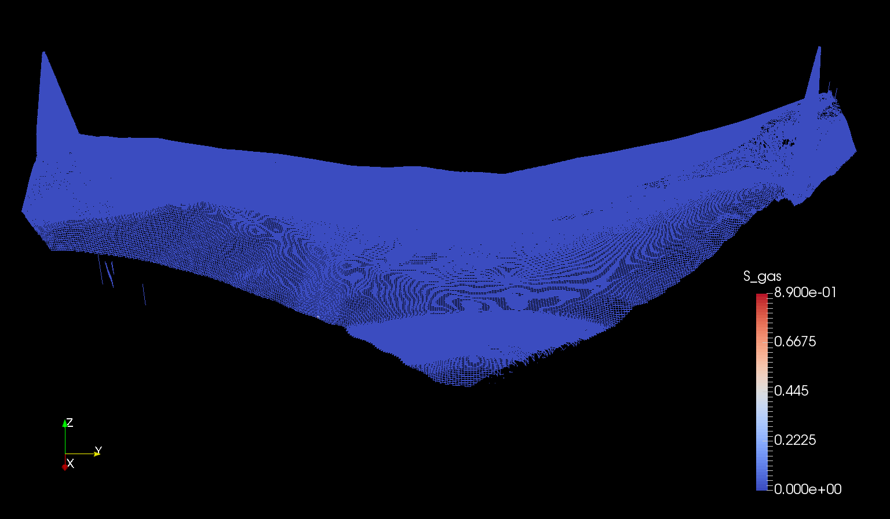
Gas/Water Formation Fluid Simulation
S_{gas} = 0.89, S_{water} = 0.11
N
~4.5 mi (7.2 km)
gas chimney
gas chimney
blue = surface of 10-ft-thick carrier bed (3 m)
well
water depth 3,700 ft (1,130 m)
carrier bed ~11,250 ft total vertical depth at well (3,430 m)

Slide 3
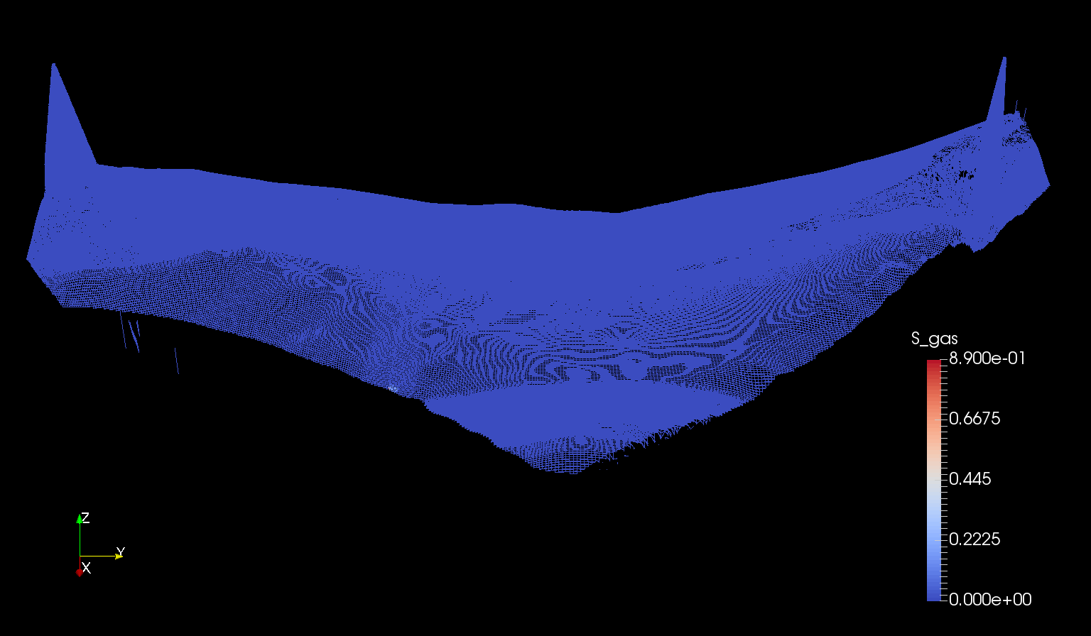
Begin Slide Show Animation Here
(go to “slide show” mode this slide; press “escape” to return to PPT)

Slide 4
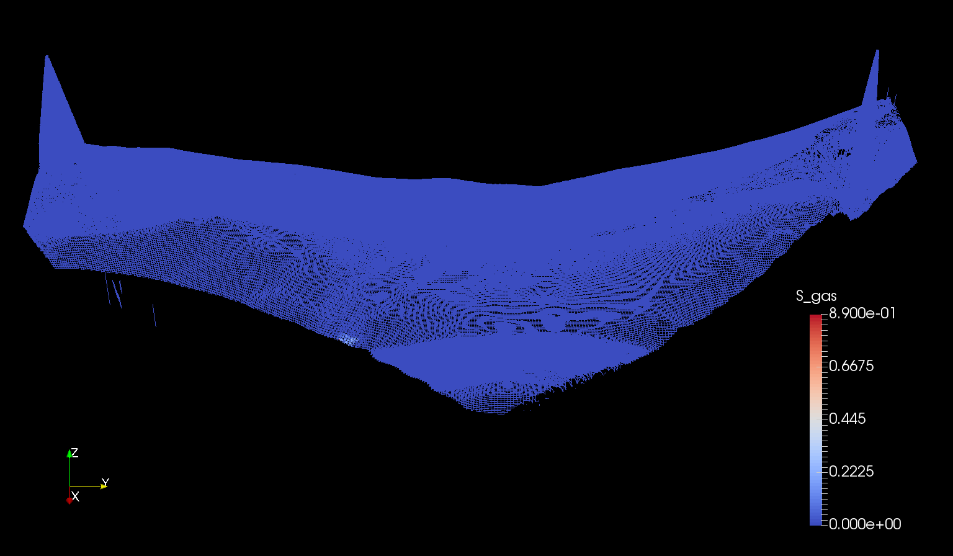

Slide 8
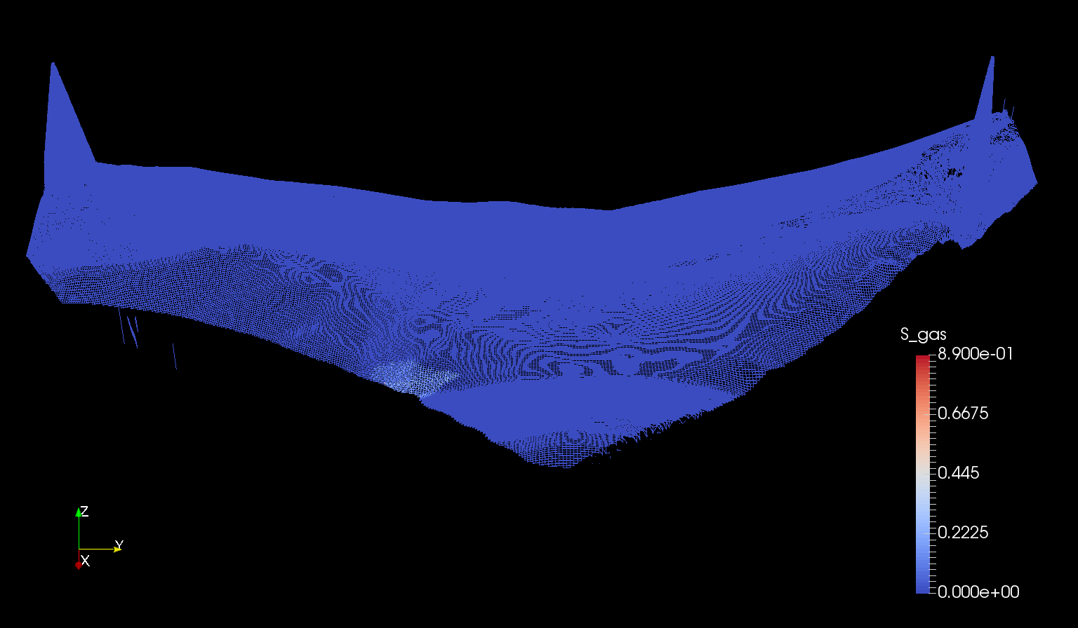

Slide 9
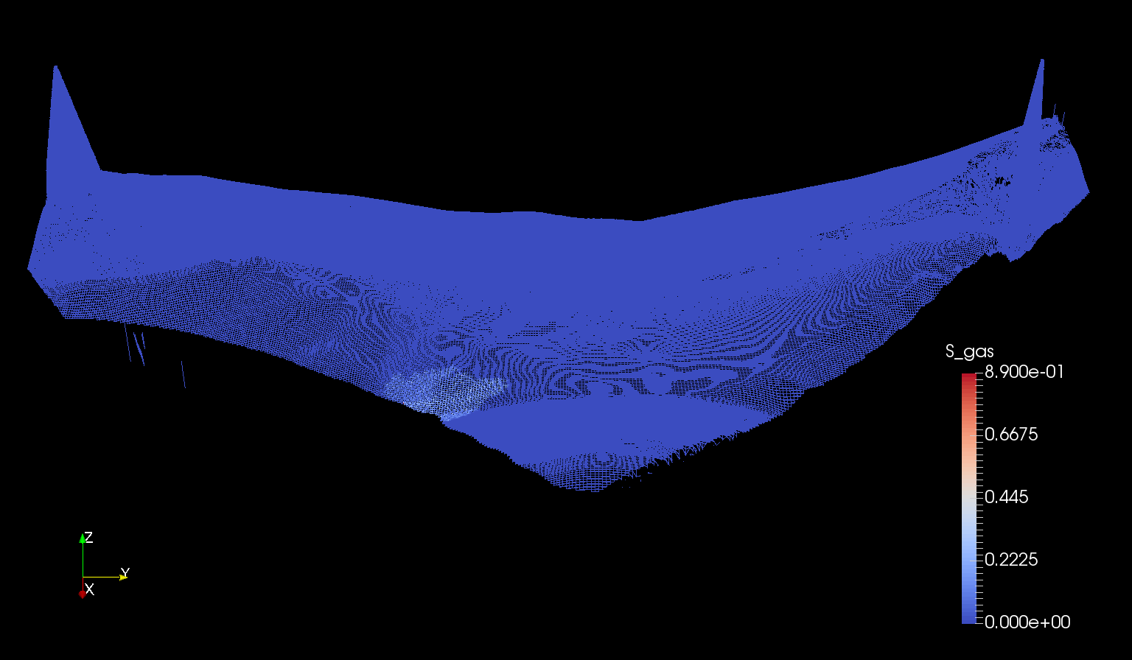

Slide 10
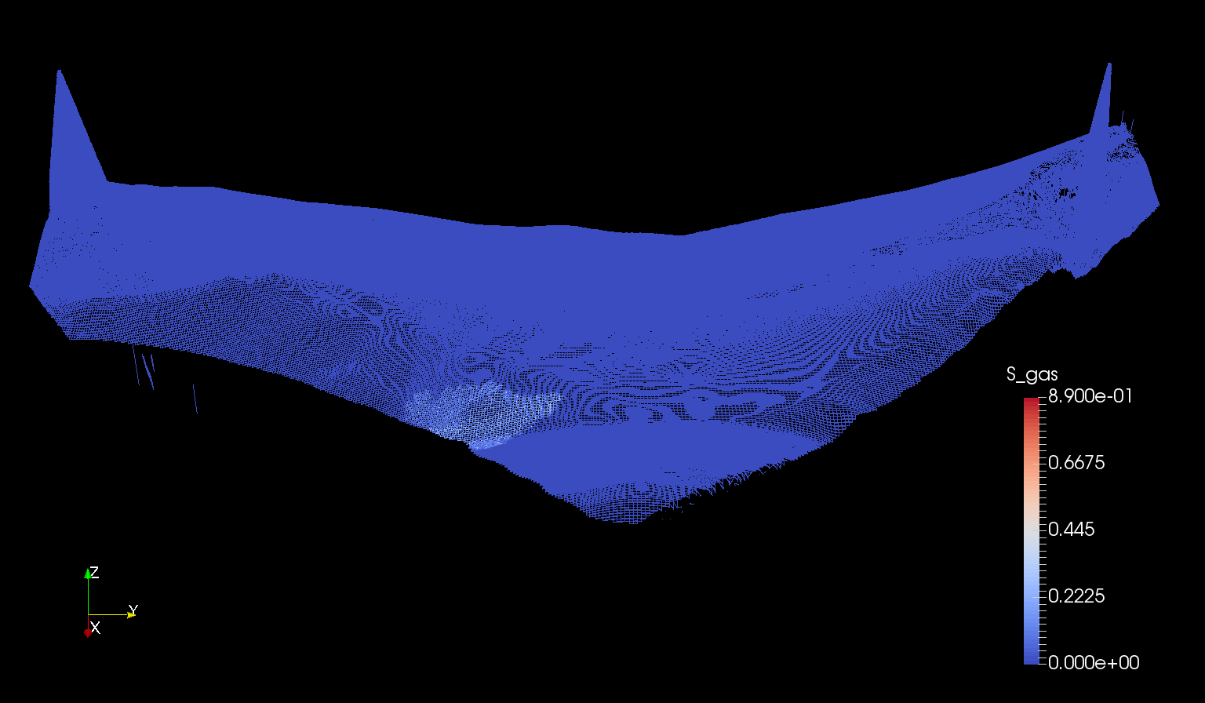

Slide 11
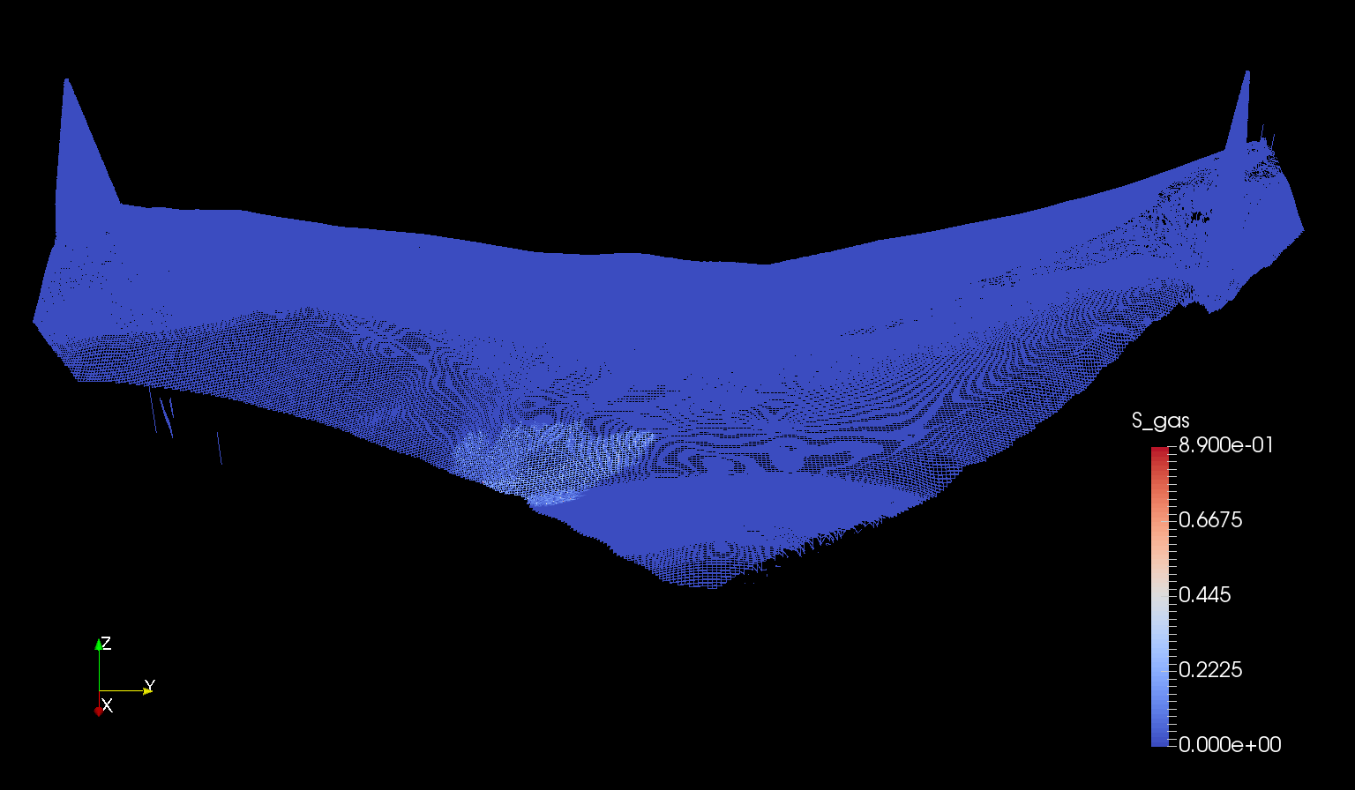

Slide 17
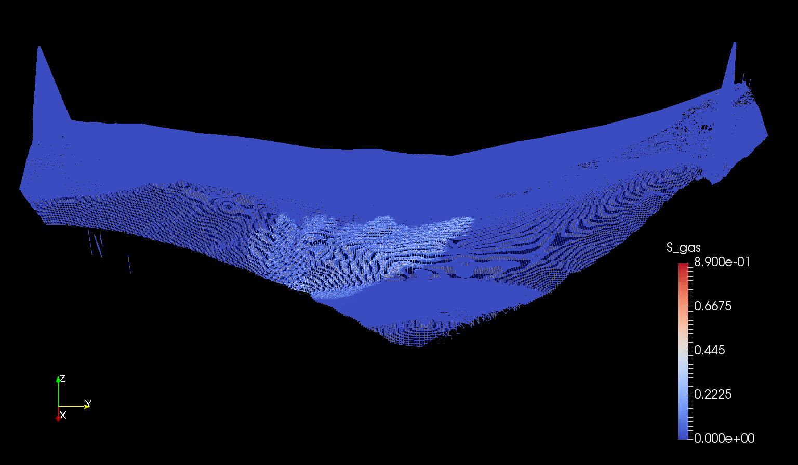

Slide 19
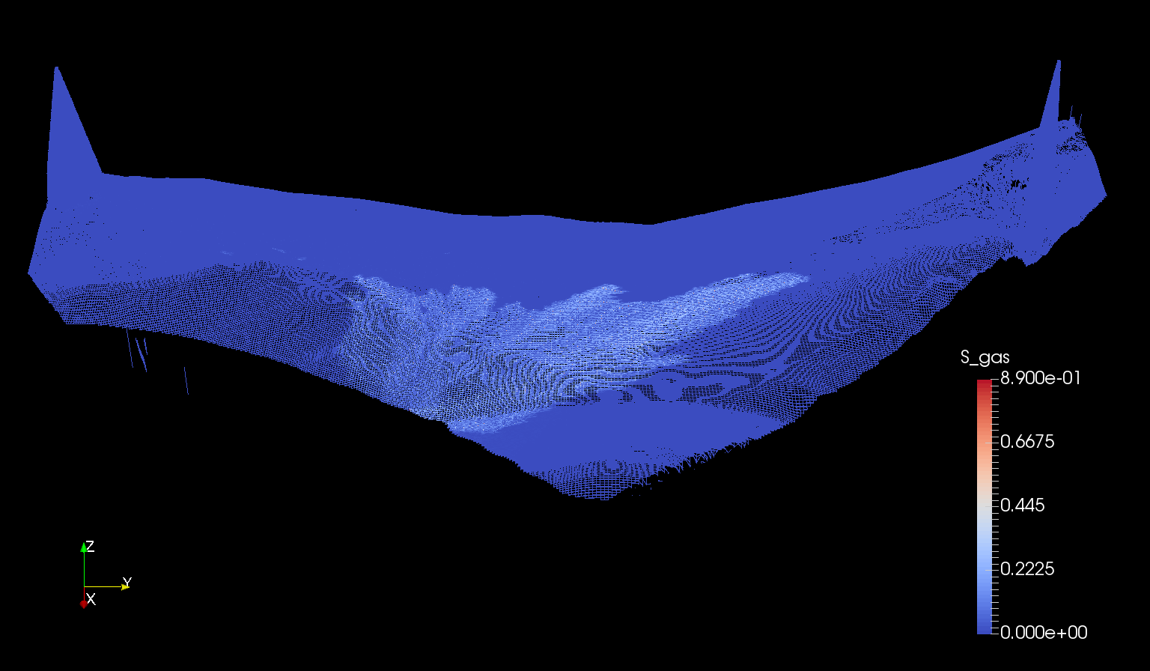

Slide 20
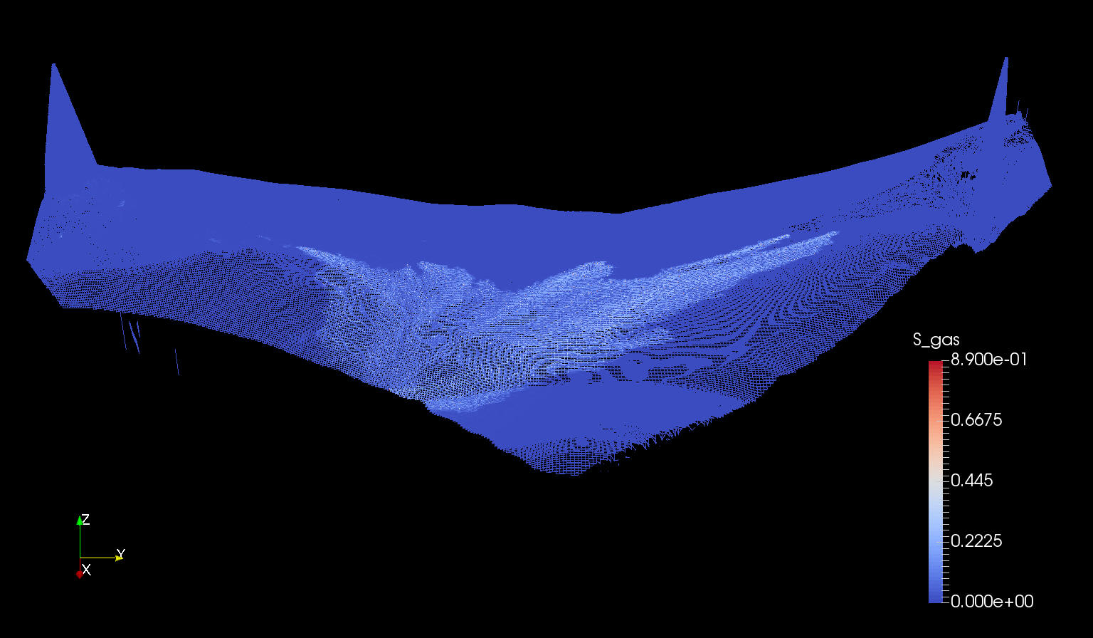

Slide 21
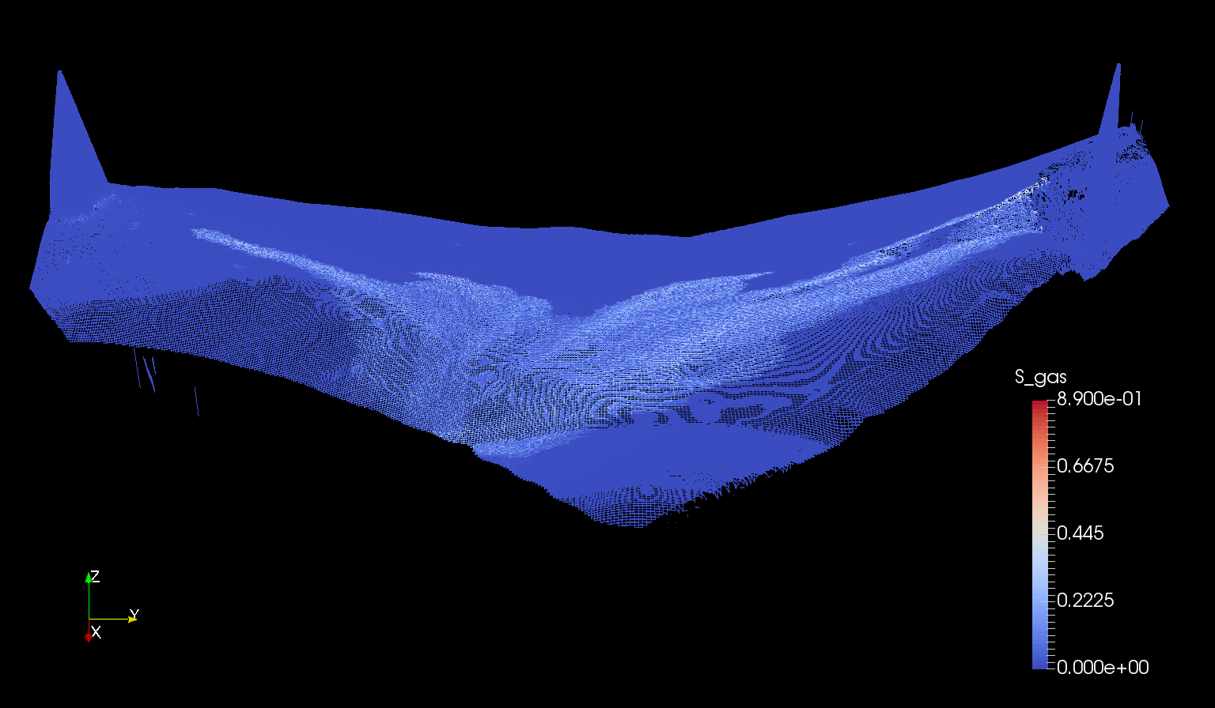

Slide 22
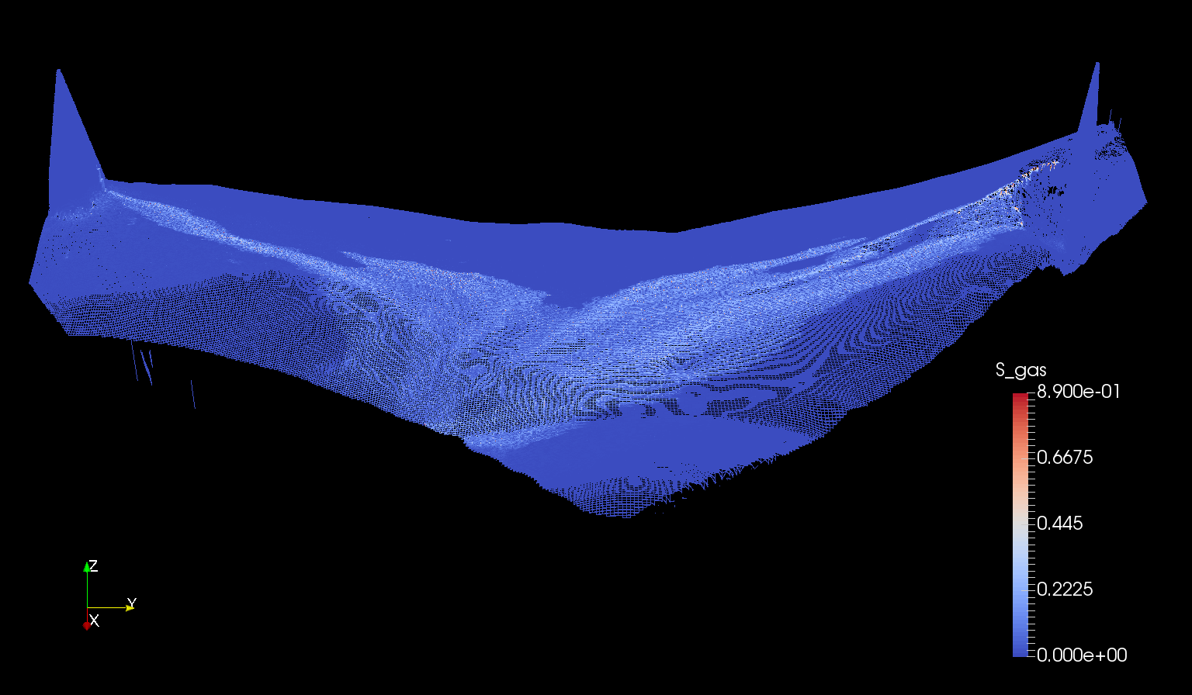

Slide 23
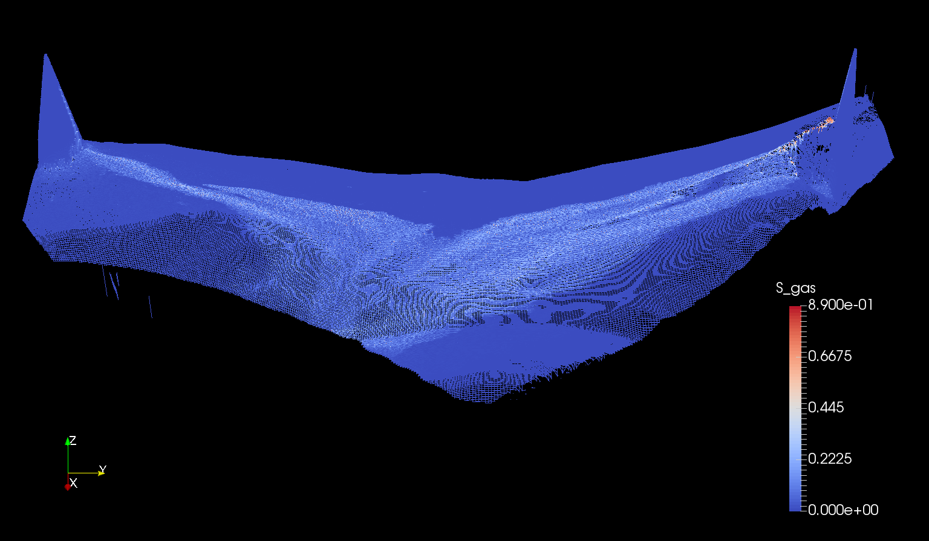

Slide 24
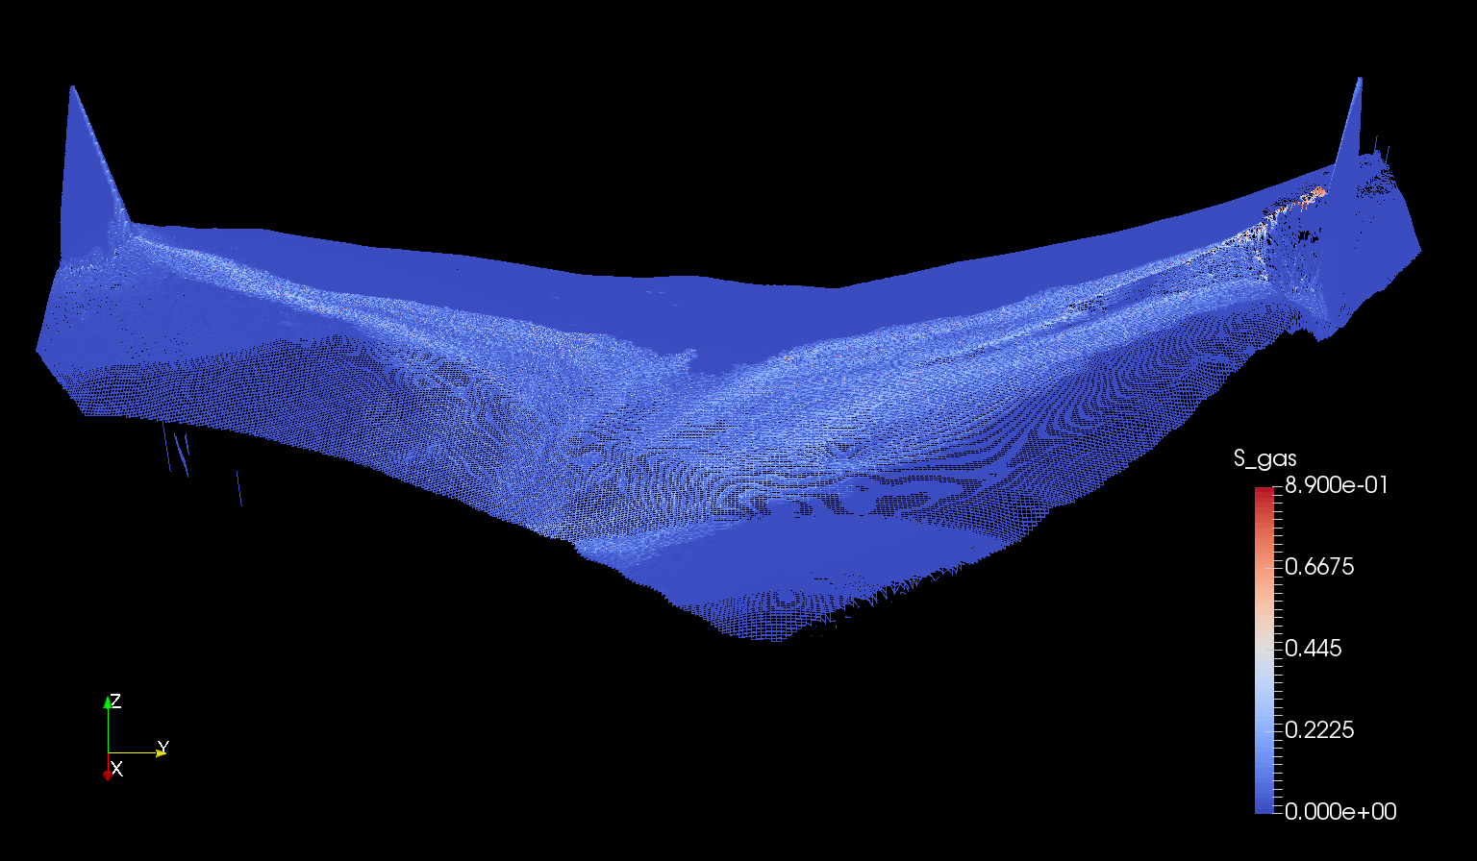
t = 70 yr

Slide 27
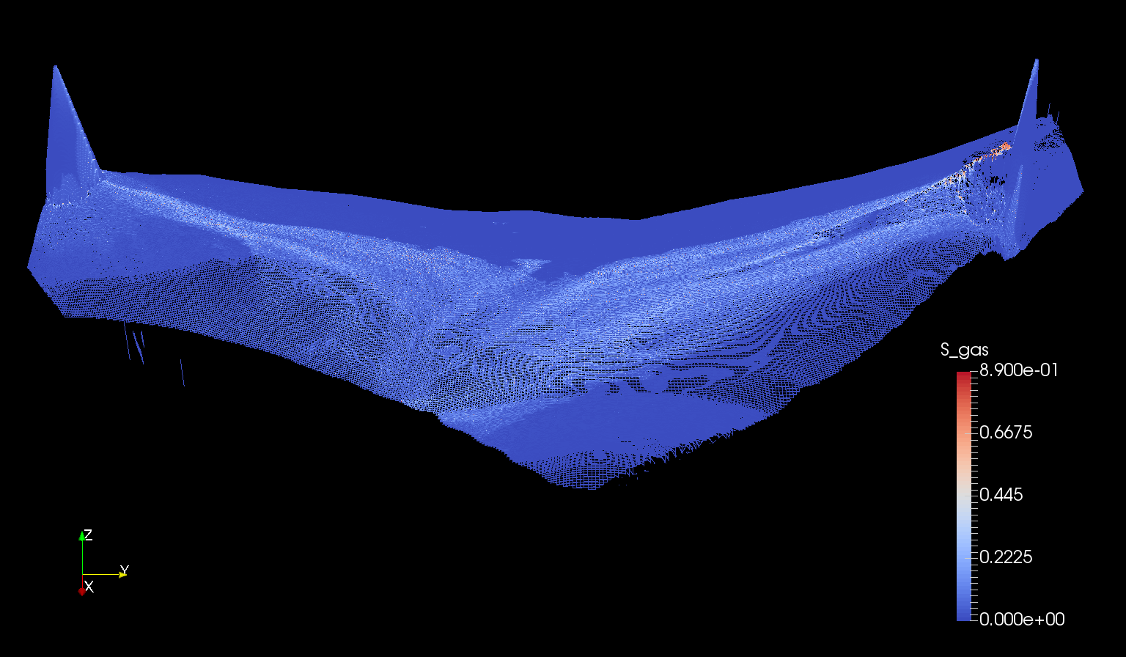
t = 100 yr

Slide 28
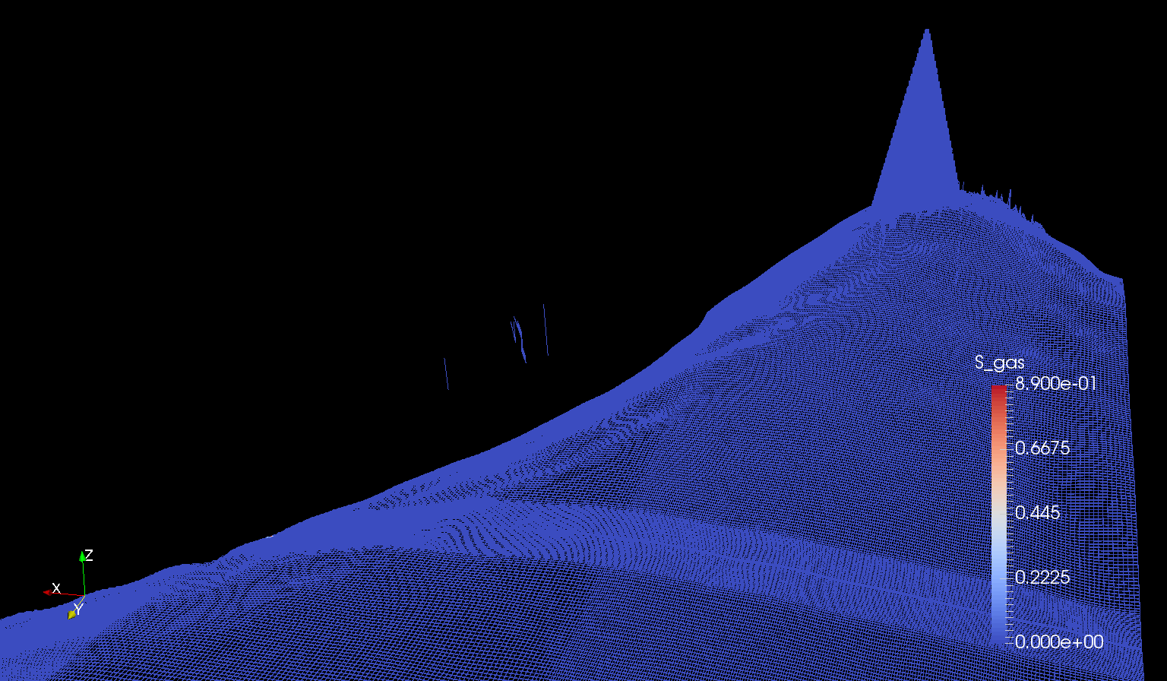

Slide 46
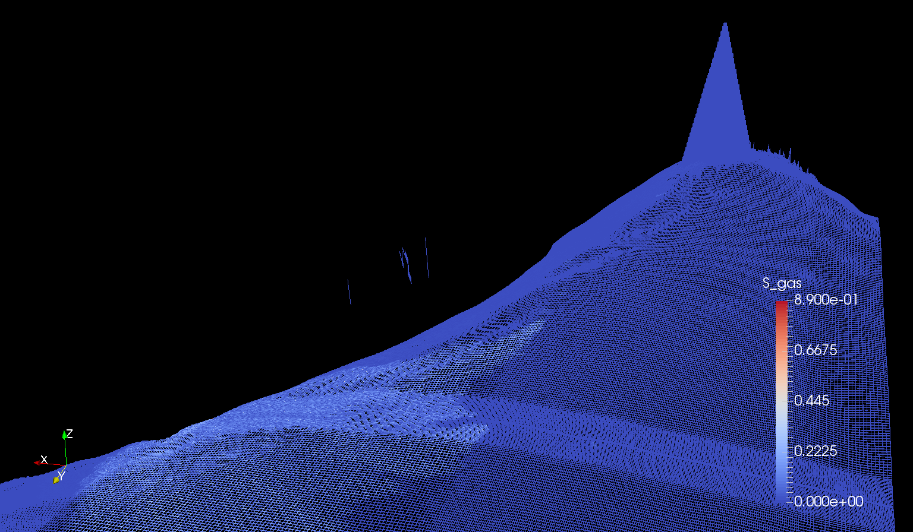

Slide 50
t = 70 yr

Slide 51
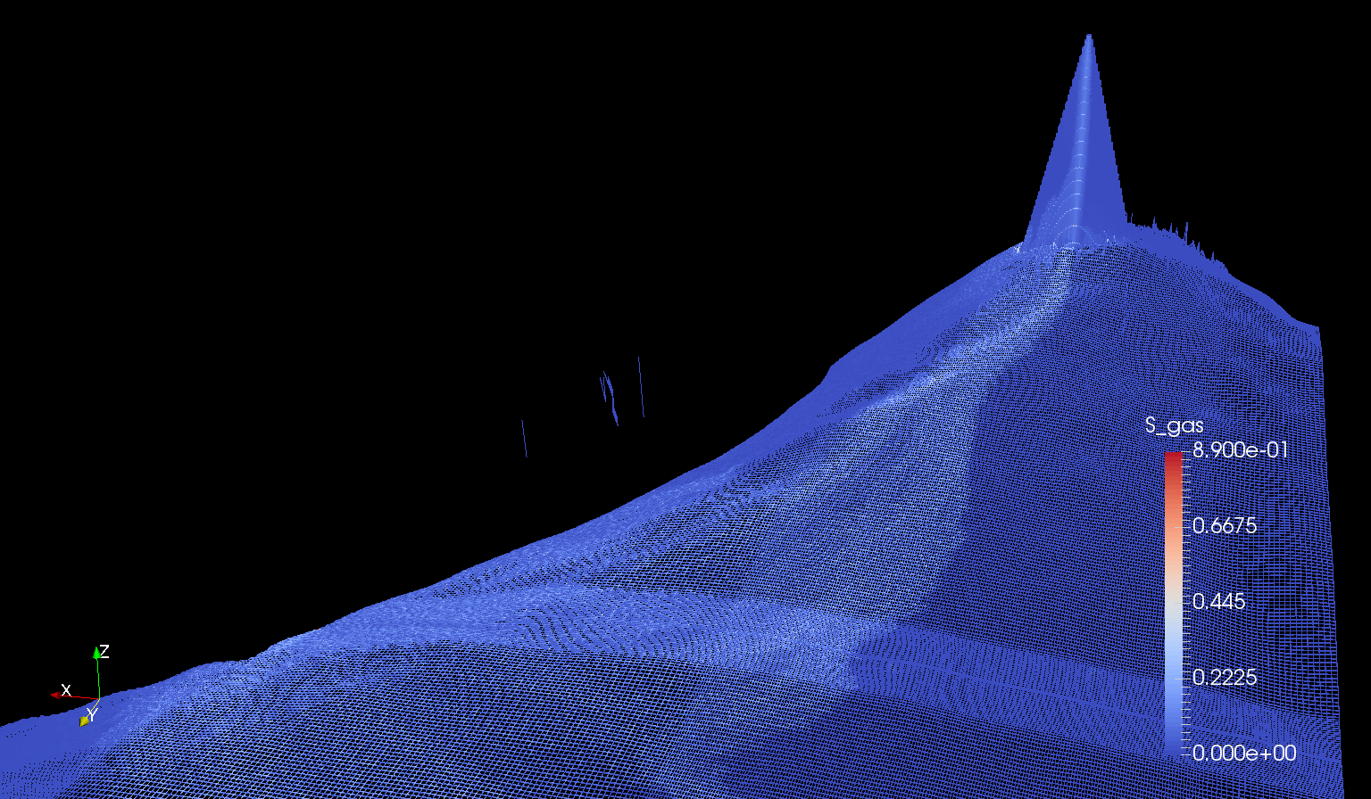

Slide 53
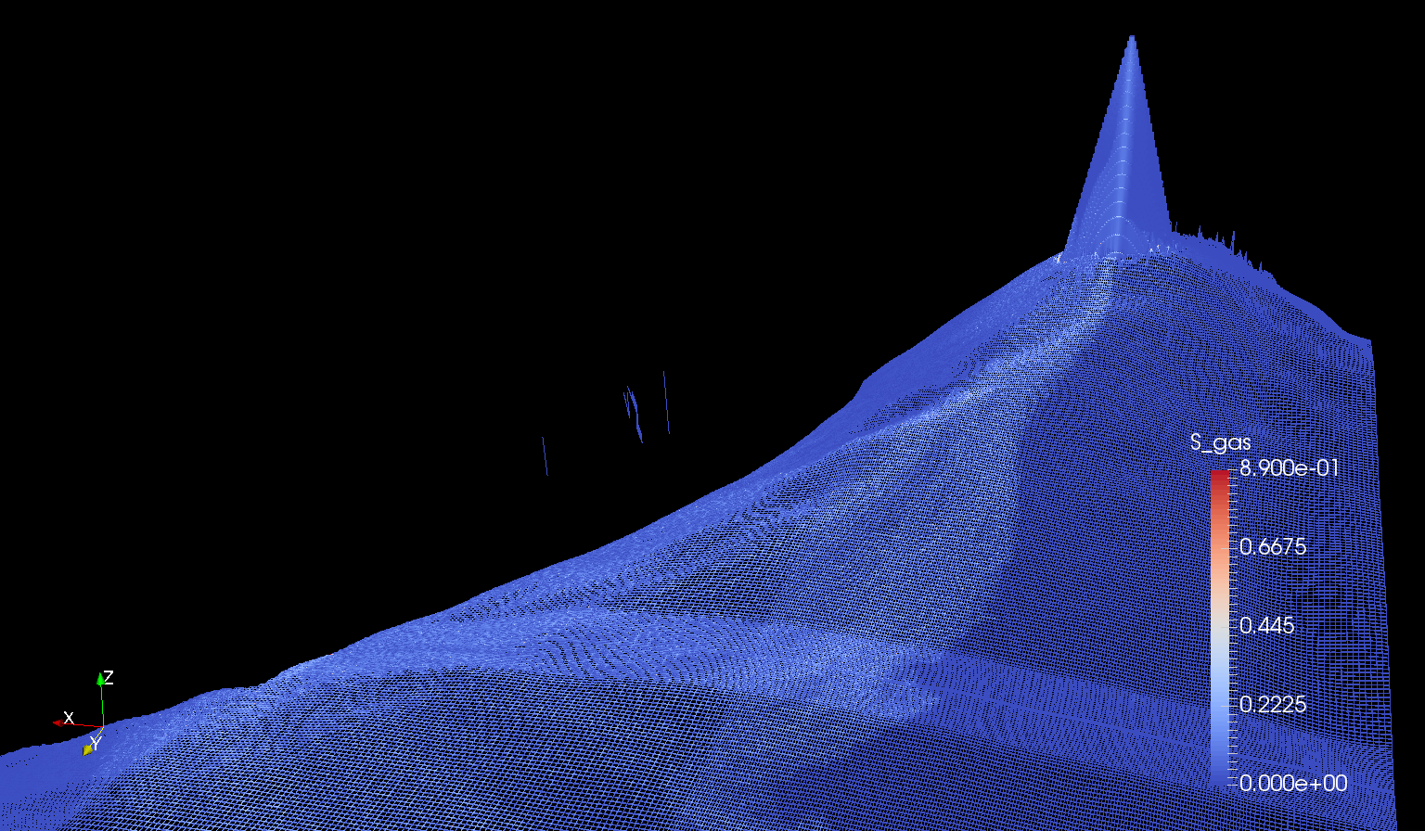
t = 100 yr

Slide 54
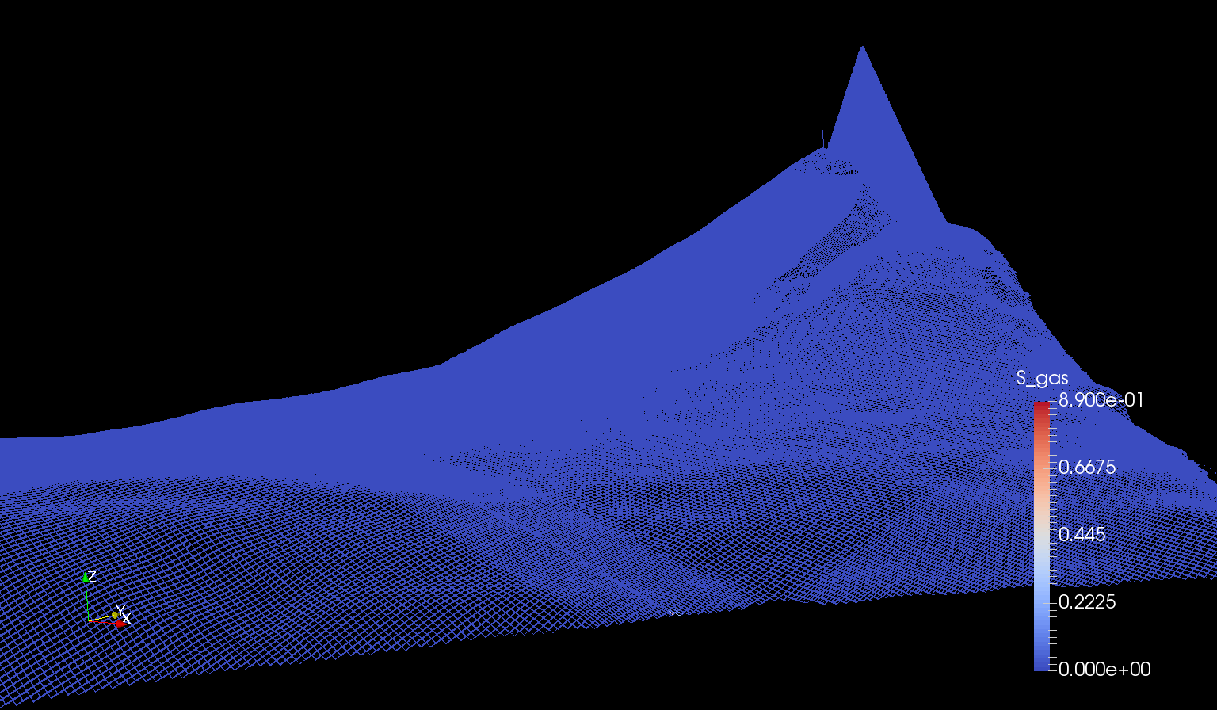

Slide 57
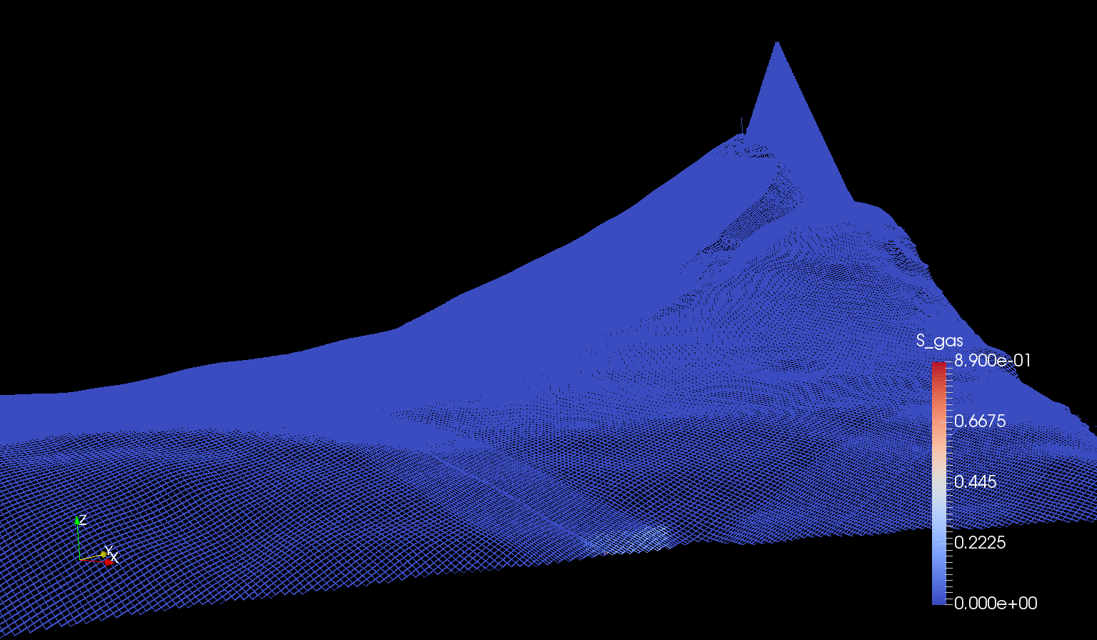

Slide 61
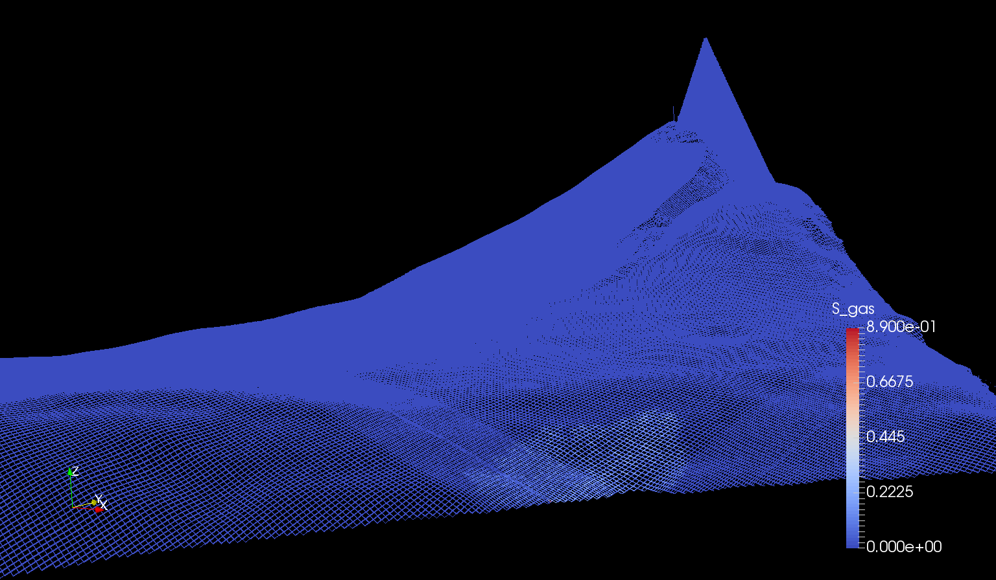

Slide 63
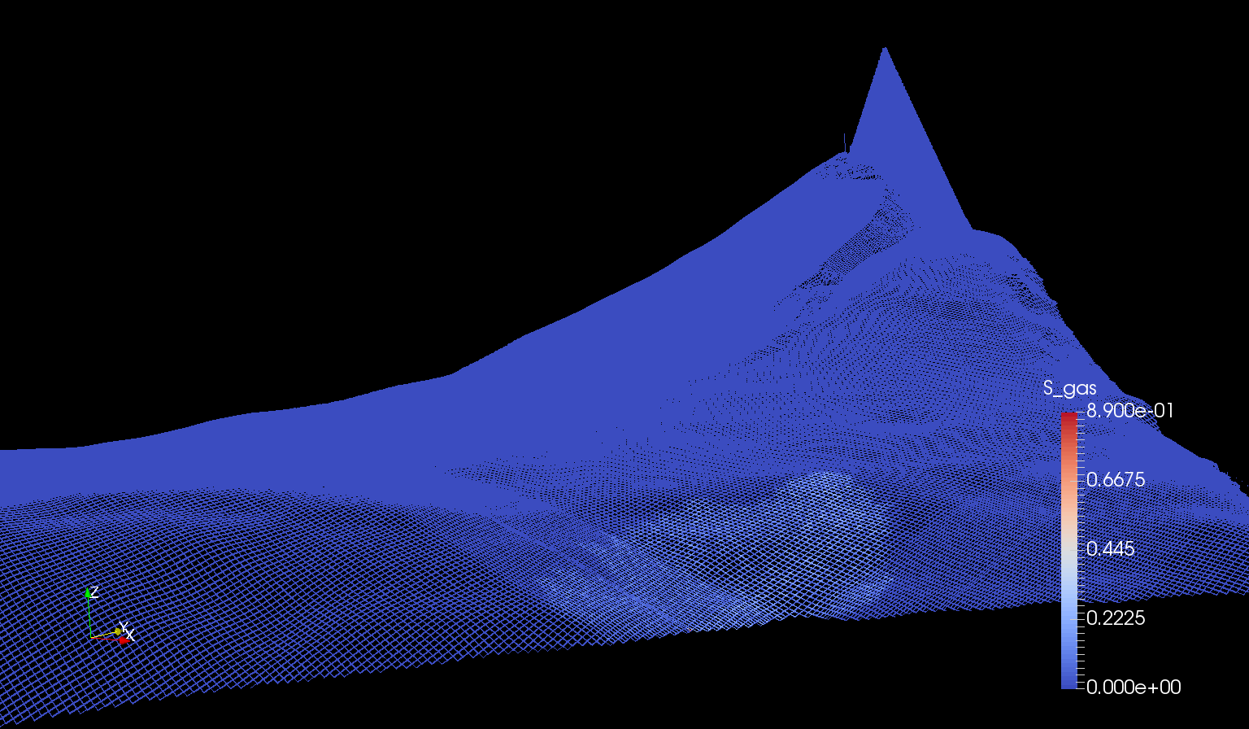

Slide 64
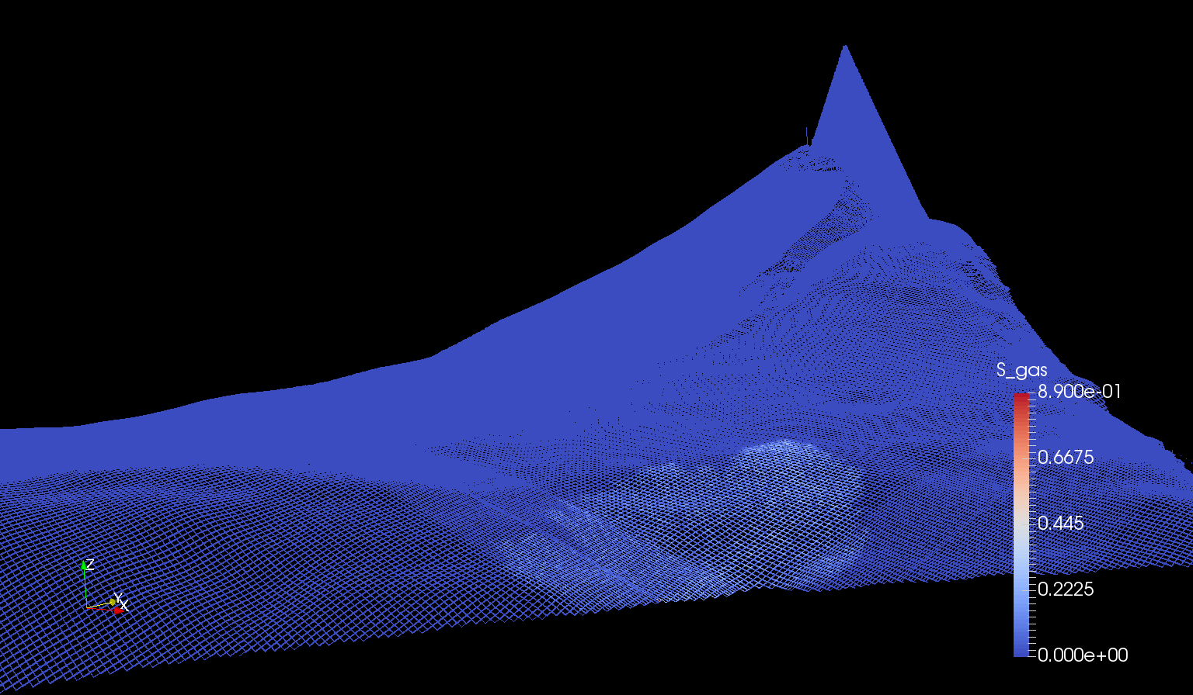

Slide 65
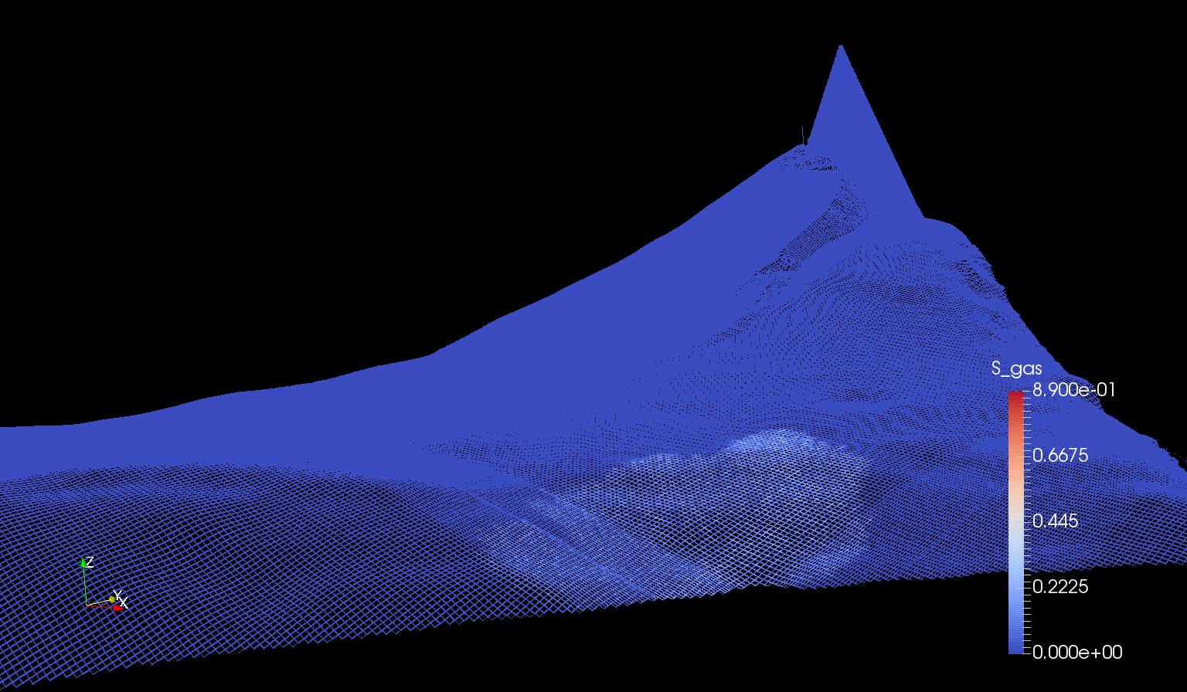

Slide 66
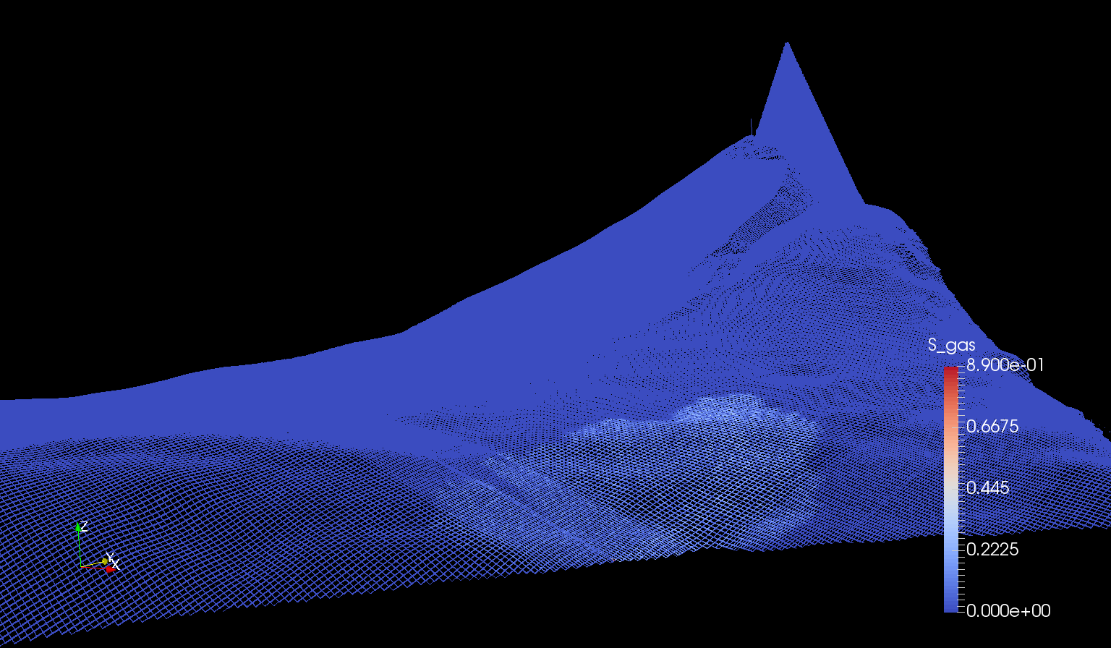

Slide 68
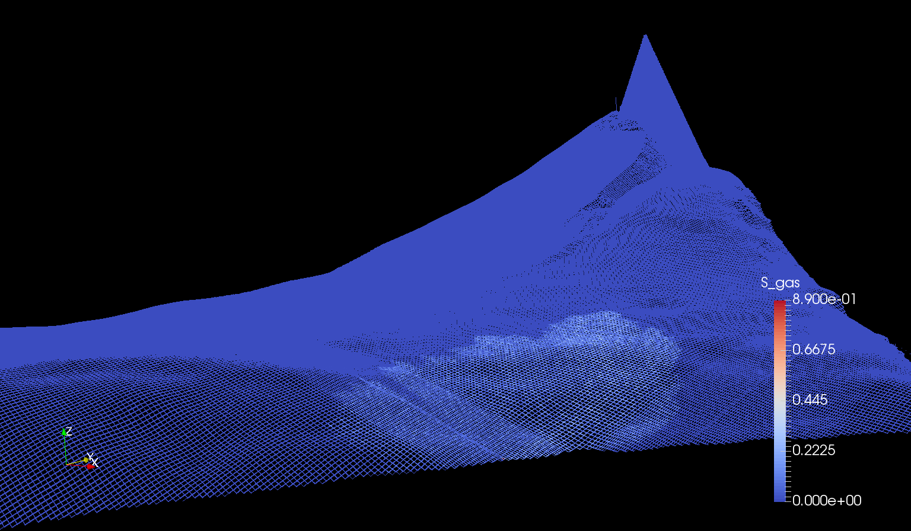

Slide 69
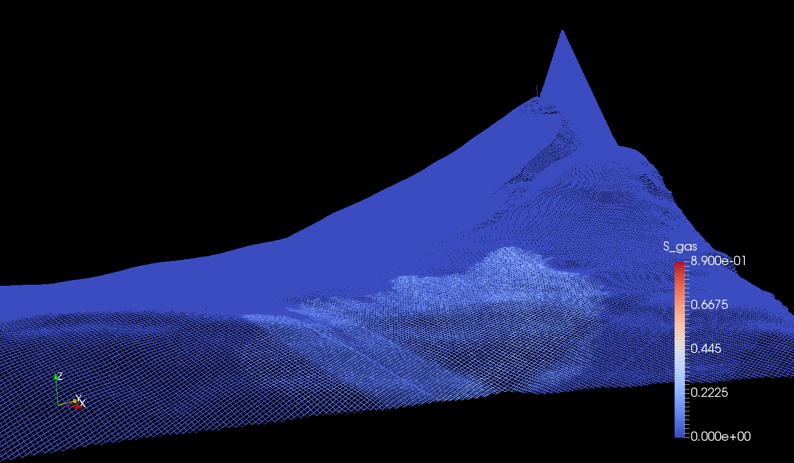

Slide 70
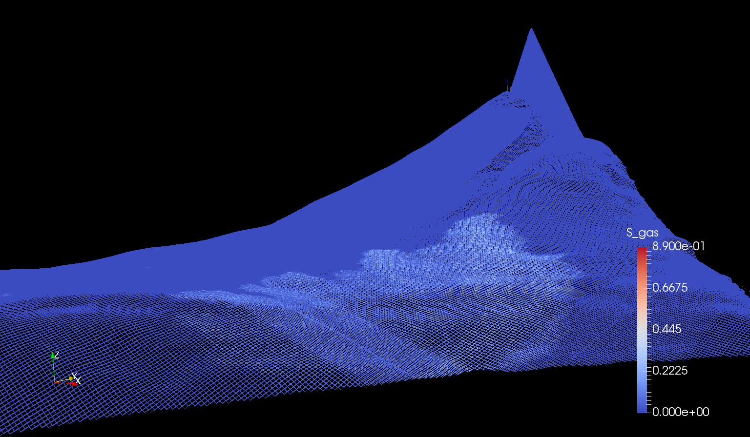

Slide 71
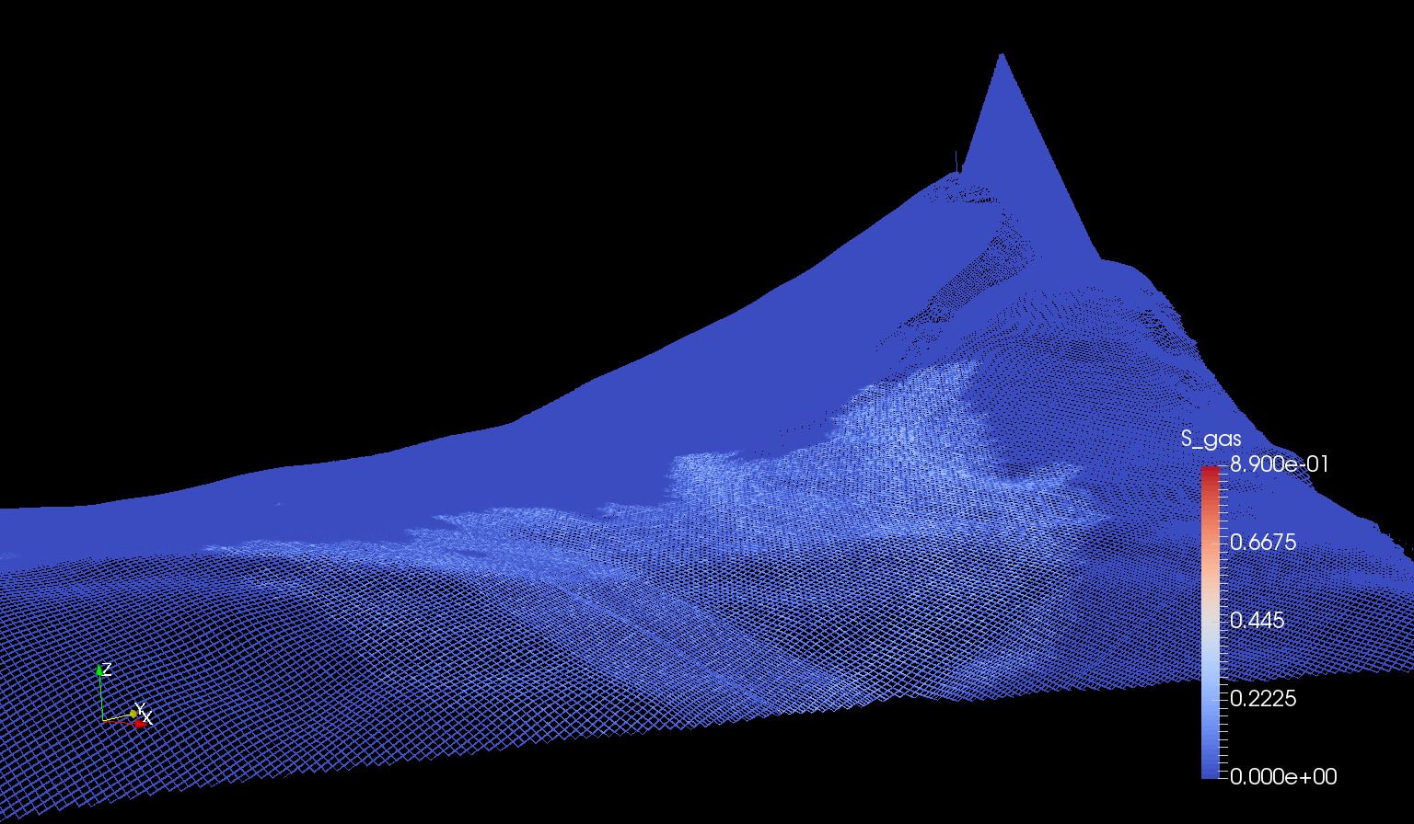

Slide 72
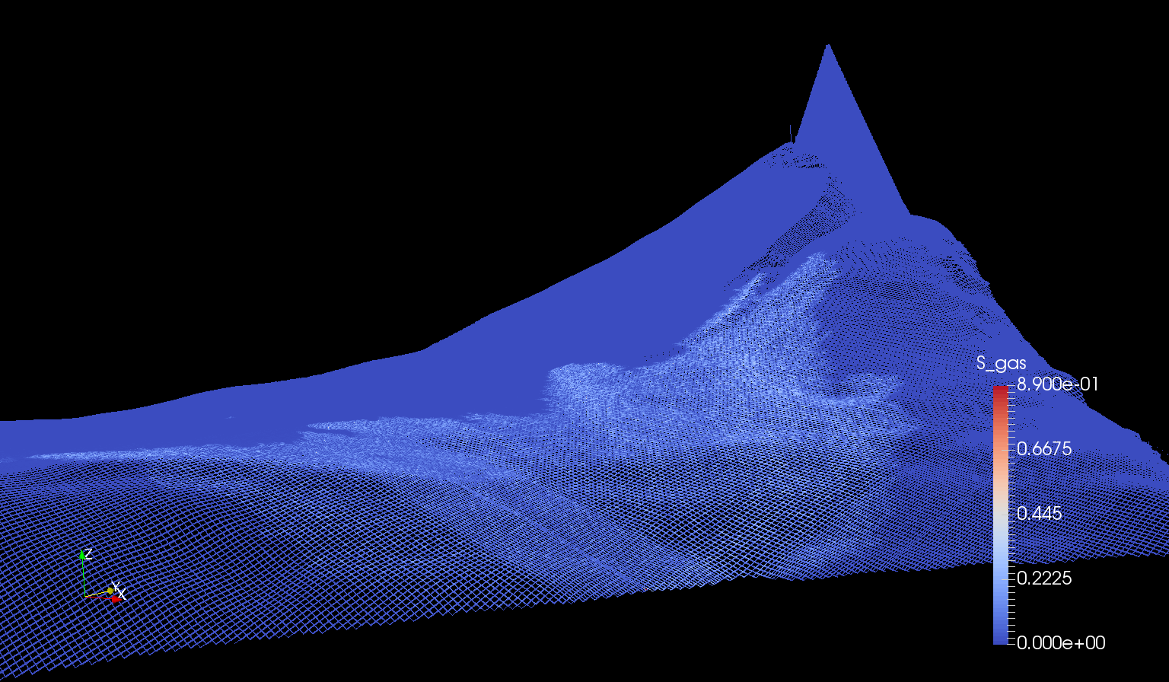

Slide 73
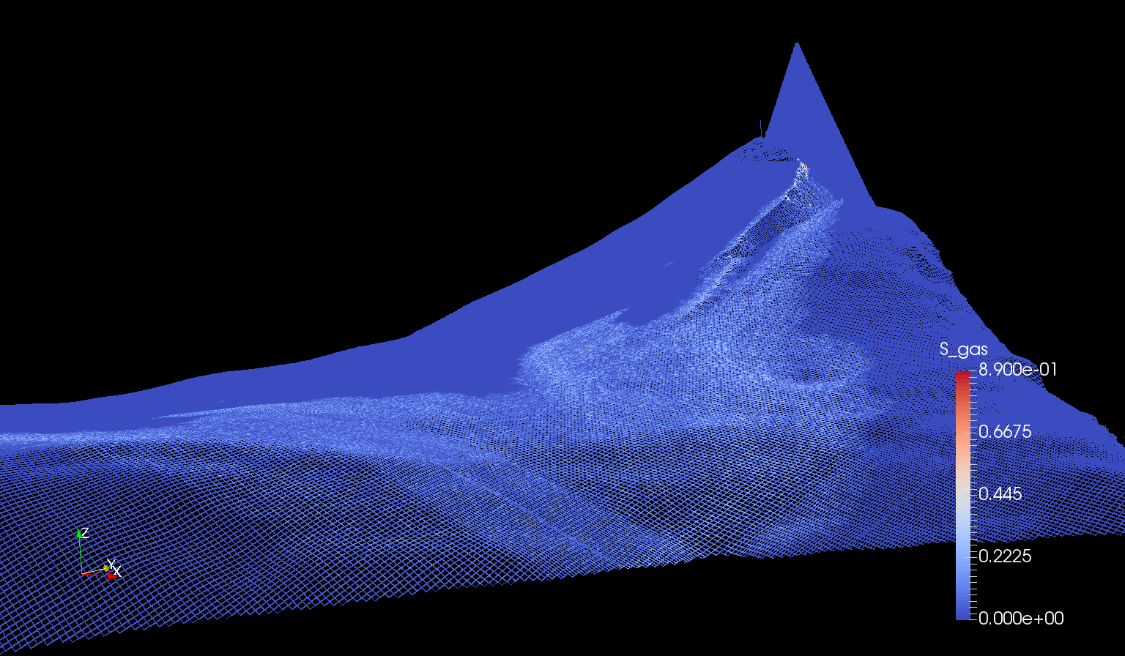

Slide 76
t = 70 yr

Slide 77
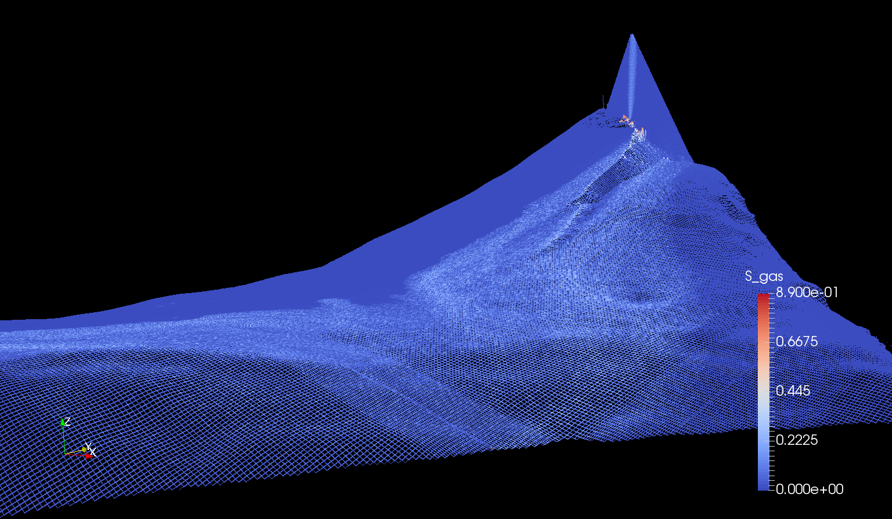

Slide 79
t = 100 yr

Slide 80
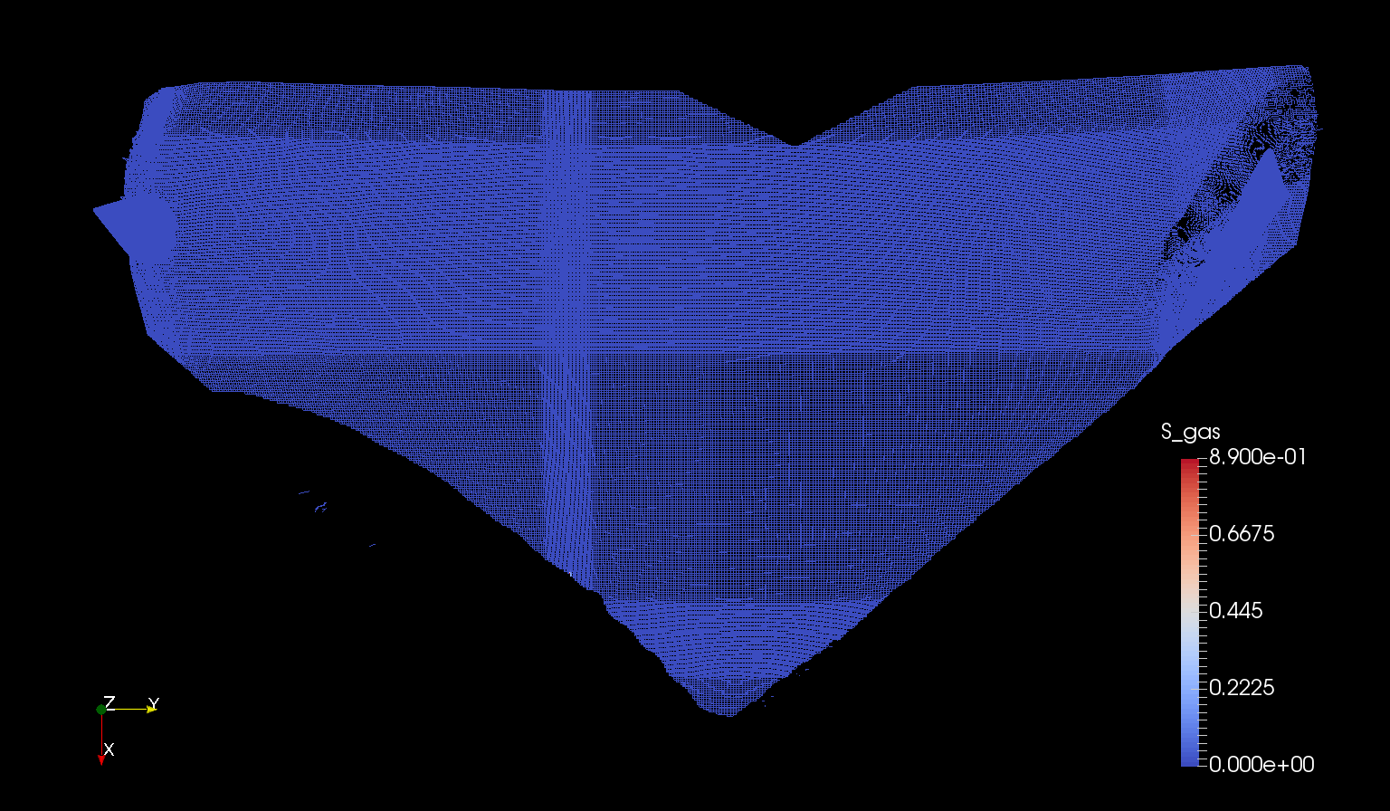

Slide 87
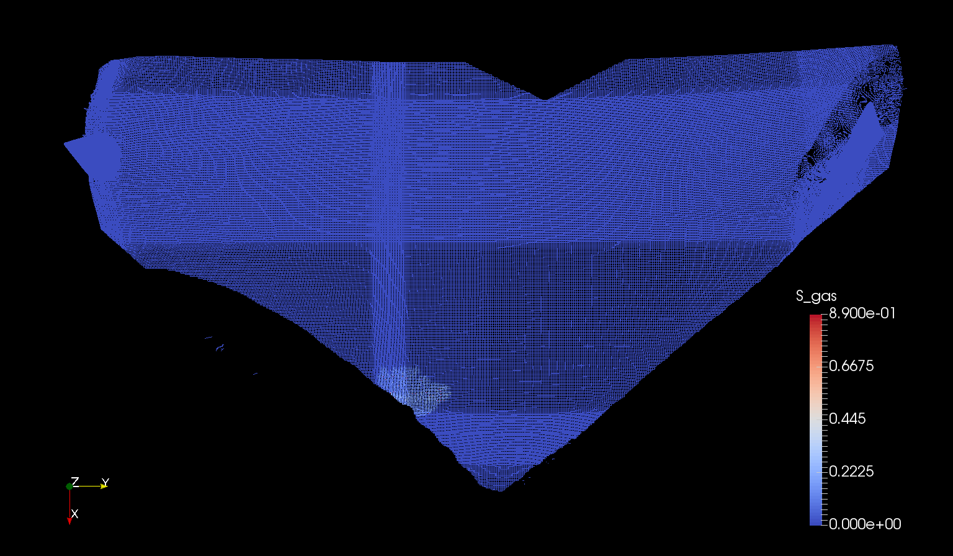

Slide 91
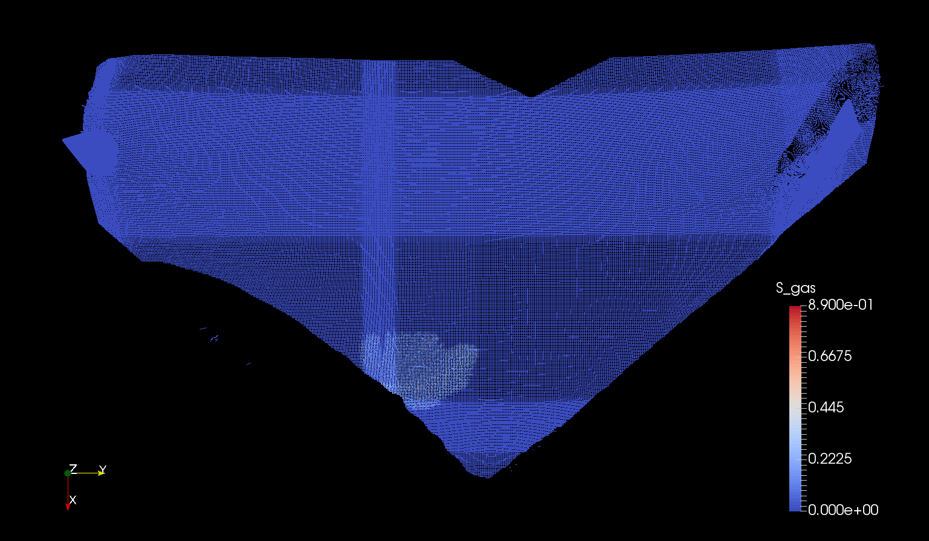

Slide 94
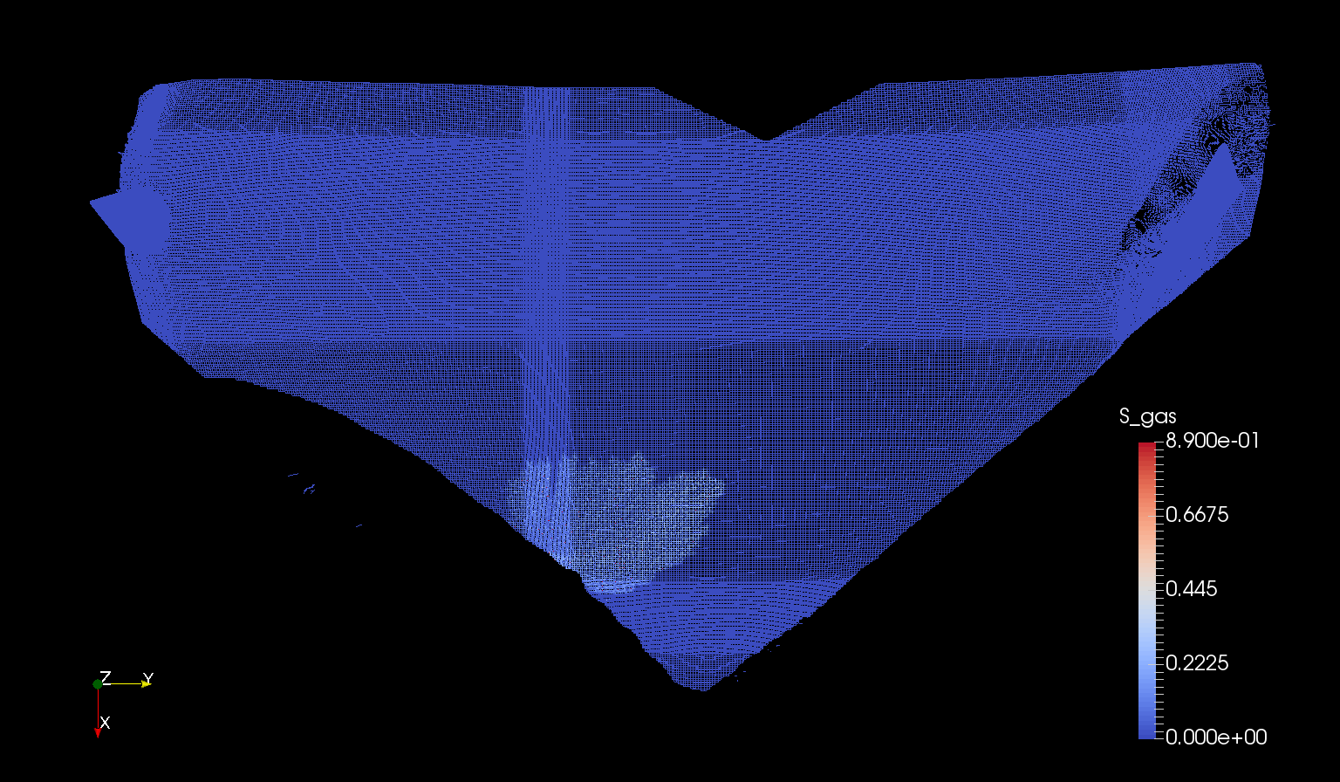

Slide 95
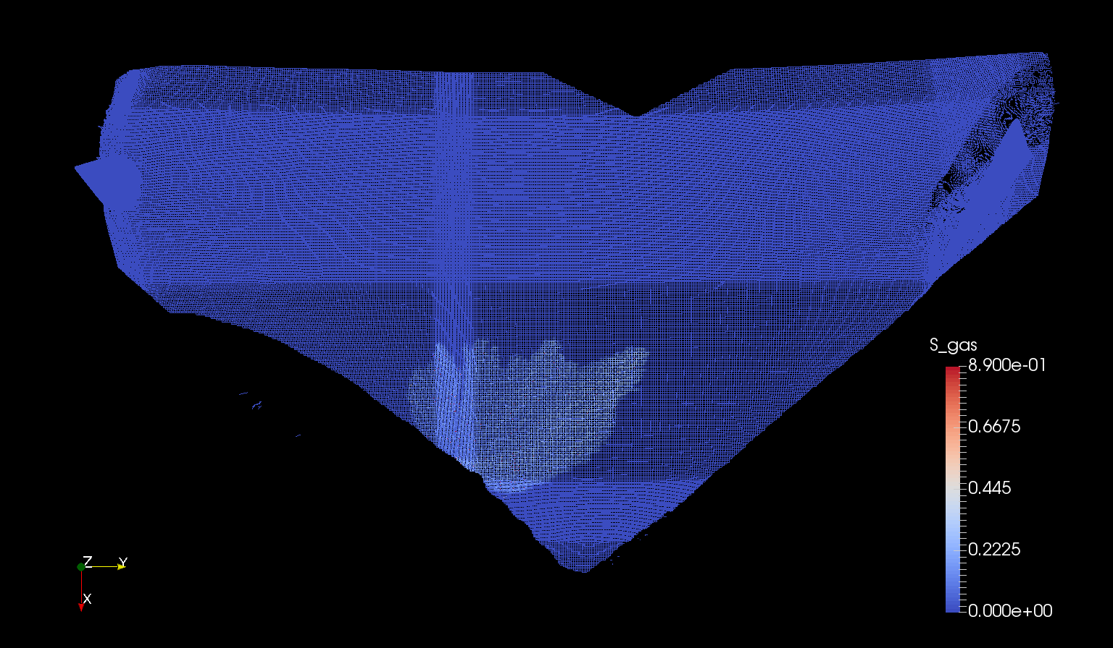

Slide 96
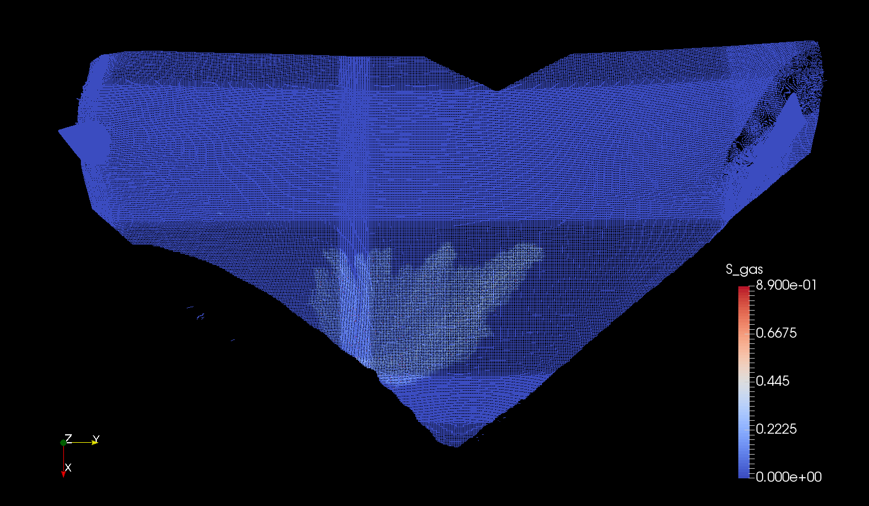

Slide 97
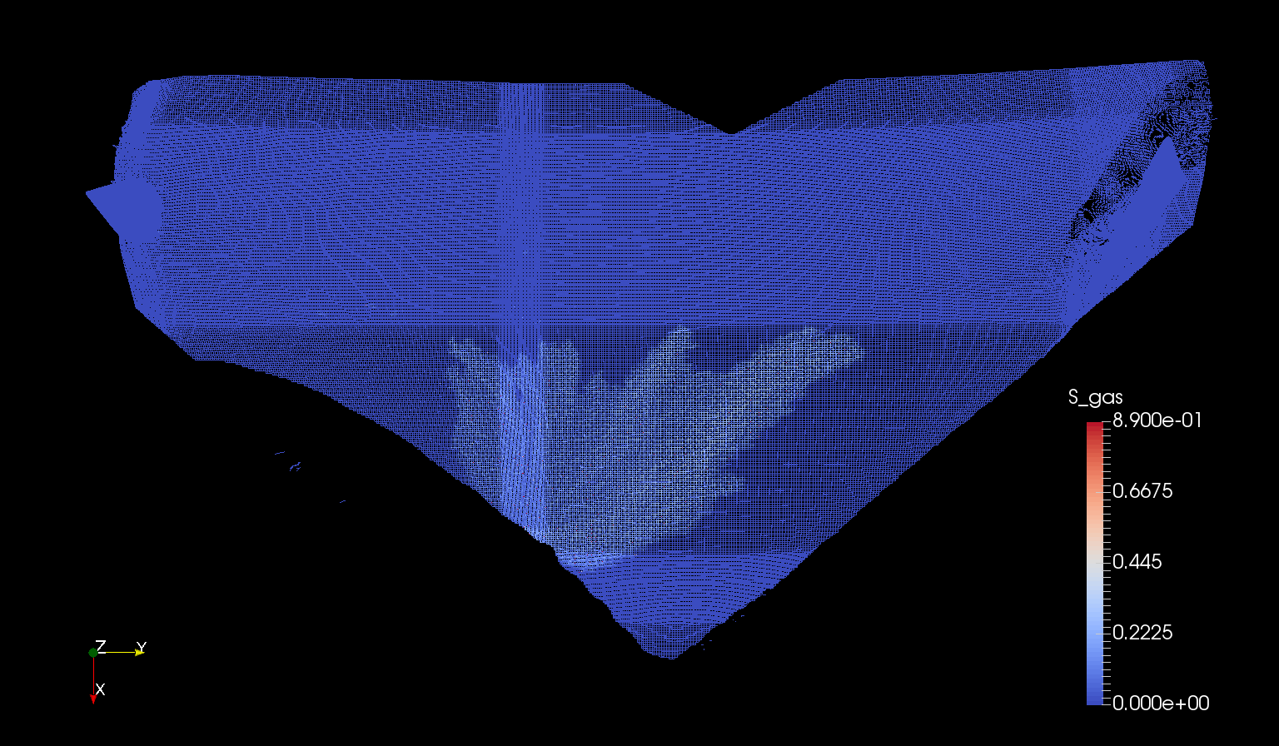

Slide 98
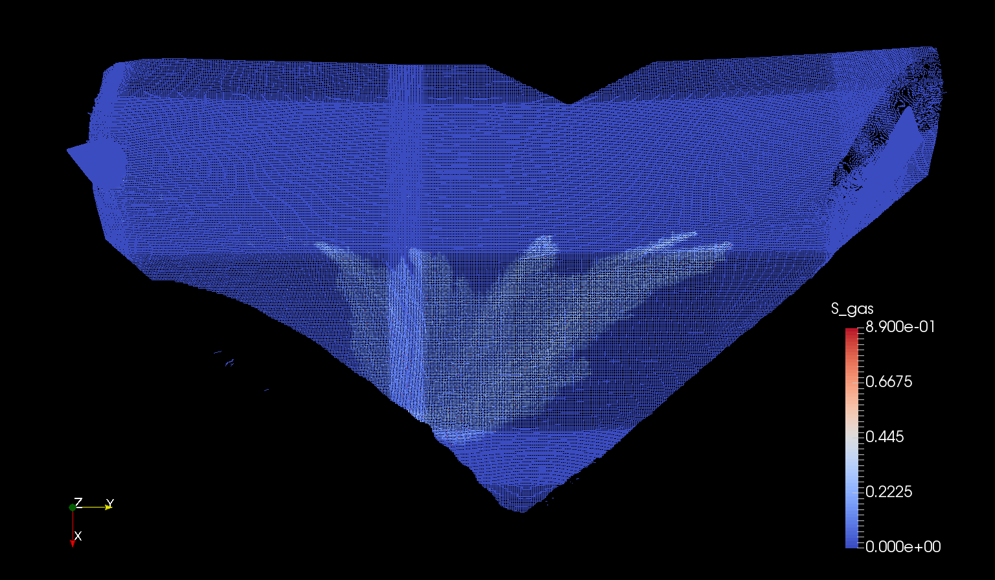

Slide 99
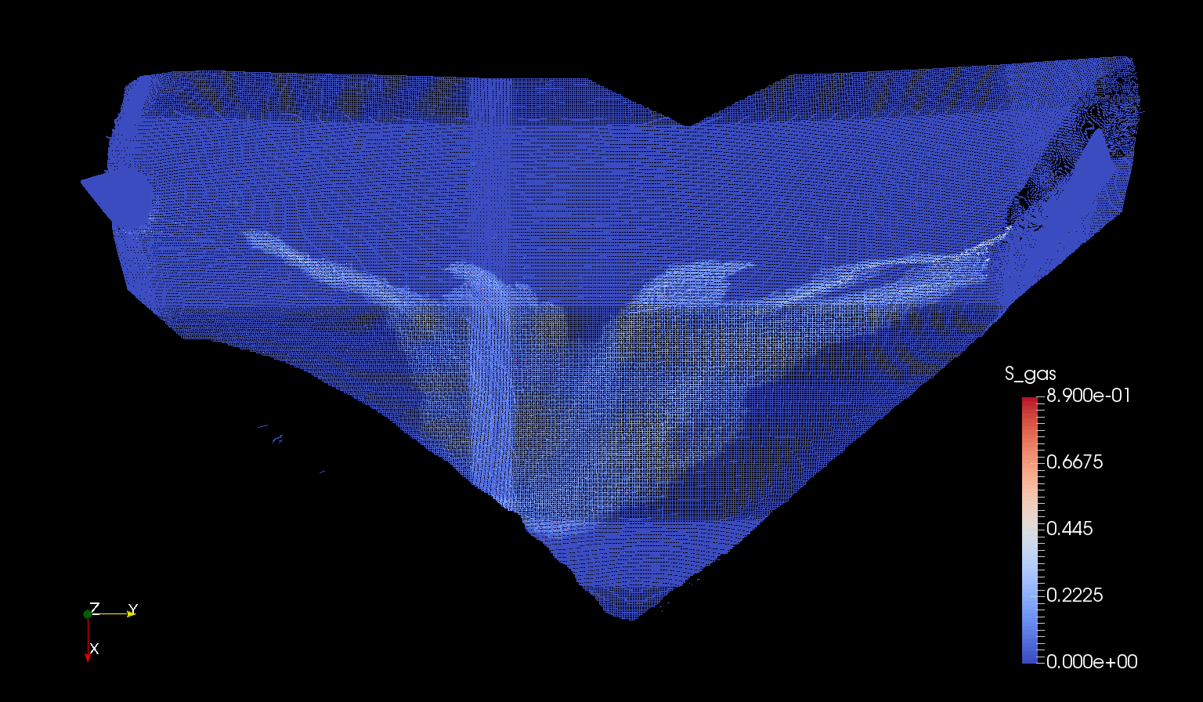

Slide 100
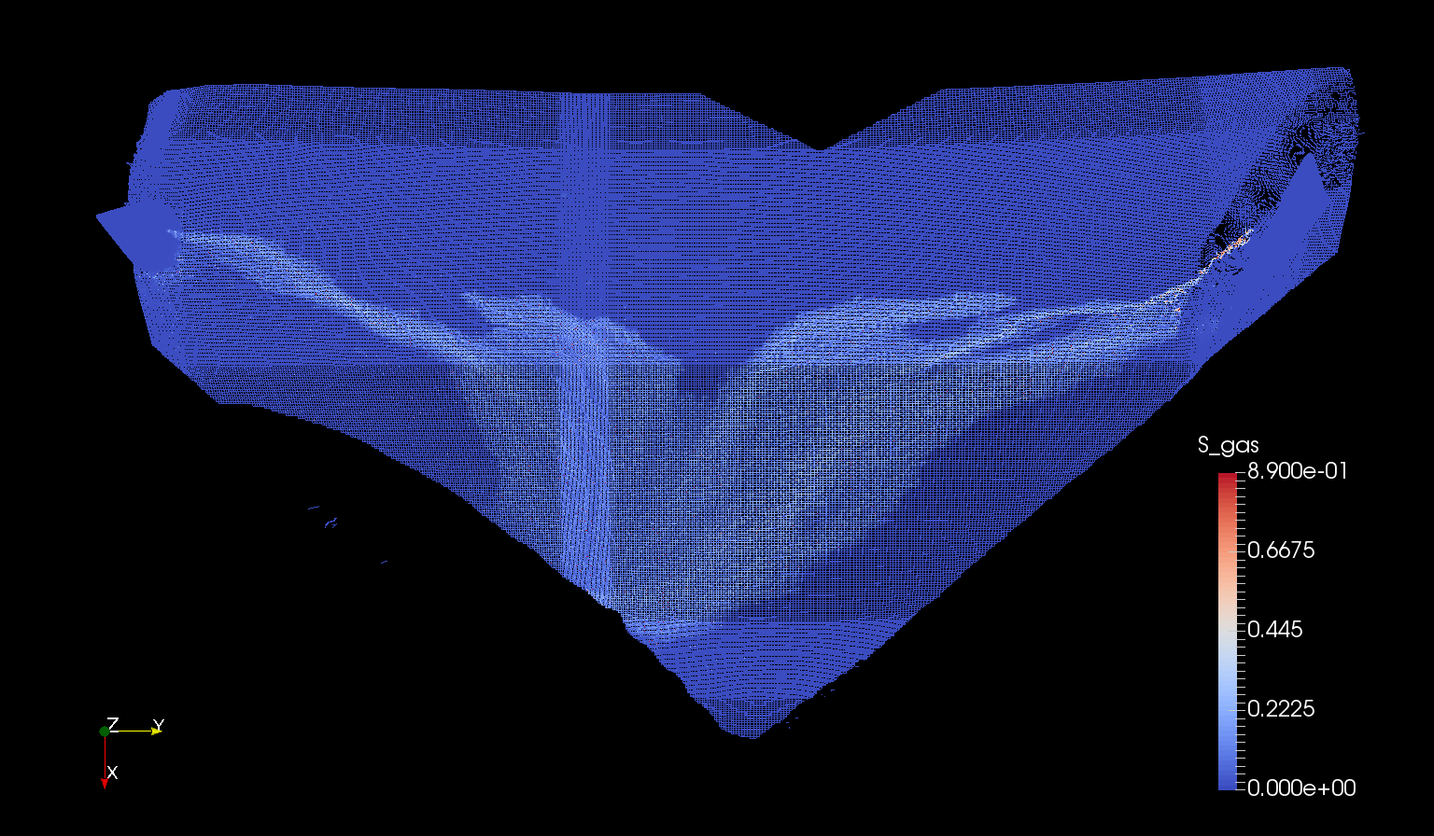

Slide 105
t = 100 yr

