Slide 1
Shallow Water Flow Mapping Project
Executive Summary
July 22, 2019
Thomas W. Bjerstedt
New Orleans Office
Notes:
BOEM developed a project to evaluate the spatial and temporal distribution of reported shallow water flows (SWFs) in Mississippi Canyon and Green Canyon. The objective was to place historical SWF incidents into a BOEM-generated interpretation. The first phase was to undertake seismic mapping to deconstruct the Pleistocene Mississippi fan and rationalize it with previous work. Revision of BOEM’s chronostratigraphic chart (Kerrin and Whitrock, 2019) allowed the mapping for this project to be set in context with BOEM’s chronozones, sequence boundaries, and sea level curves while pursuing the original goals for SWFs. Events in the upland catchment and the GOM ultra-deepwater sink (Bjerstedt, 2019) allowed first-order conclusions between catchment stimulus and basin response. In a few slides, this executive summary reports conclusions for how the spatial and temporal occurrences of SWFs in the Mississippi fan fit into this framework.
I wish to thank and acknowledge the following owners for permission to show cross sections and use their seismic data for mapping: TGS, Spectrum, PGS, Ion, Fairfield, and CGG. This contribution has been reviewed within BOEM and has received a publication number of BOEM 2019-048. Slides having a red “play” button in the upper left corner are animated or contains video that are activated in Powerpoint’s “slide show” mode. Most slides contain explanation that can be accessed in “normal” or “note page” modes.
Recommended citation:
Bjerstedt, T.W. 2019. Shallow water flow project; executive summary, U.S. Department of the Interior, Bureau of Ocean Energy Management, New Orleans Office. December 16, 2019, BOEM 2019-048, 15 p.

Slide 2
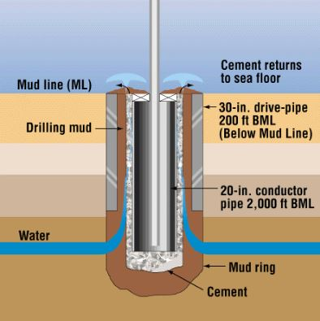
What is a Shallow Water Flow?
Shallow water flows result from unbalanced pressure regimes between mud weight and the formation.
Rapidly deposited sand and mud can dewater and compact differentially.
Furlow (1998)
Notes:
Shallow water flows (SWF) may result from drilling into poorly-consolidated sands that have been capped by slowly deposited mud. Sediments may be unable to dewater under a normal compaction gradient in the shallow subsurface. Mudstone and the fine-grained marly muds typical of condensed zones can act as a seal to normal compaction and dewatering. With burial the pore pressure in mud-capped sands may elevate. If well drillers are not prepared for a pressure kick, the unbalanced pressure between drilling mud and the formation may push drilling mud and loose sediment up hole to flow at the well bore. Salt movement may locally increase slope instability and mass sediment movements can set up conditions favorable for the pressure compartmentalization that leads to SWFs. The illustration is from Furlow (1998).

Slide 3
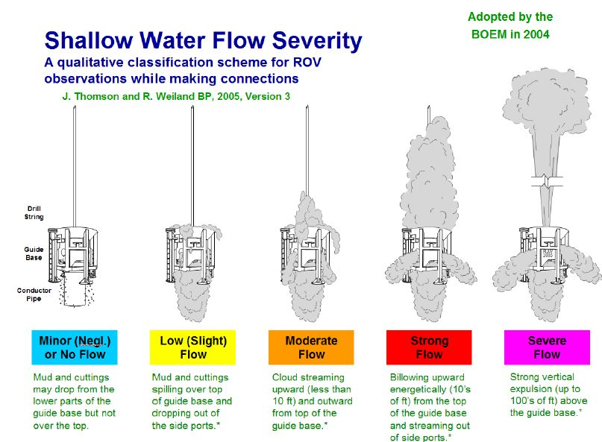
Qualitative Description of SWF Severity
Notes:
A qualitative ranking of SWF severity has been developed over the last 10-15 years between industry working in the GOM and the U.S. Department of the Interior, Minerals Management Service (now Bureau of Ocean Energy Management). The documentation provided by operator’s about SWFs incidents they encounter is not uniform, which has resulted in about 15% of SWF incidents being assigned a severity of “unknown.” Industry has become more savvy anticipating where SWFs may occur and the number of reported incidents over time has decreased.

Slide 4
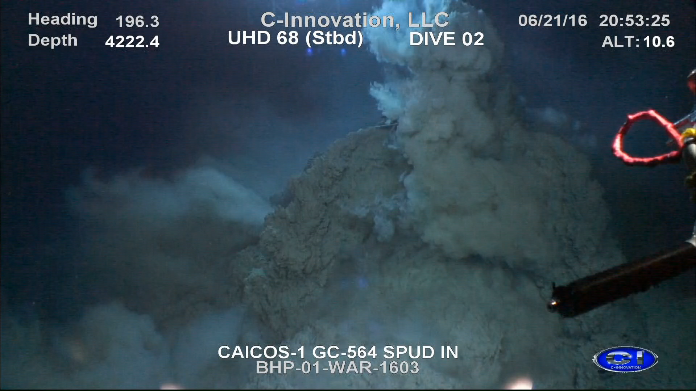
2016 SWF in Green Canyon
Strong Flow
Notes:
This is a 12 second video of a SWF in Green Canyon that occurred in 2016.

Slide 5
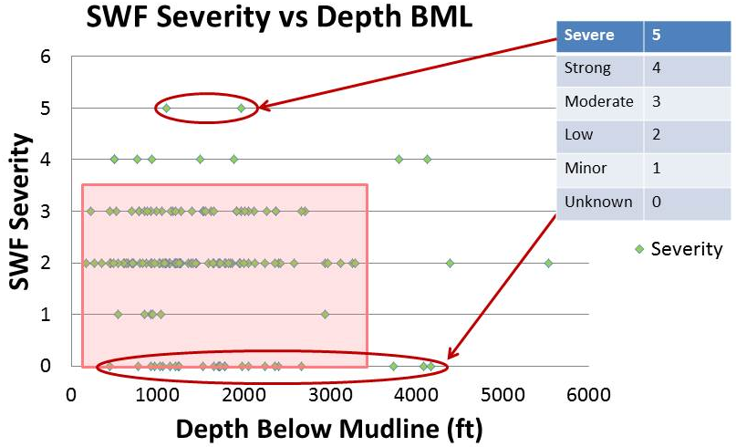
Where do SWFs occur?
In GOM SWFs occur in water deeper than 600 ft (200 m) and depths below mudline between 300 ft (91 m) and 3,500 ft (1,066 m).
Two SWF hot spots in GOM are in southwest MC and northeast GC.
Notes:
SWF events in the GOM occur beyond the shelf edge on the upper or lower slope in water deeper than 600 ft (200 m). Shown here are depths below mudline (BML) for the 163 SWFs in the GOM that have been reported since 1983 and 2015. The main population is between 300 ft (91 m) and 3,500 ft (1,066 m) BML.

Slide 6
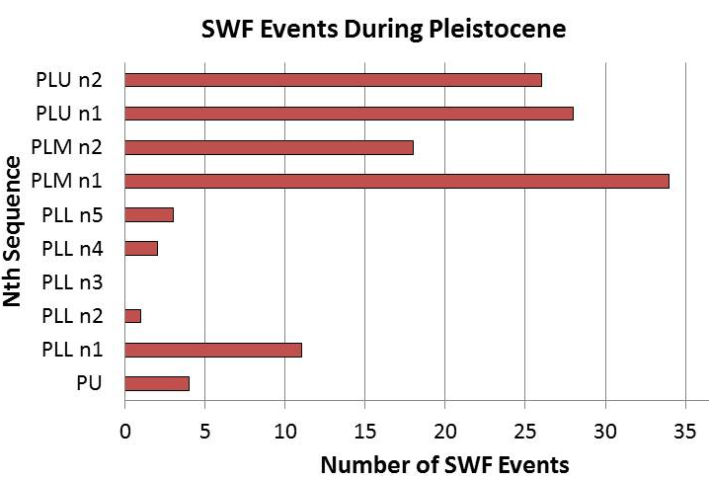
Temporal Distribution of SWFs
Notes:
SWF ages were determined by inspecting mapped units and correlating the depths below mudline in wells where SWFs and paleo data have been reported. The histogram shows BOEM’s Pleistocene chronozones; PU = Pliocene, PLL = Lower Pleistocene, PLM = Middle Pleistocene, and PLU = Upper Pleistocene. Within this framework are 3rd order sequences, those recognized over durations of 0.5-3 Myr (Haq et al., 1987; Strasser et al., 2000) and “Nth” order sequences, those recognized with greater temporal resolution than 3rd order by Resource Evaluation’s Regional Framework Unit. Within BOEM’s chronozones are the “Nth” order sequences that have been recognized.
In the central GOM SWFs have been mostly concentrated in two hot spots on the Mississippi fan; in southwest Mississippi Canyon (MC) and in northeast Green Canyon (GC). In each hot spot there are about 50 SWFs depending on how one defines a centroid around them. Within these spatial clusters, their age skews to the youngest part of the Pleistocene, younger than 700 Ka (PLM and PLU).
The temporal occurrence of SWFs is a convenient proxy indicating high sedimentation rates during PLM and PLU to drainage of proglacial lakes. This project used GIS/ArcMap 10.5 volumetric tools to calculate sediment volumes and sedimentation rates during the Pleistocene. The details of this work can be found in Bjerstedt (2019).

Slide 7
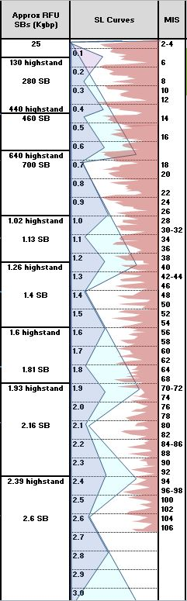
Early PLM n1
Nebraskan
influx
canopy re-entrants
Shelf margin
collapse
13*
= Depocenters
Notes:
At the 700 Ka sequence boundary (SB) sea level fell ~400 ft (125 m). Seventy five percent of the SWFs events are <700 Ka. Half the number of SWFs associated with the Mississippi fan were deposited during the Middle Pleistocene (PLM n1-2) over a ~240-300 Ky period during which large mass transport deposits (mega-MTD) entered the ultra-deepwater sink. The evidence permits an interpretation that the first PLM n1 mega-MTDs were set up by events in the upland Mississippi catchment.
Shortly before the 700 SB evidence for ice-blocked Lake Tight in central Appalachia vanished.
Deeply eroded varved clay deposited in Lake Tight is reverse-polarity, indicating the lake’s youngest age because all sediments deposited after 780 Ka are normal polarity. Draining of Lake Tight could have taken place later than 780 Ka after return to normal polarity, but such evidence is not preserved or not recognized. Based on size and depth of the lake (Erjavec, 2018) it released ~268 mi³ of water and outwash into the Ohio Valley. Glacial outwash from the lake poured into the GOM and loaded an unstable shelf margin. The shelf margin apparently collapsed near the 700 SB allowing canyon-channel feeder systems to build onto the upper slope and into ultra-deepwater.
Very thick mega MTDs (at least 3 and probably more) occurred in the deep- and ultra-deepwater sink from ~700 to 460 Ka SB. Depending on how quickly the basin responded to influx the period of MTDs could have been more compressed toward the earlier part of this interval; ~700 SB to the 640 highstand, ~60 Ky . A school of thought argues for rapid response times to upland erosion, on the order of 10⁴ years (Fildani et al., (2018). One style of mega-MDT movement includes seismically incoherent masses that appear to have been very erosive. Another style of mega-MDT movement appears to have been gravity sliding of large semi-coherent sheets.

Slide 8
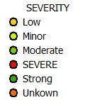
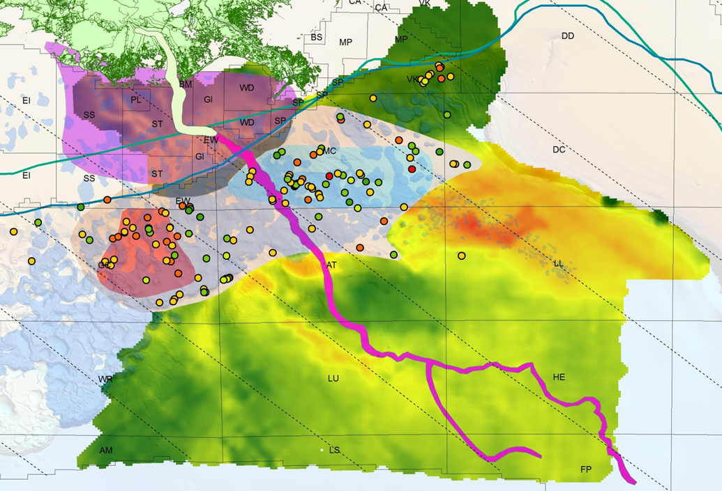
Spatial Distribution of SWFs
MC and GC SWFs conform to guidance by transfer fault-bounded structural corridors
1,400-1,500’ Bench
Outline Blue Unit (dash)
1,300’-1,400’
Bench
A
Pearl River
A
Red Unit
Mississippi River
MT Corridor
HS Corridor
Galveston
Sabine
Hackberry
Terrebonne
Notes:
SWF populations in MC (~50) and GC (~50) conform to “guidance” by a NW-SE depositional fabric of transfer-fault-bounded structural corridors inherited from the Jurassic pull apart of the GOM (Stephens, 2001, 2010). On the outer continental shelf and slope, the seismic evidence for the structural corridors is convincing and they are a useful construct within which to interpret Pleistocene depositional patterns.
The MC population routed down Mississippi-Terrebonne Corridor (MTC) and the Green Canyon population routed down the Hackberry-Sabine Corridor (HSC). The two SWF populations are roughly separated by Mississippi Canyon shown in fucia color, which is the final depisode of the fan and Weimer ‘s (1990, 1991) unit 17 .
Winker and Booth (2000) defined the SWF clusters in MC and GC; named the former “blue unit” and the later “red unit” (above). They regarded them as sand-prone intraslope fans of a deltaic lobe shown in purple. These systems are PLM n2, younger than the thick MTDs of PLM n1, but older than the PLU and Wisconsinian channel systems (Southwest Pass Canyon, and Old and Young Timbalier canyon-channels) that are typically recognized (Sawyer et al., 2007).
The two SWF populations are roughly separated by the younger PLU channel systems, strongly suggesting that red and blue units were once part of the same PLM intraslope fan, or apron (light tan). The middle part of it has been eroded away by PLU scour and erosion.

Slide 9
Depth of Shallow Water Flows BML (ft)
Spatially, MC and GC populations occur in two benches ~1,300-1,500 ft (400-460 m) BML.
Stratigraphically, each population ~100 to 150-ft-thick (30-45 m), separated vertically by ~100 ft (30 m).
Warm = deeper, Cool = shallower
Mississippi River
Pleist Shelf Edge
Max Pleist Shelf Edge GBDS
Sabine
MTC
Hackberry
Terrebonne
HSC
1,300-1,400’ BML bench
1,400-1,500’ BML bench
CI = 100 ft
Notes:
The northwest-to-southeast lineaments relate to the inherited NW-SE structural (Stephens, 2001, 2010) are labeled. The two SWF spatial populations in Mississippi Canyon and Green Canyon occur in two benches. The GC bench is ~ 1,300-1,400 ft (400-426 m) below mudline (BML). The MC bench is ~1,400-1,500 ft (426-460 m) BML. Each bench is ~100-150-ft-thick (30-45 m). The two benches are separated vertically by ~100 ft (30 m). Both spatial SWF hot spots are comprised of two temporal hot spots; ~ ½ are Middle Pleistocene age (PLM n1 & PLM n2) and ~⅓ are Late Pleistocene age (PLU n1 and PLU n2).

Slide 10
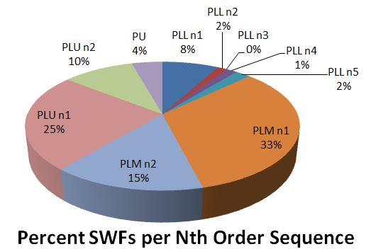
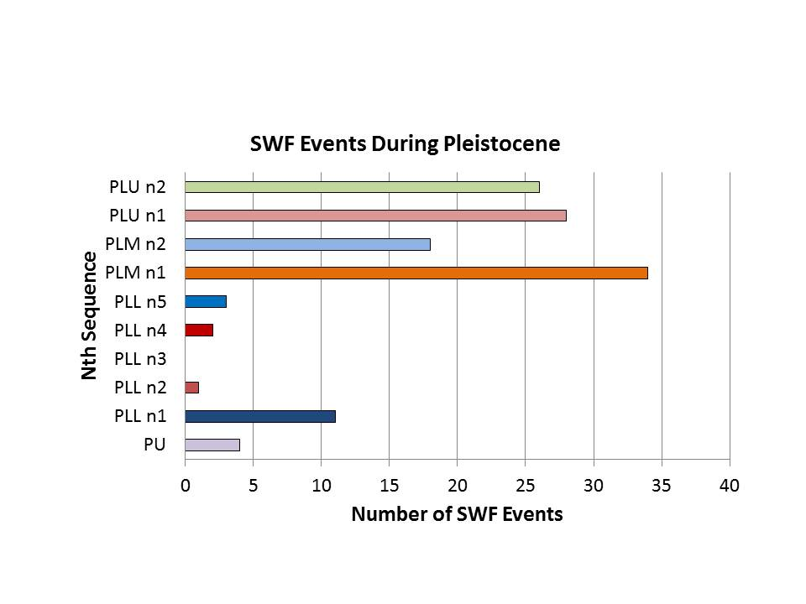
Conclusions
About half of the SWF events are Middle Pleistocene (PLM n1 & PLM n2) and a third are Late Pleistocene (PLU n1 & PLU n2).
Destabilization of the Pleistocene shelf margin ~700 Ka and influx by proglacial Lake Tight set conditions for Middle Pleistocene SWFs.
The PLU n1 high follows unification of Missouri-Mississippi catchments.
Proglacial lakes Kankakee and Agassiz set conditions for the Latest Pleistocene SWFs.
~ 19-11 Ka Lakes Kankakee and Agassiz
~ 440-400 Ka Blue Unit
~ 780-460 Ka Lake Tight
Notes:
One-half of the SWFs in the Green Canyon and Mississippi Canyon populations are Middle Pleistocene ~700-400 Ka (PLM n1-2), and one-third are Late Pleistocene (~130 Ka to Holocene) (PLU n1-2). Seventeen percent of the SWFs originate from the latest Pliocene or Early Pleistocene part of the Mississippi Fan (PLL n4-5).
The second largest temporal package of SWFs occurred during the Late Pleistocene (PLU n1-2). This period coincided with at least three events related to the deglaciation and retreat of the Laurentian ice sheet; 1) unification of Missouri and Mississippi watersheds during meltback (~77 Ka) (Fildani et al., 2018), 2) drainage of moraine-impounded proglacial Lake Kankakee into the upper Mississippi Valley, the Kankakee “torrent” (~19 Ka) (Curry et al., 2014), and 3) a direct GOM connection to enormous proglacial Lake Agassiz in the northern mid-continent through the River Warren passage (13.5-9.4 Ka) (Thorleifson et al., 1996; Michalek, 2013; Wright, 1990).

Slide 11
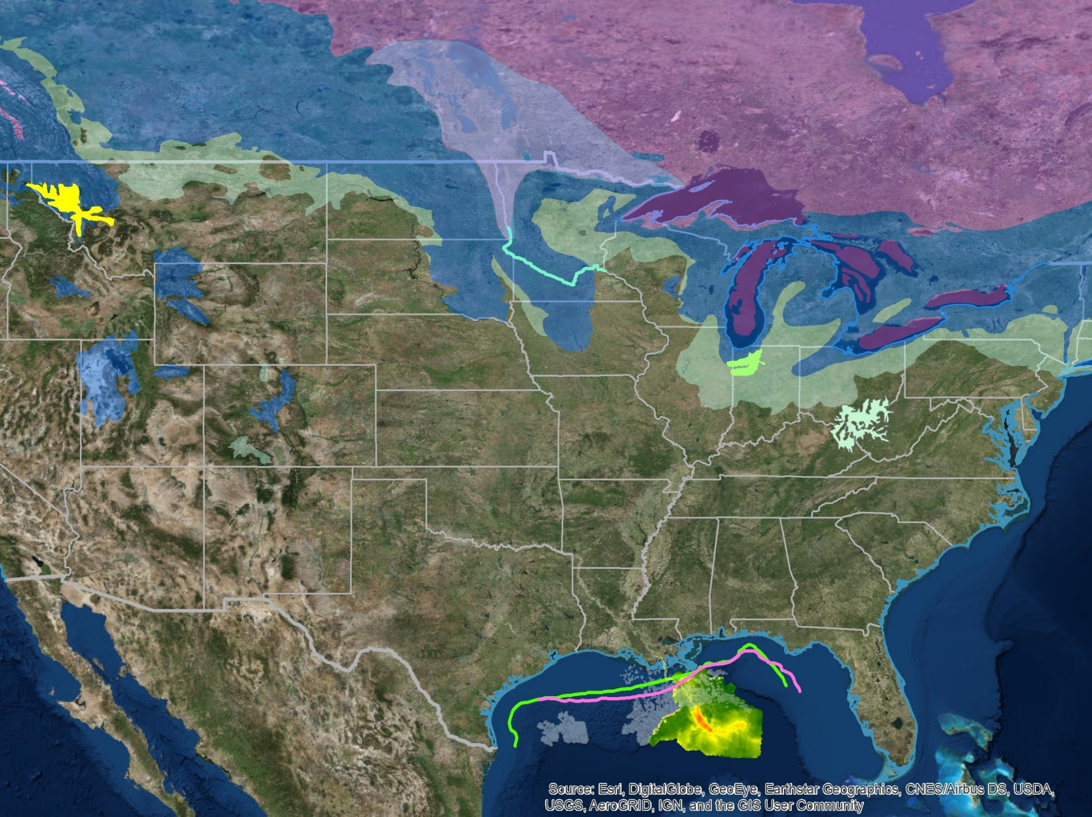
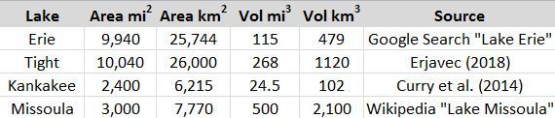
Ice ~10 Ka
Proglacial
Lake Agassiz
Ice ~18 Ka
Ice ~14 Ka
Ice ~10 Ka
Proglacial
Lake Missoula
River Warren
Ice ~14 Ka
Proglacial Lake
Kankakee
Ice ~18 Ka
Proglacial
Lake Tight
Notes:
A summary of Pleistocene glacial lakes and comparisons are shown with references. The extent and ages of Laurentide ice sheets are from Dyke et al. (2003) and Dyke (2004).
This final slide reinforces the point that proglacial lakes are ephemeral features. Once formed, however, conditions are set up for large changes in gradient to base level. Lake Tight, for example, was shown to have been filled to the level of 900 ft (275 m) above sea level (Erjavec, 2018). The height of the highest levels of Lake Agassiz reached 1,100 ft (335 m) (Michalek, 2013) above sea level during the periods it was draining into the GOM. Once these conditions are destabilized the hydraulic head driving erosion is tremendous.
Among the best known of the Pleistocene glacial lakes is Lake Missoula (upper left). It was known to have catastrophically drained (~16-12 Ka) during the Wisconsinian deglaciation (Weis and Newman, 1989). Lake Missoula stood at an elevation above sea level of 4,150 ft (1,265 m) releasing erosional forces and landscape modification so profound it can be seen from orbit. If Lake Tight experienced a similar kind of catastrophic ice dam failure, the evidence for it has not been preserved or recognized. Lake Kankakee was known to have catastrophically failed when the ground moraines impounding it were breached ~19 Ka moving boulders-sized clasts of Paleozoic bedrock (Frankie, 1998) in the “Kankakee Torrent” (Currey et al., 2014). The River Warren connecting Lake Agassiz with the Mississippi valley caused almost 25 mi of headward erosion (Hickson, 2016) through Paleozoic bedrock, leaving as evidence the only major waterfall on the Mississippi River; the Falls of Saint Anthony near Minneapolis.

Slide 12
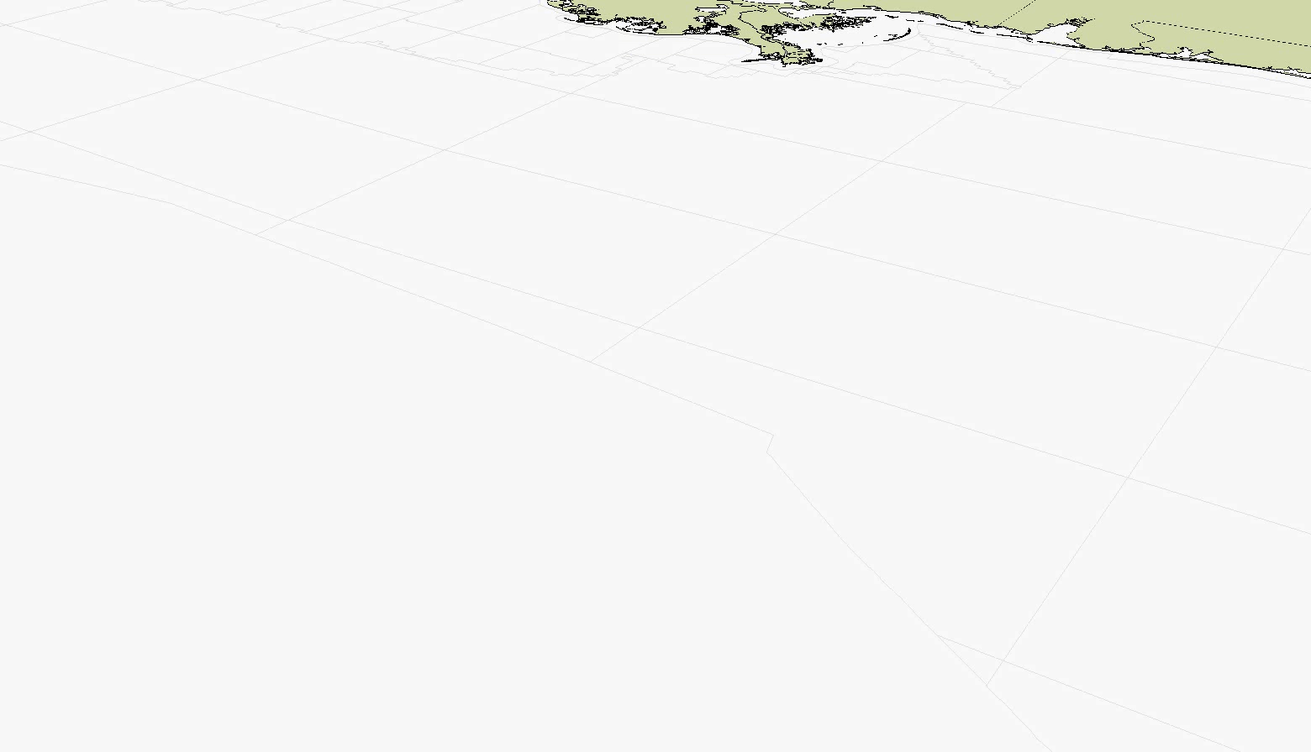
1st Surface is Structure on base of PLM n1, approx 700 Ka
Overlying this surface are isopach rasters of early, middle, and late PML n1
Note MTDs in the Eastern Fan, warmer = thicker
Notes:
Animation showing the deposition of mega-MTDs during PLM n1.

Slide 13
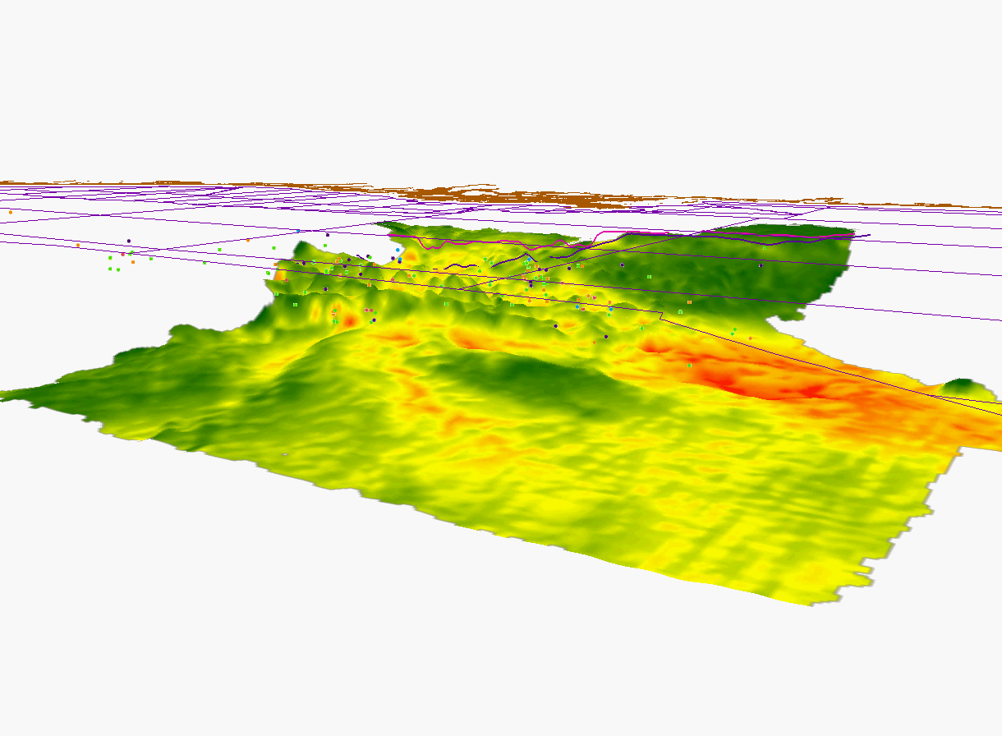
Surface is time structure on base of PLM n1, approx 700 Ka, overlain by isopach color raster of PML n1 units; warmer = thicker
Animation tracks up the Eastern Mississippi Fan to the NW toward the collapsed Pleistocene margin
Cloud of SWF events are roughly in stratigraphic relationship with PLM n1 surface
Notes:
Animation with a fly path tracking southeast to northwest up the thickest MDTs and toward the point where collapse of the Pleistocene margin formed a 100 mi (160 km) opening through which multiple vectors of Middle Pleistocene outwash entered the GOM, setting up conditions for the largest population of SWFs. The cloud of SWF incidents show in 3D space and are in approximate stratigraphic relationship with the base of PLM n1.

Slide 14
References Cited
Bjerstedt, T.W. 2019. Rise and fall of the Mississippi fan: Insights from catchment to deep sink. American Association of Petroleum Geologists, Annual Conference and Exhibition, San Antonio, TX. Search and Discovery Article. No.
Bjerstedt, T.W. and K.V. Kramer. 2019. Shallow Water Flows in Gulf of Mexico: Relating High Sedimentation Rates to Proglacial Lake Sources and Mass Transport Deposits in Deepwater Sink. American Association of Petroleum Geologists, Annual Conference and Exhibition, May 20-23, 2019, San Antonio, TX. Poster P70. May 21, 2019, p. 76.
Curry, B.B., E.R. Hajic, J.A. Clark, K.M. Befus, J.E. Carrell, and S.E. Brown. 2014. The Kankakee Torrent and other large meltwater flooding events during the last deglaciation, Illinois, USA. Quaternary Science Reviews, 90, pp.22-36.
DeCinque, J. 2015. The Kankakee torrent: a summary of how the great flood was discovered. Internet webpage, posted November 24, 2015, Emporia State University. Accessed April 29, 2019. http://academic.emporia.edu/aberjame/student/decinque1/kankeejd.html
Dyke, A. S., A. Moore, and L. Robertson. 2003. Deglaciation of North America, Open File 1574, Natural Resources Canada, Ottawa.
Dyke, A. 2004. An outline of North American deglaciation with emphasis on central and northern Canada, in Quaternary Glaciations--Extent and Chronology --- Part II: North America, vol. 2, edited by J. Ehlers and P. L. Gibbard, pp. 373–424.
Erjavec, J. 2018. A new map of Pleistocene proglacial Lake Tight based on GIS modelling and analysis. Ohio Journal of Science, 118(2), p.57-65.
Fildani, A., A. Hessler, C.C. Mason, M.P. McKay, and D.R.F. Stockli. 2018. Late Pleistocene glacial transitions in North America altered major river drainages, as revealed by deep-sea sediment. Scientific Reports, 8(1):13839. DOI: 10.1038/s41598-018-32268-7
Frankie, W.T. 1998. Guide to the geology of Kankakee River State Park Area, Kankakee County, Illinois. Field Trip Guidebook, Illinois State Geological Survey
Haq, B.U., J.A.N. Hardenbol, and P.R. Vail. 1987. Chronology of fluctuating sea levels since the Triassic. Science, 235(4793), pp.1156-1167. DOI: 10.1126/science.235.4793.1156
Hickson, T. 2016. Glacial River Warren and the retreat of St. Anthony Falls. Key Concepts in geomorphology. Science Education Resource Center at Carelton College. internet website accessed March 13, 2019. Last Modified November 15, 2016. https://serc.carleton.edu/vignettes/collection/25473.html
Kerrin, S. and R. Whitrock. 2019. BOEM Chronostratigraphic Charts. For internal use only. These charts have received no external review and are not web-posted.

Slide 15
References Cited
Michalek, M.J. 2013. Examining the progression and termination of Lake Agassiz. Michigan State University. Posted to MSU.edu. Post date unknown. https://msu.edu/~michal76/research/407_Geomorphology_Lake%20Agassiz2.pdf
Sawyer, D.E., P.B. Flemings, R.C. Shipp, and C.D. Winker. 2007. Seismic geomorphology, lithology, and evolution of the late Pleistocene Mars-Ursa turbidite region, Mississippi Canyon area, northern Gulf of Mexico. American Association of Petroleum Geologists Bulletin 91(2), p. 215-234.
Stephens, B.P. 2010. Basement controls on subsurface geologic patterns and near-surface geology across the northern Gulf of Mexico: a deeper perspective on coastal Louisiana. American Association of Petroleum Geologists, Annual Conference and Exhibition, New Orleans, LA. Search and Discovery Article. No. 25129. http://www.searchanddiscovery.com/pdfz/documents/2010/25129stephens/ndx_stephens.pdf.html
Stephens, B.P. 2001. Basement controls on hydrocarbon systems, depositional pathways, and exploration plays beyond the Sigsbee Escarpment in the central Gulf of Mexico: Proceedings of the 21st Annual Gulf Coast Section of the Society of Economic Paleontologists and Mineralogists Foundation, Bob F. Perkins Research Conference, Houston, Texas, p. 129–158.
Strasser, A., H. Hillgärtner, W. Hug, and B. Pittet. 2000. Third‐order depositional sequences reflecting Milankovitch cyclicity. Terra Nova, 12(6), pp.303-311. https://onlinelibrary.wiley.com/doi/pdf/10.1046/j.1365-3121.2000.00315.x
Thorleifson, L.H., J.T. Teller, G. Matile and W.C. Brisbin. 1996. Review of Lake Agassiz history. Sedimentology, Geomorphology, and History of the Central Lake Agassiz Basin. Geological Association of Canada Field Trip Guidebook B, 2, p. 55-84.
Weimer, P. 1991. Seismic facies, characteristics, and variations in channel evolution, Mississippi Fan (Plio-Pleistocene), Gulf of Mexico. in Seismic facies and sedimentary processes of submarine fans and turbidite systems. p. 323-347. Springer, NY.
Weimer, P. 1990. Sequence stratigraphy, facies geometries, and depositional history of the Mississippi Fan, Gulf of Mexico. American Association of Petroleum Geologists Bulletin 74(4), p. 425-453.
Weis, P.L. and W.L. Newman. 1989. Channeled scablands of eastern Washington: the geologic story of the Spokane flood. U.S. Geological Survey and Eastern Washington University Press. Publications from Special Collections. 6. https://dc.ewu.edu/cgi/viewcontent.cgi?referer=http://scholar.google.com/&httpsredir=1&article=1005&context=spc_pubs
Wright, H.E. 1990. Geologic history of Minnesota rivers. Minnesota Geological Survey, Educational Series 7. 20 p. https://conservancy.umn.edu/bitstream/handle/11299/57272/MGS_ES_7.pdf?sequence=1

