Slide 1

April 8, 2026
Overview of Alaska Seabed Minerals and OCS Mining Regulations
Daniel Lasco
Geologist, Alaska Region
Presented to Alaska Miners Association
Fairbanks Convention, 2026
BUREAU OF OCEAN ENERGY MANAGEMENT
U.S. DEPARTMENT OF THE INTERIOR

Slide 2
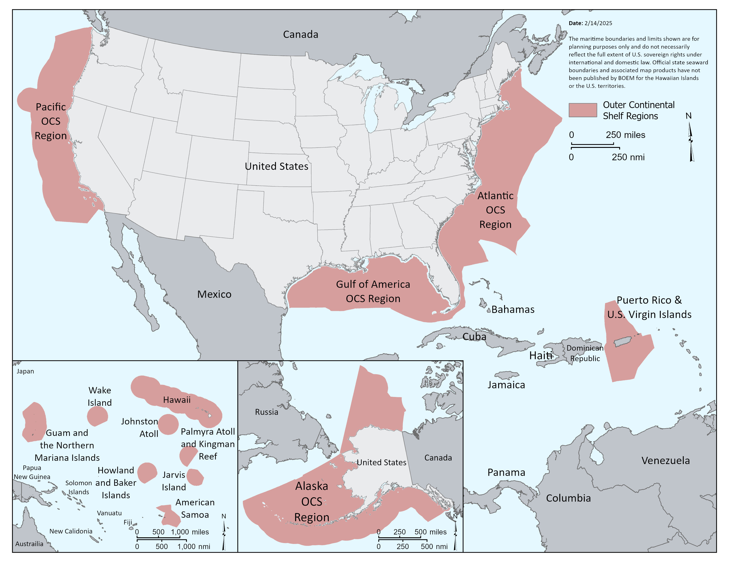

BOEM's Mission
Manage development of U.S. Federal Seabed energy, mineral, and geological resources in an environmentally and economically responsible way.
U.S. Federal Seabed = 3,169,210,000 acres
or 4.95 million square miles
or 12.8 million square km

Slide 3


BOEM’s Executive Order Guidance
2025 Executive Orders
  EO 14285 Unleashing America’s Offshore Critical Minerals and Resources
    Take immediate action to accelerate responsible development of seabed mineral resources
  EO 14156 Declaring a National Energy Emergency
    Current critical minerals efforts do not meet Nation's needs
  EO 14154 Unleashing American Energy
    Prioritizes expanding exploration and development of critical minerals
  EO 14213 Establishing the National Energy Dominance Council
    Council prioritizes expansion of critical mineral production
BOEM Executive Orders Guidance page

Slide 4
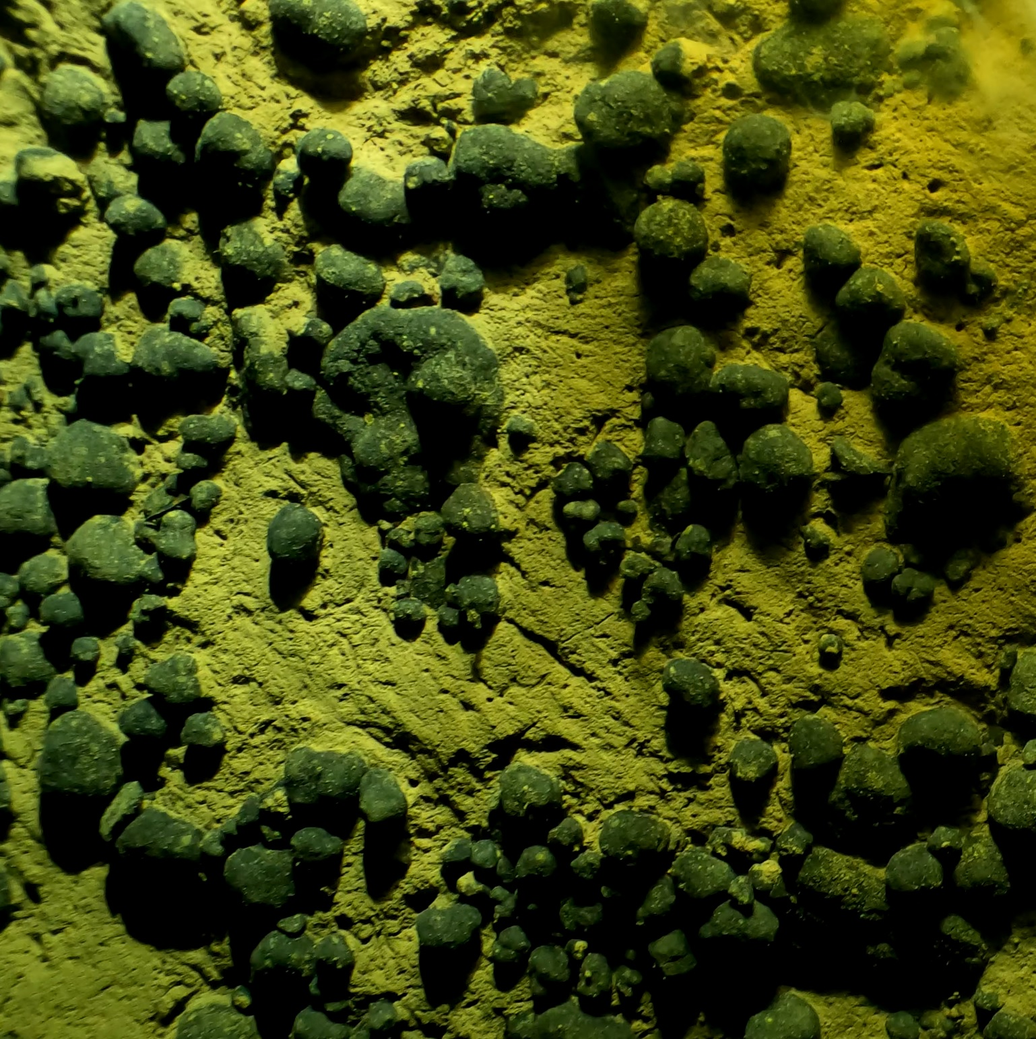
EO 14285: Unleashing America's Offshore Critical Minerals and Resources
Build domestic capabilities for seabed mineral exploration, characterization, extraction, and processing
Streamline permitting and leasing under both the Outer Continental Shelf Lands Act and the Deep Seabed Hard Mineral Resources Act.
  Secretary of the Interior must "establish an expedited process for reviewing and approving permits" for seabed mineral resource activities
Support deep‑sea science, mapping, and technology investment, coordinated across departments.
Strengthen international coordination, especially with key partners and allies.
H.R. 4018 - To unleash America's offshore critical minerals and resources
BOEM, OET, American Samoa, OCS (2024)
Notes:
EO 14285 directs the Department, and BOEM, to
“establish an expedited process for reviewing and approving permits for prospecting and granting leases”
“identify which critical minerals may be derived from seabed resources”
support interagency efforts to further deep-sea mapping and technology
Image of polymetallic nodules in the area under consideration for leasing in the OCS east of American Samoa

Slide 5



Notice of Proposed Rulemaking – Administrative Revisions
The Department has proposed administrative revisions to the regulations that govern prospecting, leasing, and development of minerals other than oil, gas, and sulfur on the OCS, as directed by the following Executive Orders (E.O.):
E.O. 14285, Unleashing America’s Offshore Critical Minerals and Resources;
E.O. 14154, Unleashing American Energy; and
E.O. 14192, Unleashing Prosperity through Deregulation.
The Notice of Proposed Rulemaking was published in the Federal Register on February 24, 2026, initiating a 60-day public comment period that will conclude on April 27, 2026.

Slide 6
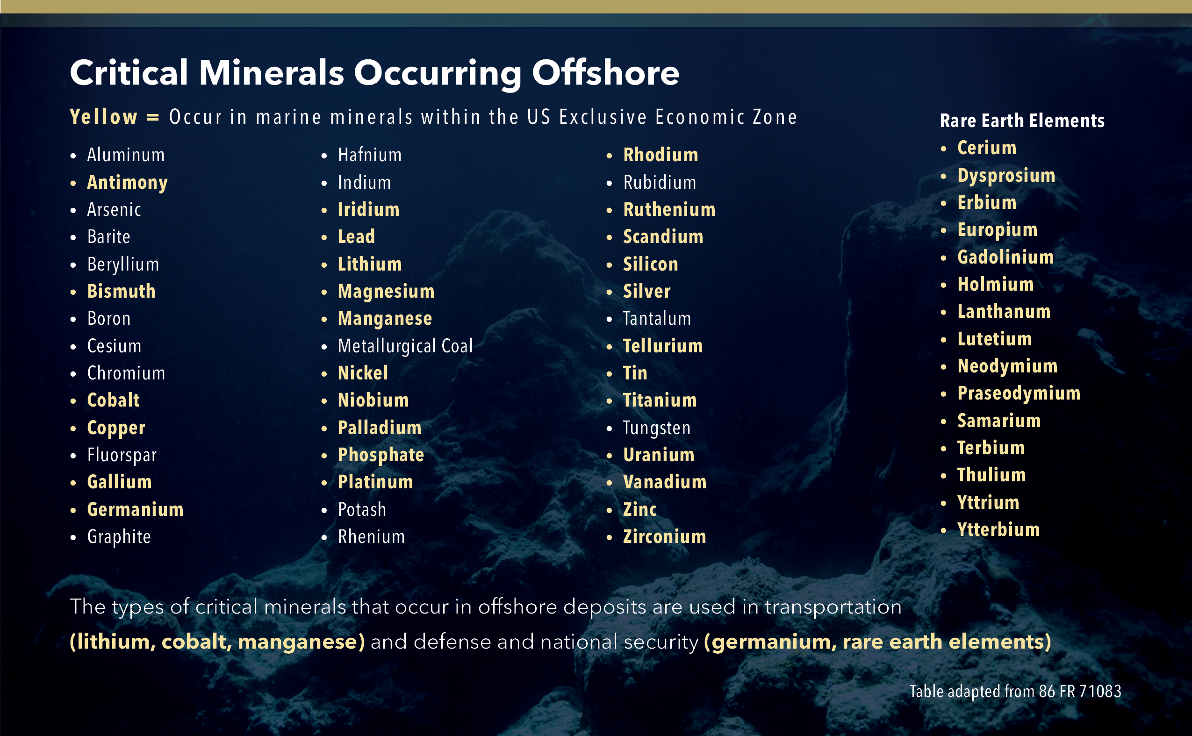
Offshore Critical Minerals (Elements of Interest)
BOEM Minerals
Non-energy [marine] minerals
Minerals other than Oil, Gas, and Sulphur on the OCS
Includes Critical Minerals
Sand and gravel sometimes regulated differently
U.S. Geological Survey developed list of Critical Minerals (Elements)
Essential to U.S. economic and national security
Updated 2025 list adds Copper, Lead, Silver, and others
Removes Arsenic and Tellurium

Slide 7
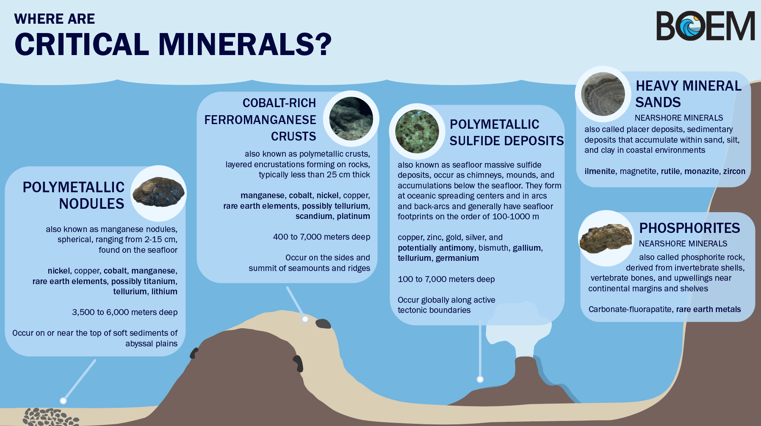
Source: BOEM Resource Evaluation of Critical and Hard Offshore Mineral Programmatic Reference (RE-CHOMPR)

Slide 8
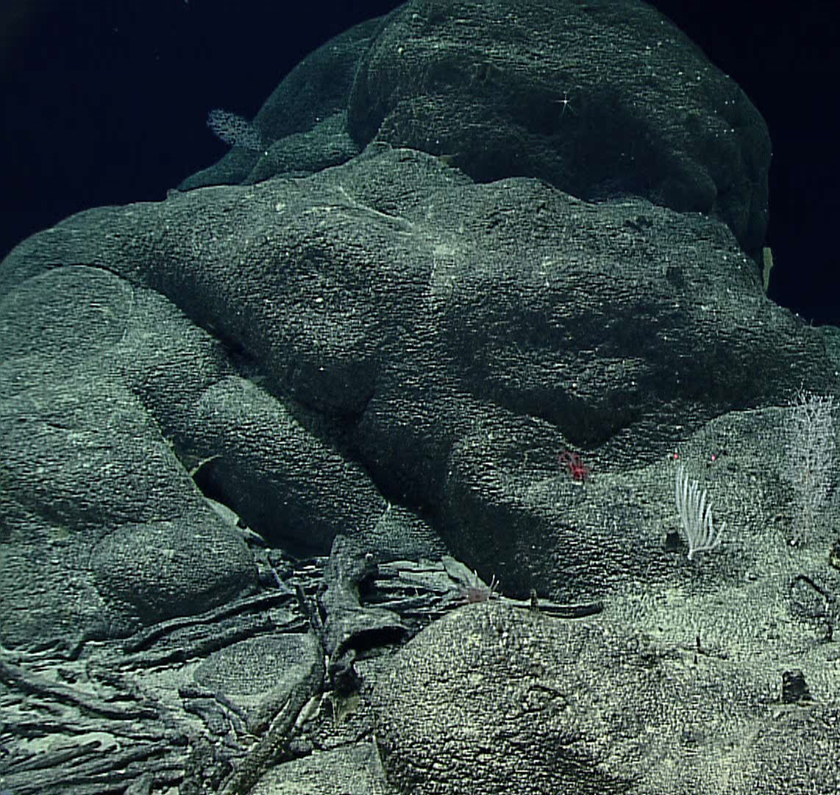
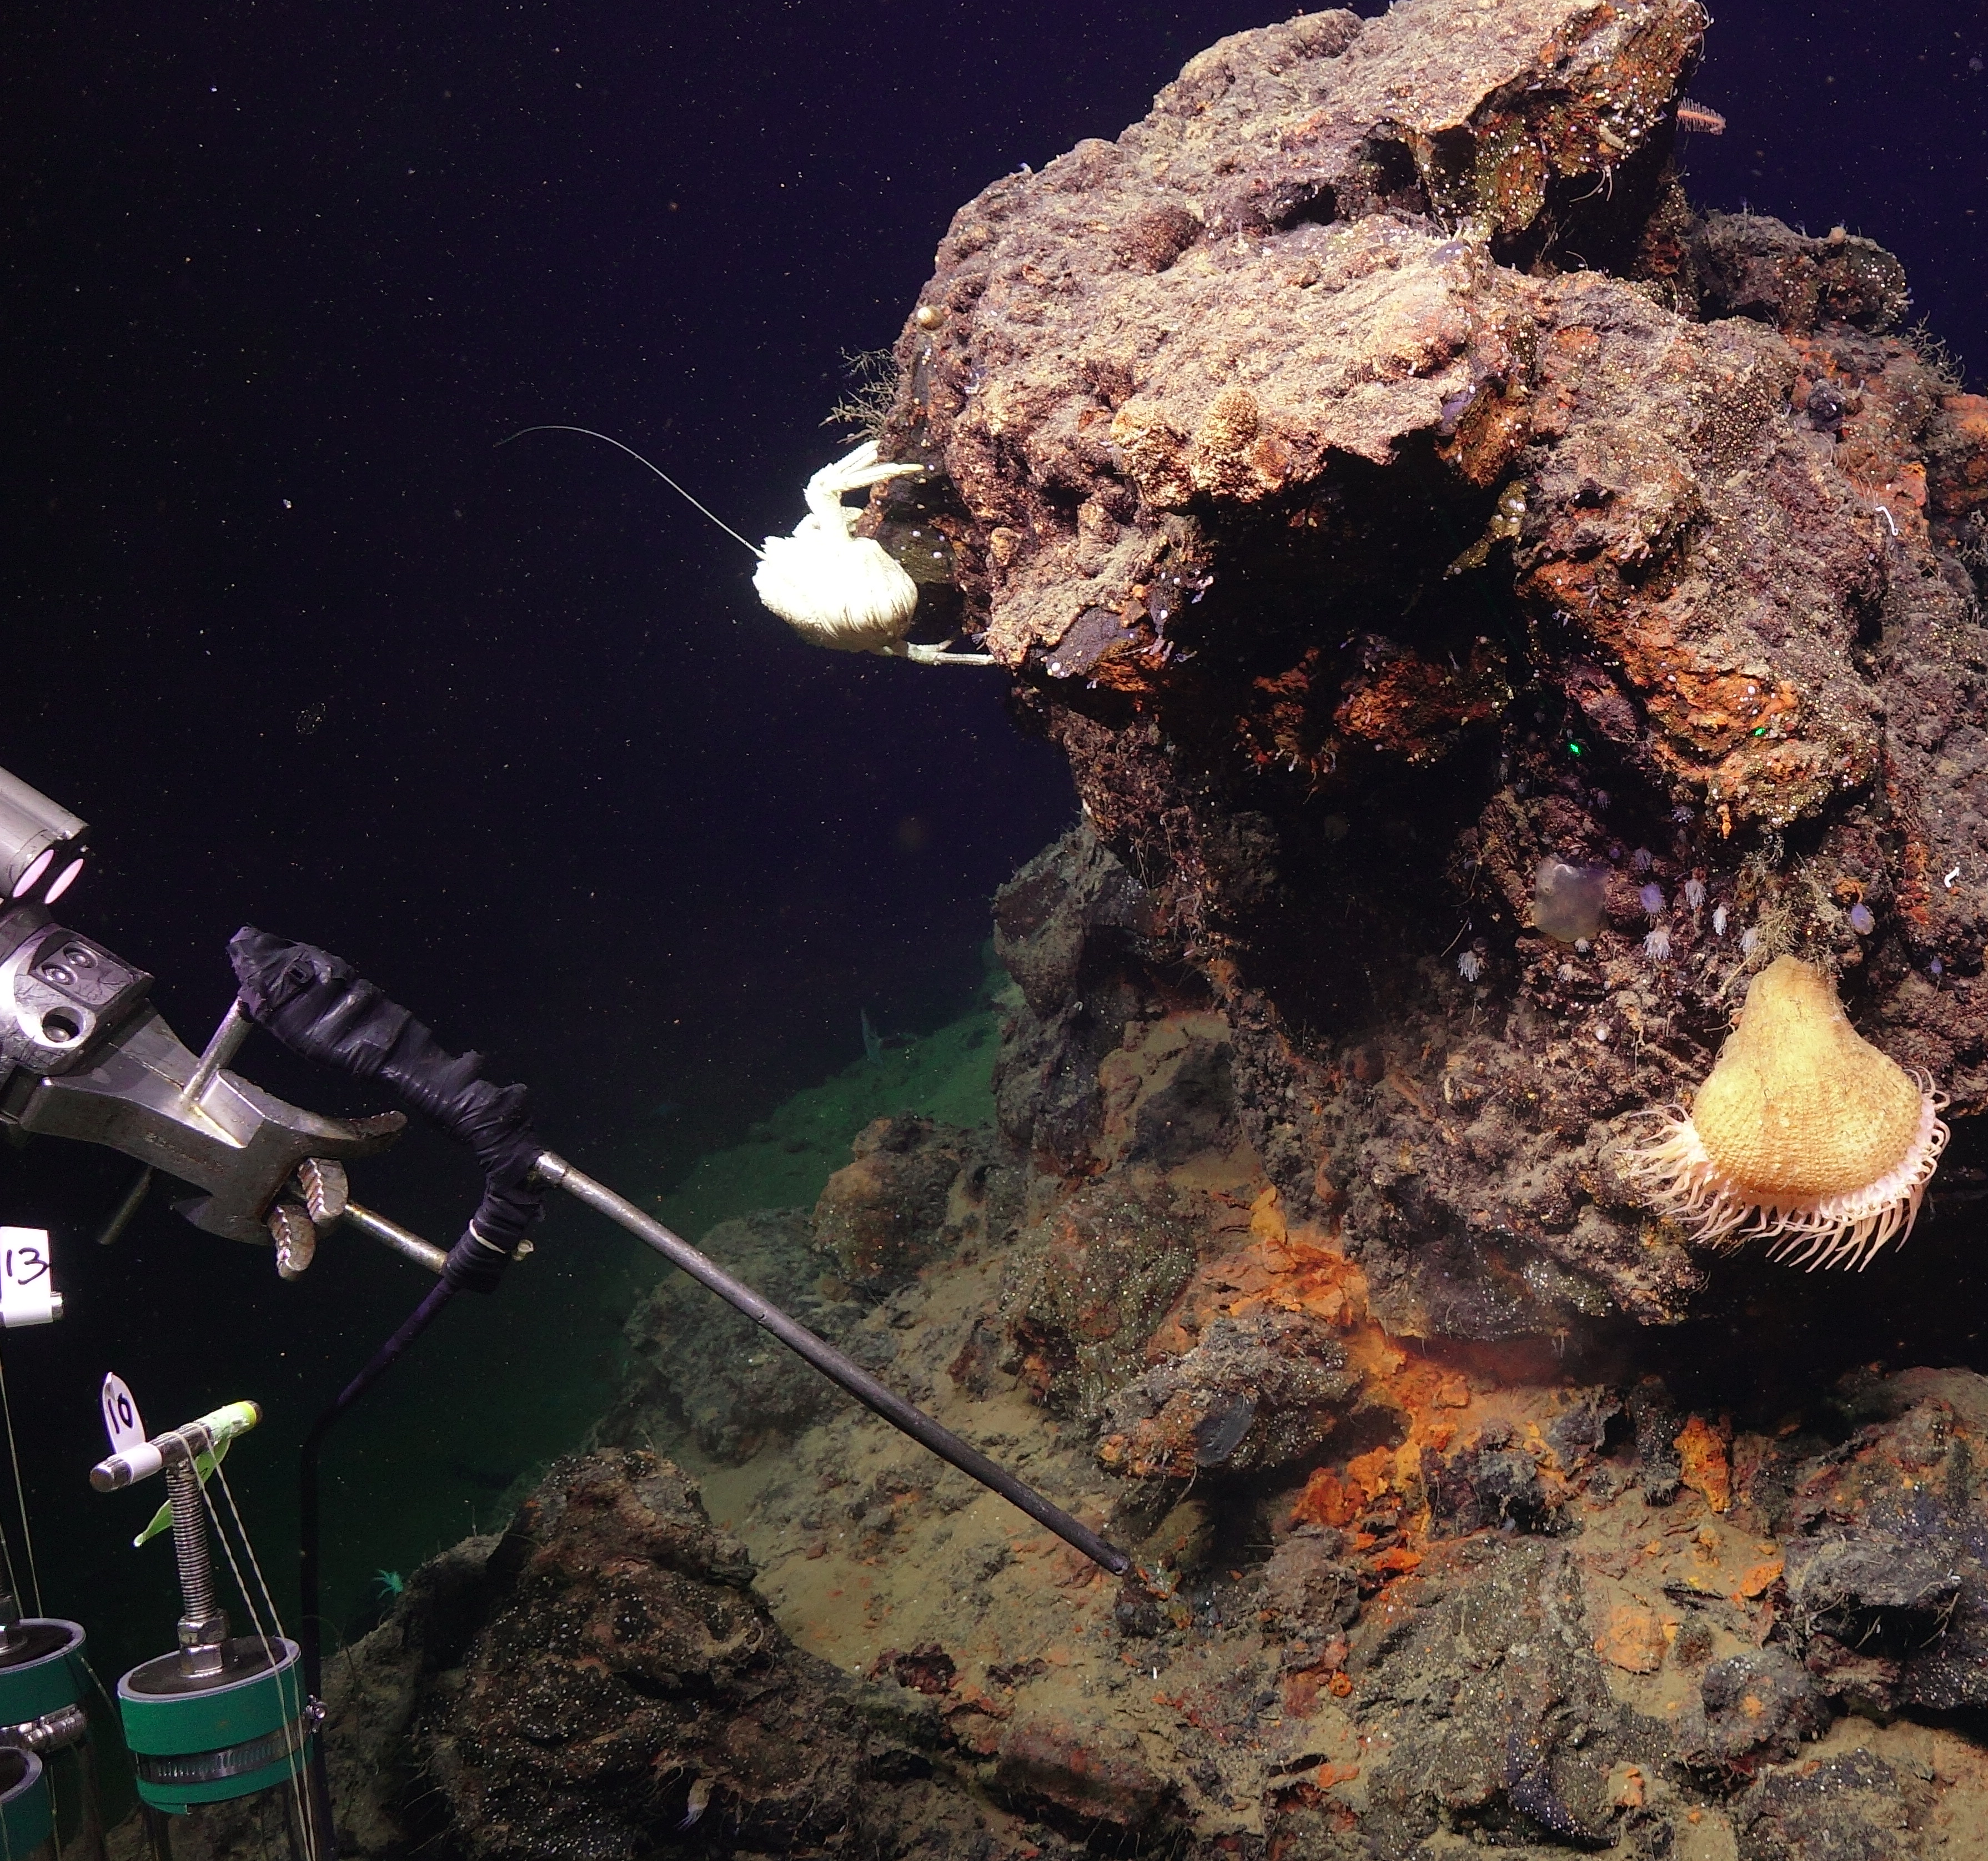

Critical-Mineral Occurrences on the Federal Seabed
Polymetallic Nodules
Ferromanganese Crusts
Seafloor Massive Sulfides (SMS)
Heavy Mineral Sands
BOEM, OET, American Samoa, OCS (2024)
Marianas, NOAA-OER (2016)
BOEM, Escanaba Trough, OCS (2022)
BOEM, Savage Neck Dunes, VA

Slide 9
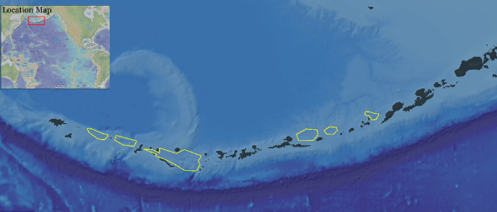
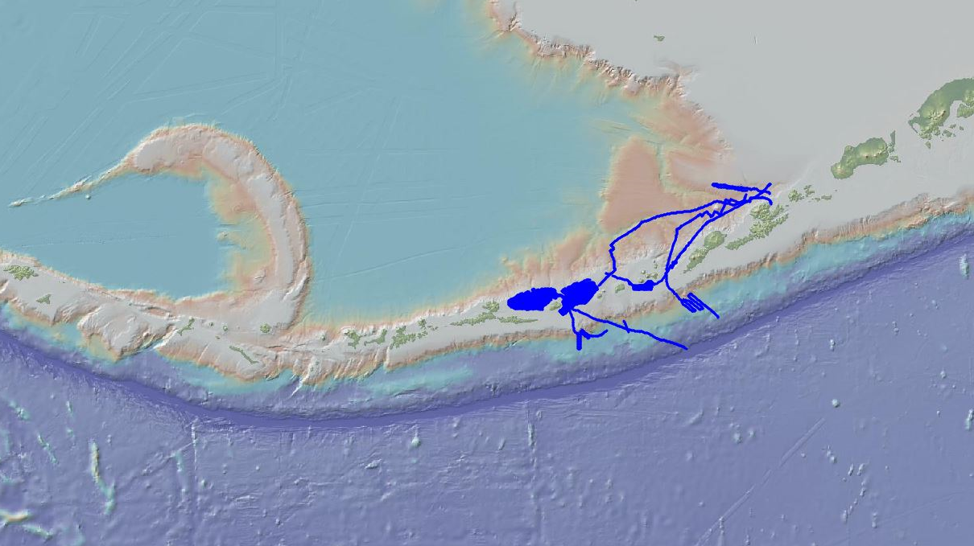

Recent BOEM-Funded Studies
Buldir Island
Kagamil Island
BOEM/USGS IAA desktop study of AK potential resource areas completed in 2022- USGS Pub 1870
2022 BOEM partnered with NOAA to fund the mapping of 17,375 sq. miles of unmapped sea floor around the Aleutian Islands with Saildrone, an uncrewed autonomous mapping vehicle
MM 21-04:Summer 2025 NOAA, USGS, BOEM funded cruise to map and explore dive sites in Aleutian Islands with the goal of benthic characterization of the seabed ecosystems and search for critical minerals.
Saildrone

Slide 10
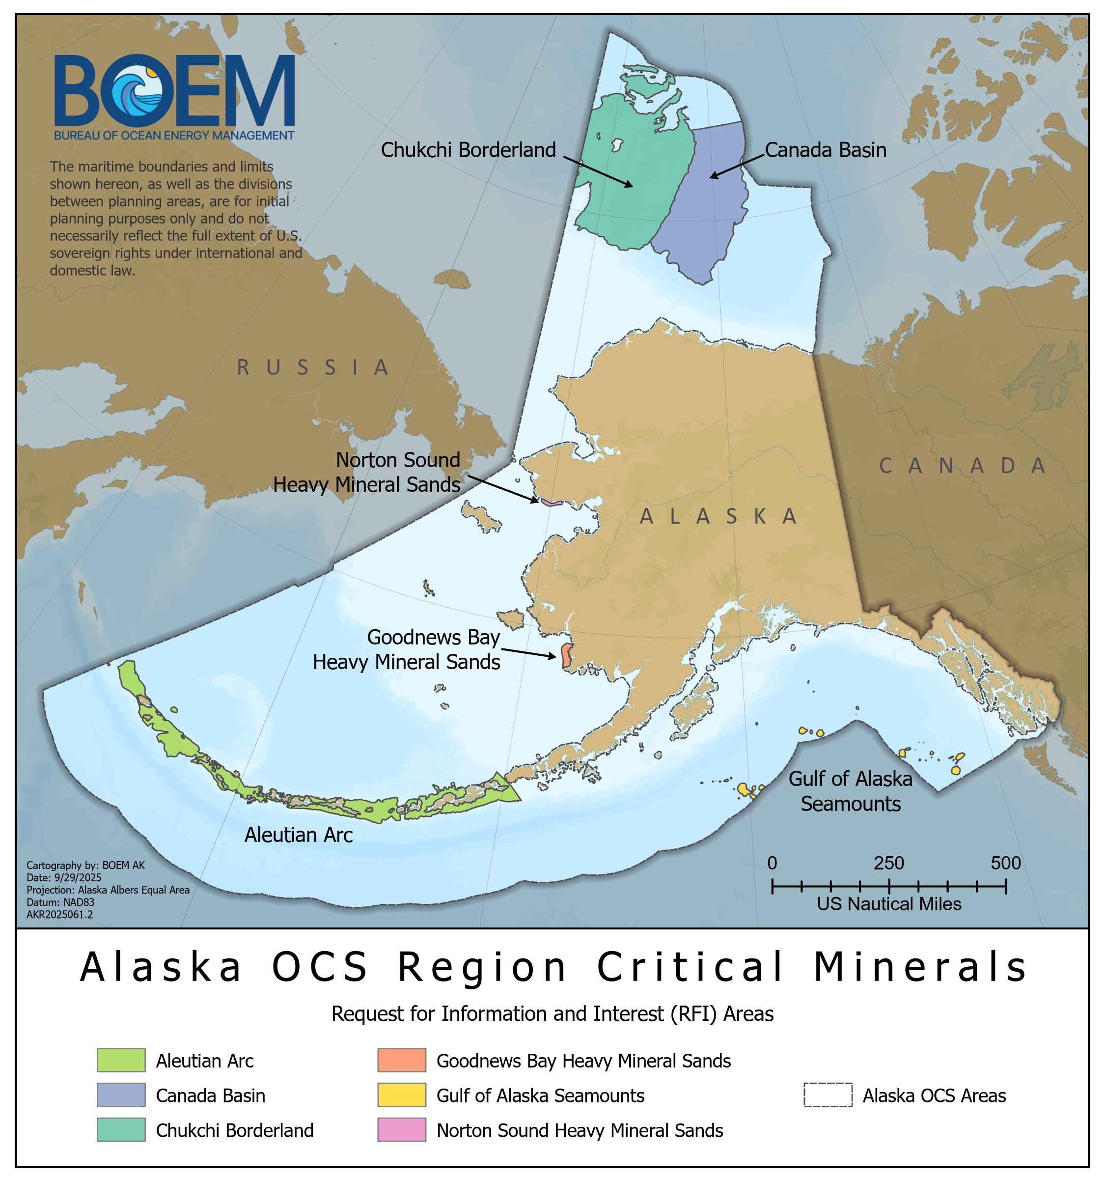
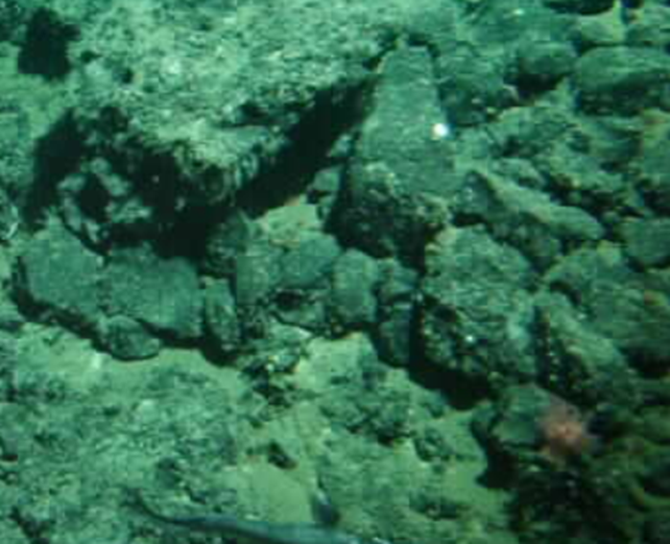
Ferromanganese Crusts
Present in Chukchi Borderland, Canada Basin, and Gulf of Alaska
Hard, layered deposits that form on the surfaces of seamounts, ridges, and other underwater features
Thought to include large occurrences of cobalt, nickel and rare-earth elements
Patton Seamount (USGS)

Slide 11
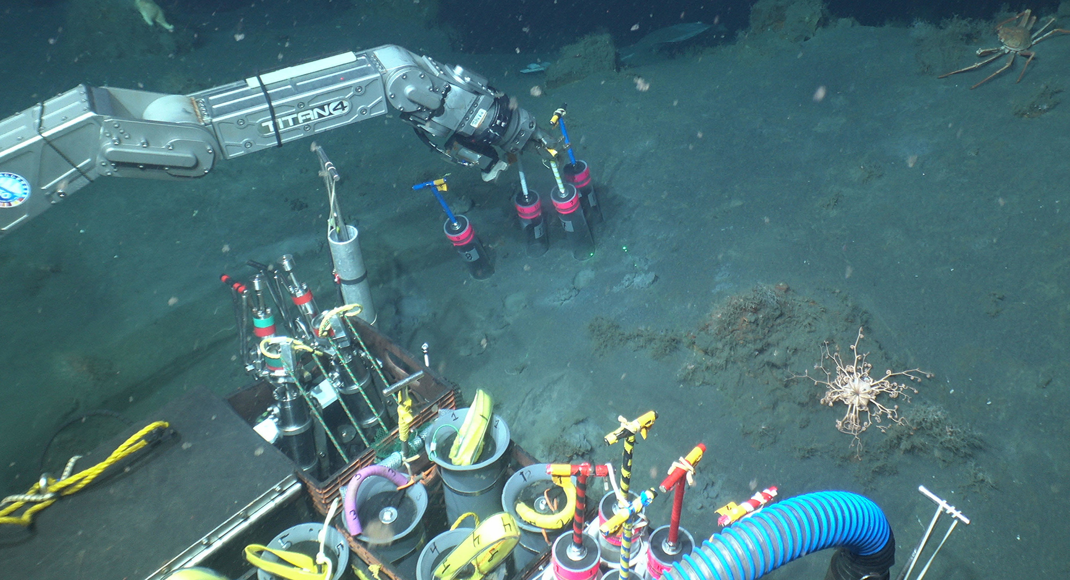
Polymetallic Sulfides
Present in volcanic arc or back-arc geologic setting
Thought to contain copper, zinc, gold, and silver with associated rare elements
No confirmed deposits yet, but the area is underexplored.
Alvin HOV collecting push cores offshore Bogoslof Island
NOAA 2025 Aleutian Arc expedition

Slide 12
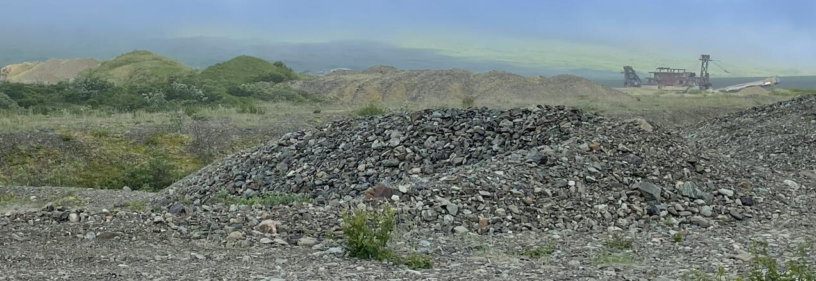
Heavy Mineral Sands
Norton Sound
  Mined since the 1980s with ~130,000 oz recovered
  83 state leases covering 23,793 acres (Alaska DNR)
Goodnews Bay
  Platinum mined 1926–1970s
  Approx. 650,000 oz produced, largest U.S. source. (USGS; BLM)
Historic dredge and tailings, Goodnews Bay, Alaska
USGS

Slide 13
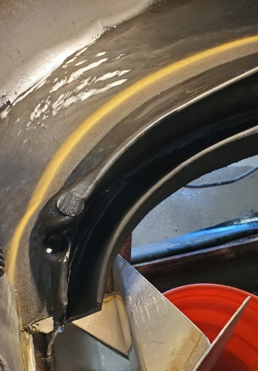

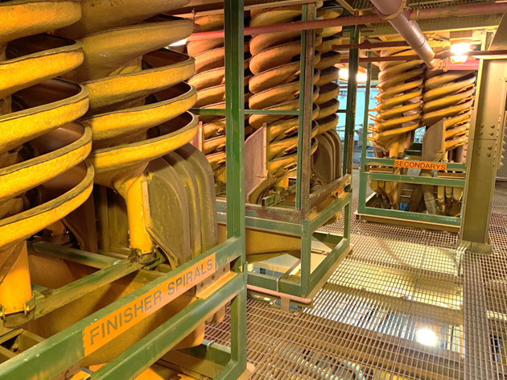
Heavy Mineral Concentration
Humphrey spiral is used to separate high and low-density minerals (quartz, feldspar, mica) from marine sands.
Separation facility can fit in a conex container
Possibility for modular and seasonal operations in Alaska
Lighter, coarser, rounder
slurry input
high density minerals
Heavier, finer, flatter
split output
Atlantic Strategic Minerals’ heavy mineral separation facility (Stony Creek, VA)
splitter
Notes:
(Dobbs, K. AASG 2024 presentation)
Following grain-size analyses and core logging, the bulk samples from the intervals selected for HM analysis were wet sieved to remove greater than 2-millimeter (mm) diameter. Then dried and weighed to obtain a total dry bulk weight prior to processing in 3-turn Humphry spiral, where material is slurried and input at constant flow rate (1gpm in this case)…light on outside, heavies on inside, splitter at the bottom
The output HM concentrate for each sample was dried and sub-sampled using a calibrated sediment splitter at the SGS laboratory.
Results used to quantify total EHM to assess value & compare/calibrate pXRF results

Slide 14
BOEM’s Regulatory Frameworks for Critical Minerals Development
30 CFR 580
Prospecting for Minerals
30 CFR 581
Leasing of Minerals
30 CFR 582
Operations
BOEM Regulations
Prospecting
Commercial prospecting requires a Geophysical and/or Geological Permit; prospecting does not convey mineral rights
Non-commercial exploration requires an Authorization (or Notice for Scientific Research)
Leasing
Activities under a Lease
Competitive process separate from prospecting
Two components:
  Sale
  Lease administration (e.g., required payments, bonding)
Exploration and operations are to be conducted in manner that protects environment and promotes orderly development
  Delineation
  Testing
  Mining
Lessees must also comply with applicable BSEE regulations
Action:
Total = ~ 2-3 months for Permit;
~ 1 month for Authorization
Notes:
Statutory Authority – Outer Continental Shelf Lands Act (OCSLA)
43 U.S. Code § 1340(a)(1)
“Any agency of the United States and any person authorized by the Secretary may conduct geological and geophysical explorations in the outer Continental Shelf, which do not interfere with or endanger actual operations under any lease maintained or granted pursuant to this subchapter, and which are not unduly harmful to aquatic life in such area.”
43 U.S. Code § 1337(k)(1)
“The Secretary is authorized to grant to the qualified persons offering the highest cash bonuses on a basis of competitive bidding leases of any mineral other than oil, gas, and sulphur in any area of the outer Continental Shelf not then under lease for such mineral upon such royalty, rental, and other terms and conditions as the Secretary may prescribe at the time of offering the area for lease.”
Prospecting for Minerals
Under OCSLA, all parties prospecting marine minerals for commercial purposes must receive authorization.
Under BOEM regulations, pre-lease G&G prospecting ("exploration") can only be performed under a permit, authorization, or scientific research notice.
Interested parties are required (under 30 CFR 580.12) to submit a permit application form (Form BOEM-0134) at least 30 days before the start date.
Application provides the information necessary to evaluate the applicant’s qualifications, and upon approval, a permit or authorization is issued to the applicant.
Environmental assessment may be required as part of the permitting process.

Slide 15
30 CFR 580 – Prospecting for Minerals
OCSLA requires all parties who are prospecting marine minerals for commercial purposes to receive authorization. Under BOEM regulations, pre-lease G&G prospecting (“off-lease exploration") can only be performed under a permit, authorization, or scientific research notice.
Interested parties are required (under 30 CFR 580.12) to submit a permit application form (Form BOEM-0134) at least 30 days before the start date.
Application provides the information necessary to evaluate the applicant’s qualifications, and upon approval, a permit or authorization is issued to the applicant.
Environmental assessment may be required as part of the permitting process.
You may not claim any oil, gas, sulphur, or other minerals you discover while conducting operations under a permit or notice (30 CFR 580.20(h)).
Activities are approved for a specified period and typically do not exceed 5 years. Permits may be issued for a shorter period of time and extended as appropriate.

Slide 16

30 CFR 581 – Leasing of Minerals
Leasing is a competitive process separate from the prospecting permit.
The lease sale process can be initiated by:
  An unsolicited request for a lease sale (30 CFR 581.11)
  DOI’s own initiative (30 CFR 581.12)
Followed by:
  A request for OCS mineral information and interest (30 CFR 581.12) (“RFI”)
Lease sale:
  Competitive, cash bonus bidding under terms & conditions specified in leasing notice. Minimum lease term is 20 years.
  BOEM has not issued a competitive lease under these regulations

Slide 17
Leasing Steps: Regulatory Pathway and Projected Timeline Estimates
1
2
3
4
5
6
7
8
9
Applicant submits request to lease minerals
BOEM publishes Request for Interest (RFI)
BOEM identifies location and size of lease area
BOEM
conducts environment & agency reviews
BOEM issues proposed leasing notice
BOEM receives comments submitted by governors of adjacent states
BOEM issues leasing notice
Applicants bid for minerals lease
BOEM issues critical minerals lease
PUBLIC INVOLVEMENT
3 – 12 Months
1 – 3 + Years
6 – 12 Months
Total Process: 2 – 5 + Years
Notes:
Minerals leasing is a competitive process with either sealed bid, cash bonus bid, and royalties (581.18(a)).
The leasing notice will specify the use of sealed or oral bids (581.18 (b) and (c))
Each action by BOEM is subject to review and approval by the Secretary of Interior or their designee before the process proceeds.
Minimum lease term is 20 years.
BOEM is currently engaged in updating and modernizing the existing regulatory framework.

Slide 18

30 CFR 582 – Leasing Operations Related to Minerals
Requirements for Exploration, Delineation, Testing, Mining, and Abandonment (30 CFR 582.21 – 582.24)
Operations conducted in a manner that protects the environment and promotes orderly development of OCS minerals (30 CFR 582.12)
Opportunities for stakeholder review and comments on plans and environmental documentation (30 CFR 582.4)
Environmental protection measures and monitoring (30 CFR 582.28)
Reporting requirements (30 CFR 582.29)
Noncompliance, remedies, and penalties (30 CFR 582.14)

Slide 19
NEPA Framework
NEPA
(National Environmental Policy Act)
Clean Air Act
Endangered Species Act
Magnuson Stevens Fishery Conservation and Management Act
Marine Mammal Protection Act
National Historic Preservation Act
Coastal Zone Management Act
Federal Water Pollution Control Act
NEPA integrates environmental requirements
  Physical
    Federal Water Pollution Control Act
    Clean Air Act
  Biological
    Endangered Species Act
    Magnuson-Stevens Fishery Conservation and Management Act
    Marine Mammal Protection Act
  Social-Cultural-Historical
    National Historic Preservation Act
    Coastal Zone Management Act
Consultation and coordination with states, Tribes, and other agencies

Slide 20
Leasing Process – steps and estimated minimum times
Item | Regulation | Estimated Duration
Unsolicited request for a lease sale | 581.11 | 45 days
Request for OCS mineral information and interest | 581.12 | 6 months – 2 years
OCS mining area identification, tract size | 581.14, 581.15 | 6 - 12 months
Proposed leasing notice | 581.16 | 6 - 12 months
Final leasing notice and sale | 581.17 | 6 - 12 months
Decision points to continue or stop occur throughout the process
Competitive, cash bonus bidding, minimum 20-year term
Specific terms, minimum royalty payments, rental fees specified in leasing notice
Operations under a lease include delineation, testing, and mining
Prospecting regulated by 30 CFR 580; leasing by 30 CFR 581; operations under lease by 30 CFR 582
All plan reviews are subject to NEPA

Slide 21
Request for Information and Interest: Commercial Leasing for Outer Continental Shelf Minerals Offshore Alaska
BOEM is evaluating whether to advance a competitive lease sale for minerals (other than oil, gas or sulfur) on the Alaska Outer Continental Shelf
Requests information and comments on, and indications of interest in, the leasing of OCS minerals in an area offshore Alaska.
Comment period closed 1 April 2026.
https://www.regulations.gov/document/BOEM-2025-0318-0001
www.boem.gov/ak-minerals-2027

Slide 22



Thank you
Follow BOEM announcements on social media:
X (aka Twitter)
Facebook
LinkedIn
Daniel Lasco
Geologist, Alaska Region
AKOCS.GGPermits@boem.gov
BUREAU OF OCEAN ENERGY MANAGEMENT
U.S. DEPARTMENT OF THE INTERIOR

Slide 23
Notice of Proposed Rulemaking – Administrative Revisions
The Department has proposed administrative revisions to the regulations that govern prospecting, leasing, and development of minerals other than oil, gas, and sulfur on the OCS, as directed by the following Executive Orders (E.O.):
E.O. 14285, Unleashing America’s Offshore Critical Minerals and Resources;
E.O. 14154, Unleashing American Energy; and
E.O. 14192, Unleashing Prosperity through Deregulation.
The Notice of Proposed Rulemaking was published in the Federal Register on February 24, 2026, initiating a 60-day public comment period that will conclude on April 27, 2026.

Slide 24

Notice of Proposed Rulemaking – Administrative Revisions
DOI/BOEM intends these revisions to eliminate outdated and unnecessary regulations and introduce additional clarity.
  These administrative changes do not substantively affect applicants for permits or lessees
  The changes primarily remove or revise duplicative or confusing language. The changes include eliminating provisions that lack legal underpinnings, removing language redundancies with existing statutes, and/or eliminating provisions that are addressed elsewhere in statute or regulation.
  One regulatory change proposes to shorten the time in which BOEM must respond to an unsolicited lease sale request (from 45 to 28 days).

Slide 25

Notice of Proposed Rulemaking – Administrative Revisions
One revision to 30 CFR part 580 eliminates a provision to share the application for a pre-lease, prospecting permit with the governor of an adjacent state. The change is ministerial.
  BOEM remains committed to close coordination with its intergovernmental partners.
  The revision does not affect the governor's notice and commenting during leasing and/or subsequent plan phases.
  The existing provision is inconsistent with Section 11 of the OCS Lands Act. Moreover, applications are posted online with business confidential information removed. The regulation put into place in 2002 also confuses several related processes and steps.
  The revision has no effect on the Coastal Zone Management Act consistency process and coordination that occurs before a prospecting permit is issued. The state receives copy of any prospecting application.
  The revision does not affect the ability of any state to participate in NEPA process as a cooperating agency, if warranted.

Slide 26

Notice of Proposed Rulemaking – Administrative Revisions
Another revision to 30 CFR part 580 eliminates an unnecessary statement about BOEM's role in environmental effects evaluation and monitoring related to prospecting. The proposed elimination deletes a generalized statement that imposes no requirement on industry and also poorly explains internal BOEM process.
  Under existing law and regulatory requirement, independent of 30 CFR part 580, BOEM must conduct necessary NEPA review and environmental consultations to evaluate prospecting activities, as well as the need for mitigation measures and any monitoring.
  The proposed deletion does not obviate that responsibility. The environmental performance standard for prospecting remains unchanged in 30 CFR 580.20.

Slide 27

Potential Additional Rulemaking in the Future
Section 3(b)(i) of the E.O. 14285 directs the Secretary of the Interior to
  establish an expedited process for reviewing and approving permits for prospecting and granting leases for exploration, development, and production of seabed mineral resources
  without compromising environmental and transparency standards within the federal OCS under OCSLA, consistent with applicable law.
In response to E.O. 14285, DOI/BOEM are reviewing permitting, leasing, and operations regulations and evaluating how to advance efforts to facilitate the exploration and extraction of OCS marine minerals.
After the review and evaluation, additional regulatory revisions may be proposed.

