Slide 1

BAS: BOEM Auction System
Bidding Tutorial
Notes:
1. Welcome
Welcome to BOEM’s online bidding tutorial for BAS, the BOEM Auction System. BAS is BOEM's new auction system used for offshore wind leasing. This tutorial should not be used as a substitute for reviewing all the auction rules documents, policies, and public notices released regarding offshore wind leasing. The links to the auction rules document and detailed public notices outlining the procedures, terms and conditions for these auctions can be found on BOEM's website. Bidders are also encouraged to read the BOEM Auction System User Guide which is provided to qualified bidders in advance of the auction. The examples that appear in this tutorial include fictitious data and are for illustrative purposes only. Additionally, the examples do not reflect any predictions or assumptions about the actual bidding in the auction, the number of rounds, or the outcome of the auction.

Slide 2
Overview
Notes:
2. Overview
We start by providing an overview of the auction. We will later go into more detail on some of these topics.

Slide 3
What’s New
BAS remains an ascending clock auction, similar to previous wind auctions, however it includes a set of rule changes:
  New auction system is an “iterative second price auction.”
    The highest price at which there was competition for a lease area:
      Becomes the start-of-round price for the next round (during the auction); or
      The winning bid (at the end of the auction).
    Second price auctions allow the bidder to bid as high as they are willing to go, with the assurance that they will not pay more than what was necessary to win the auction.
  After Round 1, the prices are presented as ranges.
Notes:
3. What’s New
Starting with offshore lease sales in 2024, BOEM will be using this new auction platform, the BOEM Auction System or BAS. The new auction system will continue to use the ascending clock auction format, but there will be a few important rule changes regarding pricing and bidding. The first change is the use of an iterative second price auction. The highest price at which there was competition for a lease area becomes the start-of-round price for the next round during the auction or the winning bid at the end of the auction.
This means that the winning bidder pays the competitive “second price” for its winning lease areas. Both the pricing rule and the activity rule are chosen to encourage truthful bidding in each round of the process. This lets the bidder focus on identifying its most preferred lease area or areas given the prices.
Consider an example with a single lease area. The highest bidder wins the lease area and pays the second‐highest price. This makes bidding the true value a dominant strategy; it is the best strategy regardless of what the other bidders are doing. For instance, if you have the highest bid of $100 and my bid of $90 is the second highest, then you win and pay $90. You can bid your true value, $100, regardless of what the others are bidding.
Also, note that after round 1, the prices are presented as ranges.

Slide 4
What’s New
  Within the same round, bidders can submit a bid to reduce demand on one lease area and a bid to increase demand for another lease area.
    This allows a bidder to possibly switch to another lease area if the price of the lease area exceeds it’s specified price.
  The determination of provisional winners will no longer use a two-stage process.
    The bidder who remains on a lease area after the final round becomes its provisional winner.
  A bidding credit will be calculated simply as a percentage of the final price.
  Bids for two or more lease areas will no longer be treated as package bids.
Notes:
3.1 What’s New
The second change is in bidding. Within the same round, bidders can now submit a bid to reduce demand on one lease area if they are not willing to pay the full price for that area in that round and a bid to increase demand for another lease area.
The third change is that the determination of provisional winners will no longer use a two-stage process. The bidder who remains on a lease area after the final round become its provisional winner.
The fourth change is that the bidding credit will be calculated simply as a percentage of the final price.
The fifth change is that bids for two or more lease areas will no longer be treated as package bids.

Slide 5
Auction Flow
ANNOUNCE:
Next round’s clock prices
Round opens
Bidder places bids
Round closes (when time expires)
start
POST:
Publish posted prices for each lease area for this round
CALCULATE:
Bids are processed to determine if auction should close
POST:
Winners are informed
POST:
Winners are informed
POST:
Winners are informed
open
close
POST:
Winners are informed
Notes:
3.2 Auction Flow
This slide illustrates the flow of the auction. Before the round begins, the clock prices for the lease areas are announced. The round opens and qualified bidders place bids. The round closes when the time expires. The auction system then processes the bids, calculates the aggregate demand for each lease area, and checks whether aggregate demand is less than or equal to one for every lease area. If aggregate demand exceeds one for at least one lease area, then the auction continues. The posted prices are published for each lease area and the auction will proceed with another round of bidding for every lease area. If, after the bids of a round have been processed, aggregate demand is less than or equal to one for every lease area, the auction ends.

Slide 6
Key Terms
  In Round 1, opening price – the minimum bid price for a lease area
  In other rounds, there is a price range for each lease area:
    Start-of-round price – the lowest price in the range
    Clock price – the highest price in the range
  Posted price – the price for each lease area after processing of all bids for a round
  Price Points – bids are processed in increasing order of price point
    For a given bid price, the percentage distance between the start-of-round price and the clock price
      For example, the 0% price point refers to the start-of-round price, the 100% price point refers to the clock price, and the 50% price point refers to the mid-point of the start-of-round price and the clock price.
      Additional price point examples:
Start-of-Round Price | Clock Price | Bid Price | Price Point
$1,000,000 | $1,100,000 | $1,000,000 | 0%
$1,000,000 | $1,100,000 | $1,023,000 | 23%
$1,200,000 | $1,320,000 | $1,260,000 | 50%
$1,200,000 | $1,320,000 | $1,290,000 | 75%
$1,200,000 | $1,320,000 | $1,320,000 | 100%
Notes:
3.3 Key Terms
There are several key terms to know before we get into the bidding process. Opening price is the minimum bid price for a lease area. This is the clock price in Round 1. Opening prices are determined by BOEM prior to the auction.
In other rounds, there is a price range for each lease area, and bidders submit bids at prices within the round’s price range. The lowest price in the range is called the start-of-round price, while the highest price in the range is called the clock price.
Posted price is the price for each lease area after the processing of all bids for a round. The posted price for a lease area in each round is the start-of-round price for that lease area in the next round. More detail on posted prices will be discussed later in this tutorial.
Bids are processed in increasing order of price point. Any bid price you submit in the round will be assigned a price point, which is the percentage distance between the start-of-round price and the clock price. For example, the 0% price point refers to the start-of-round price, the 100% price point refers to the clock price, and the 50% price point refers to the mid-point of the start-of-round price and the clock price. Additional price point examples are shown in the table. Note that price points for increase demand bids are not relevant in bid processing for auctions with one per customer rule.

Slide 7
Key Terms
Demand (either 0 or 1)
  In Round 1, bidders specify their demand for the lease areas at opening prices.
  After round 1, bidders specify their demand for lease areas at prices between the start-of-round price and the clock price.
Processed Demand – The demand (either 0 or 1) of a bidder for a lease area following the processing of the bids for the round.
Aggregate Demand – The number of bidders with processed demand of 1 for a given lease area following the processing of the bids for the round.
Notes:
3.4 Key Terms
Bidders specify their demand for a lease area with either a 0 or a 1. A demand of 1 indicates the lease area or areas they are bidding on.
Processed demand is the demand, either 0 or 1, of a bidder for a lease area following the processing of the bids for the round.
Aggregate demand is the number of bidders with processed demand of 1 for a given lease area following the processing of the bids for the round.

Slide 8
Key Terms
  Eligibility
    Round 1 – cannot exceed bidder’s initial eligibility (upfront bid deposit)
    Round 2+ – cannot exceed bidder’s eligibility (sum of processed demand)
  Processed Activity – The number of lease areas for which a bidder’s processed demand is 1.
Notes:
3.5 Key Terms
Eligibility is the maximum number of bids that the bidder can submit in a given round. The eligibility for Round 1 is known as the initial eligibility. The initial eligibility is based on the number of lease areas included in the payment of its upfront bid deposit. With a ‘one-per-customer’ rule, the initial eligibility of a bidder who has submitted a bidding deposit is one. After round 1, a bidder’s eligibility for a round equals the bidder’s processed activity following the processing of the bids for the previous round. Processed activity is the number of lease areas for which the bidder’s processed demand is 1.

Slide 9
Authentication and Login.gov
Prior to Auction
  Bidder purchases a FIDO-compliant key for each user.
  User registers with Login.gov.
  User’s email is specified on the Bidder Financial Form (BFF).
    The email on the BFF must match the email at Login.gov.
  User downloads Google Authenticator on their phone.
Notes:
3.6 Authentication and Login.gov
BOEM auctions requires a FIDO (Fast Identity Online) compliant security key to log in. Prior to the auction, bidders must purchase a FIDO-compliant key for each user. Each user will also need to register with Login.gov. The email listed on the Bidder Financial Form (or BFF) must match the email registered with Login.gov. In addition, users will need to download the Google Authenticator onto their phone. Please refer to BOEM Auction Login and Authentication Procedures document on BOEM's website for more detailed instructions.

Slide 10

Authentication and Login.gov
Logging in (Connectivity Test Day)
  From the home page, click the link to log in.
  Click the Login.gov button.
  Requires phishing resistant multi-factor authentication method.
Click here to login
Notes:
3.7 Authentication and Login.gov
Bidders will have the opportunity to test their log in on connectivity test day prior to the mock auction. At the BAS home page, bidders will click on the link to login. It will redirect to the Login.gov page. Bidders will need to associate a phishing resistant multi-factor authentication method to the Login.gov account. BOEM recommends obtaining a Fast Identity Online (or FIDO) compliant physical security key.

Slide 11
Authentication and Login.gov
Authentication for Helpdesk Calls
  First time user logs into the auction system and will need to set up authentication.
  QR code is scanned into the Google Authenticator.
  This is done only once. The authenticator will be migrated from connectivity day through mock auction, live auction, and any future auctions.
  When calling the helpdesk for assistance, the user’s name, phone number, and 6-digit code from the Google Authenticator app will be confirmed.
Notes:
3.8 Authentication and Login.gov
Once in the auction system, first time users will need to authenticate, which will allow them to call the helpdesk for assistance during an auction. Scan the QR code with the Google Authenticator app. This will only need to be done once as the authenticator will be migrated to the mock, live, and future auctions. Whenever users need to call the helpdesk, they will provide the user’s name, phone number, and the 6-digit code from the Google Authenticator app. Please refer to BOEM Auction Login and Authentication Procedures document for more detailed instructions.

Slide 12
Bid Verification and Contingency Plans
Submit bids well before the end of the round
  Confirm via Bid Summary
  Download My Bids file
Establish contingency plan in case of difficulties
  Ensure that each authorized bidder can access the auction system and place bids
  Arrange for alternative locations
Notes:
3.9 Bid Verification and Contingency Plans
Bidders are advised to submit their bids well before the end of each round and to confirm that the auction system reflects those bids. Bidders can verify their bids by viewing and printing the Bid Summary screen or by downloading the My Bids file.
To avoid missing bids, bidders should have comprehensive contingency plans that can be quickly implemented in case difficulties arise when participating in the auction. A qualified bidder should ensure that each of its authorized bidders can access the BOEM Auction System and place bids in the system, without relying upon the same computer to do so. Contingency plans will ideally include arrangements for accessing the auction system and placing bids from one or more alternative locations.

Slide 13
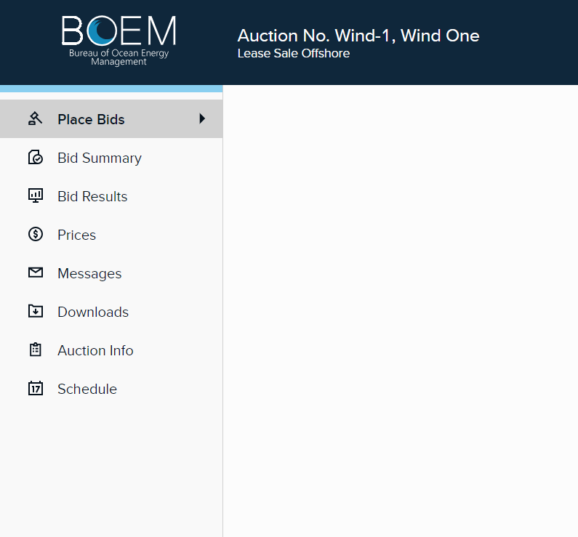
Auction System Overview
Notes:
3.10 Auction System Overview
For detailed information about the auction system, please see the User Guide. This will be emailed to you prior to the auction. You will use the navigation bar on the left-hand side of the auction system to navigate to the different screens within the auction system.

Slide 14
Round 1
Notes:
4. Round 1
Now we will begin discussing bidding and bid processing in more detail. We start with the first round of the auction.

Slide 15
Round 1 Bidding
In Round 1:
  Bidders specify their demand on the lease areas at the opening prices.
  A bidder’s initial eligibility is determined by its upfront bid deposit.
    ‘One per Customer’ rule – initial eligibility is 1.
    Bidders cannot submit bids that exceed their eligibility.
  All bids are applied.
Notes:
4.1 Bidding in Round 1
In Round 1, bidders specify their demand for the lease areas at the opening prices by indicating a quantity of one for each of those lease areas.
A bidder’s initial eligibility is determined by its upfront bid deposit. The number of lease areas a bidder can bid on will depend on its initial eligibility. In an auction with the “One per Customer” rule, a bidder’s initial eligibility equals 1, and the bidder can win at most one lease area in the auction. In an auction without this rule, a bidder’s initial eligibility may exceed one, and the bidder may win more than one lease area in the auction. The eligibility will be updated after each round to indicate the bidder’s eligibility status to bid.
All bids submitted in Round 1 are applied. If a bidder does not submit a bid in Round 1, the bidder will lose its eligibility to bid in subsequent rounds and will be locked out of the auction system.

Slide 16
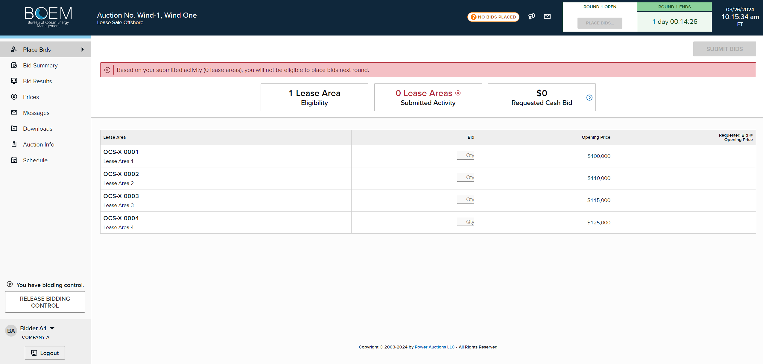
Place Bid Screen
Notes:
4.2 Place Bid Screen
This slide shows the Place Bid screen for Round 1. This screen provides the following information:
Eligibility
The number of lease areas a bidder is eligible to bid on in the round.
Submitted Activity
The total number of lease areas the bidder has submitted bids for.
Requested Cash Bid
The total bid amount on the lease areas that the bidder has submitted bids for. A bidder that has qualified for a bidding credit can also see it’s bidding credit and requested cash bid by clicking the blue arrow.
Timer
The timer indicates how much time is left before the round starts or the time left in the round.
Lease Areas
The lease areas available to bid.
Status
Provides status and warning messages of bids placed.
Banner Messages
Warning and informational messages will be displayed throughout the bidding process.

Slide 17
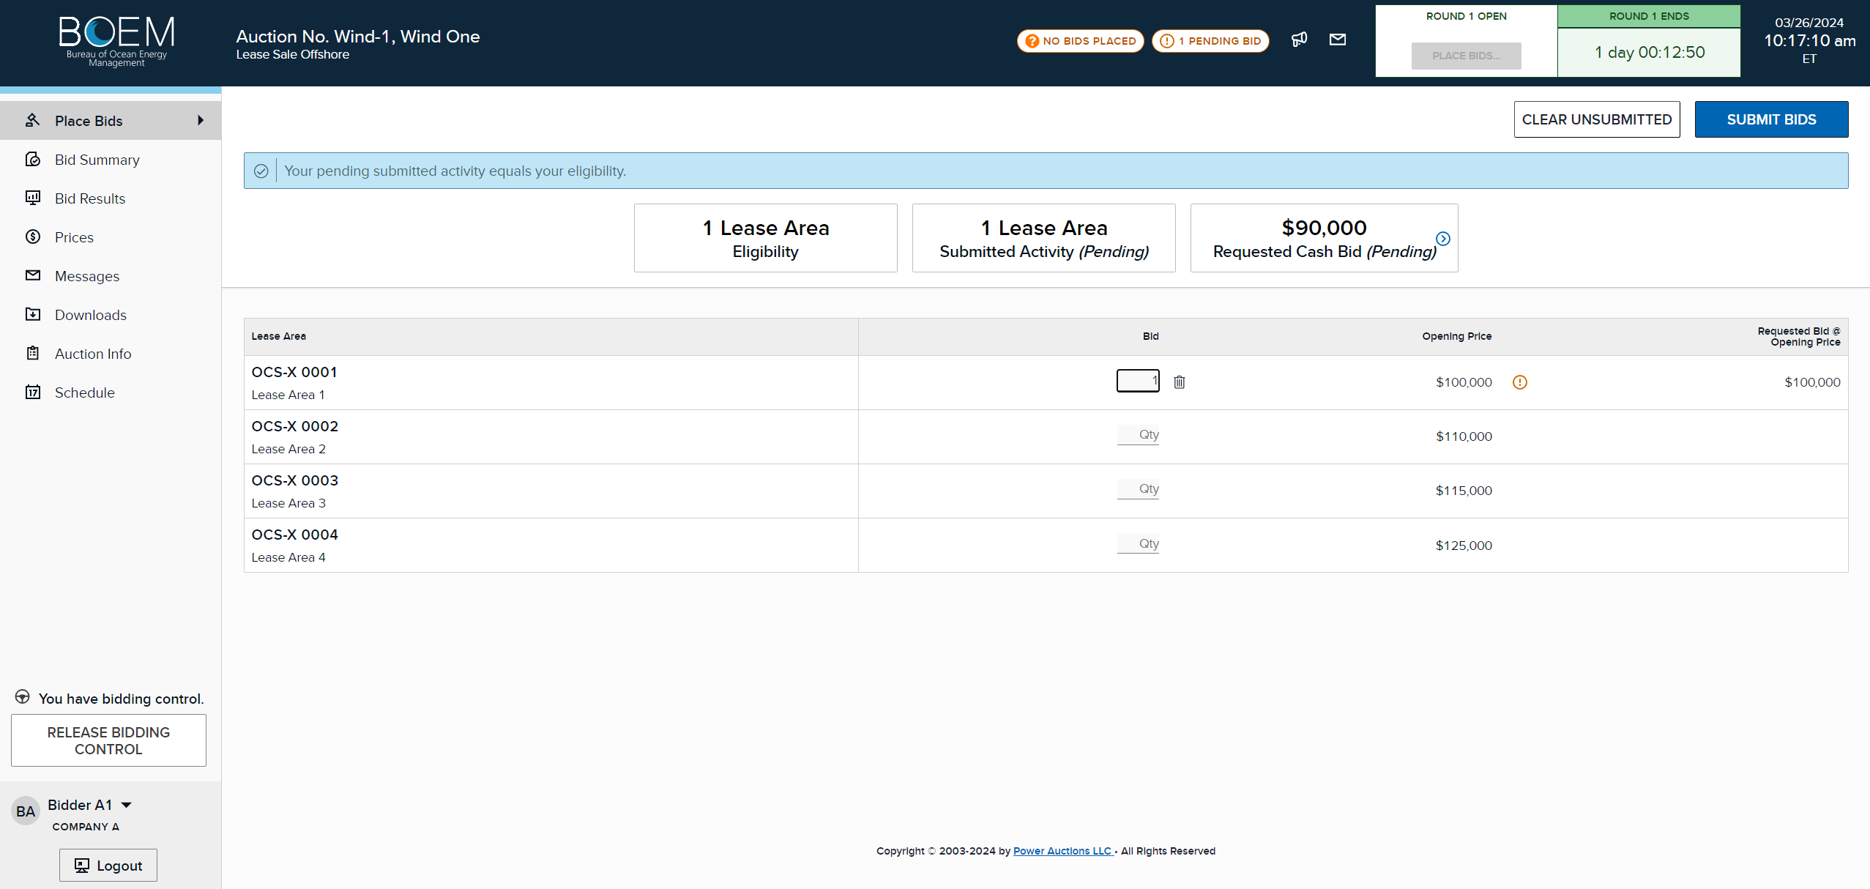
Place Bid Screen
Enter 1 for the lease area(s) you want to bid on and click “Submit Bids”
Notes:
4.3 Place Bid Screen
Enter 1 under Bid Quantity for the lease areas you want to bid on. You can bid on as many lease areas as you have eligibility.
Once bid quantity has been placed, note the status indicator “No Bids Placed” and “1 Pending Bid” at the top of the banner. You must click the “Submit Bids” button in order for your bid to be placed.

Slide 18
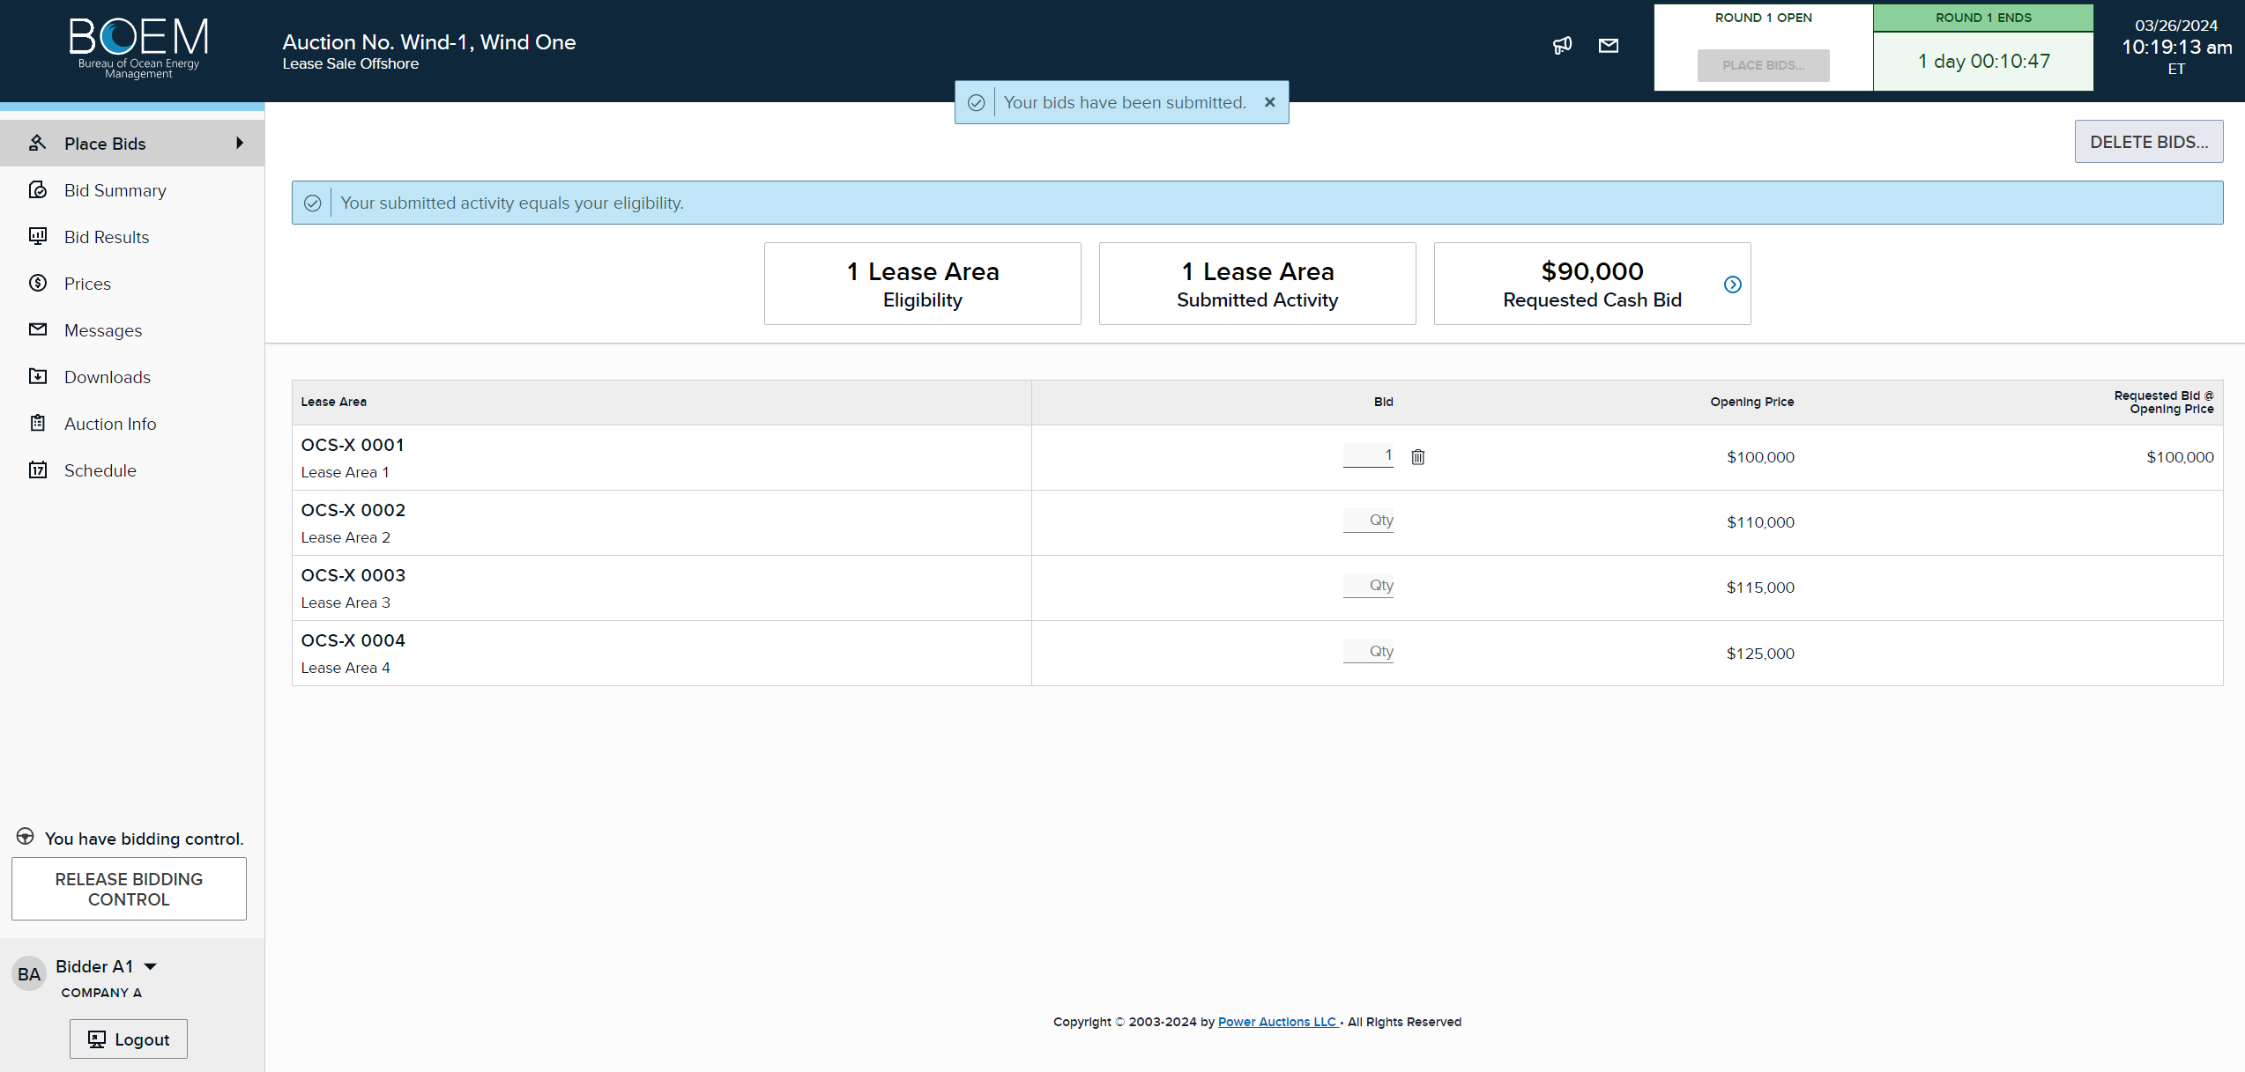
Place Bid Screen
Notes:
4.4 Place Bid Screen
Once the bid is submitted, the “Submit Bids” button is replaced with “Delete Bids” button. You can change your bid up until the round ends. To change your bid, click on “Delete Bids” or the trash can and enter a new bid.

Slide 19
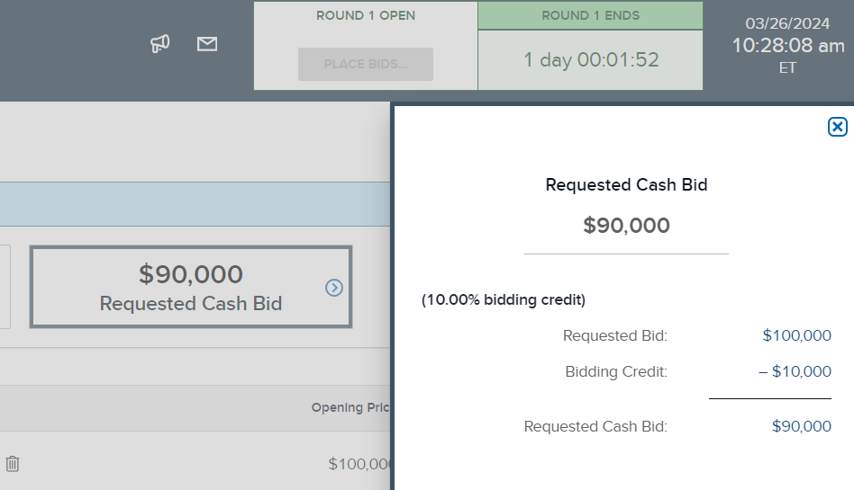
Place Bid Screen – Bidding Credit
If a bidder qualified for bidding credit, Requested Cash Bid can be expanded
Slide-out shows Bidding Credit and Cash Bid calculation
Notes:
4.5 Place Bid – Bidding Credit
If a bidder qualified for bidding credit, the requested cash bid can be expanded. The slide out shows the bidding credit and cash bid calculation.

Slide 20
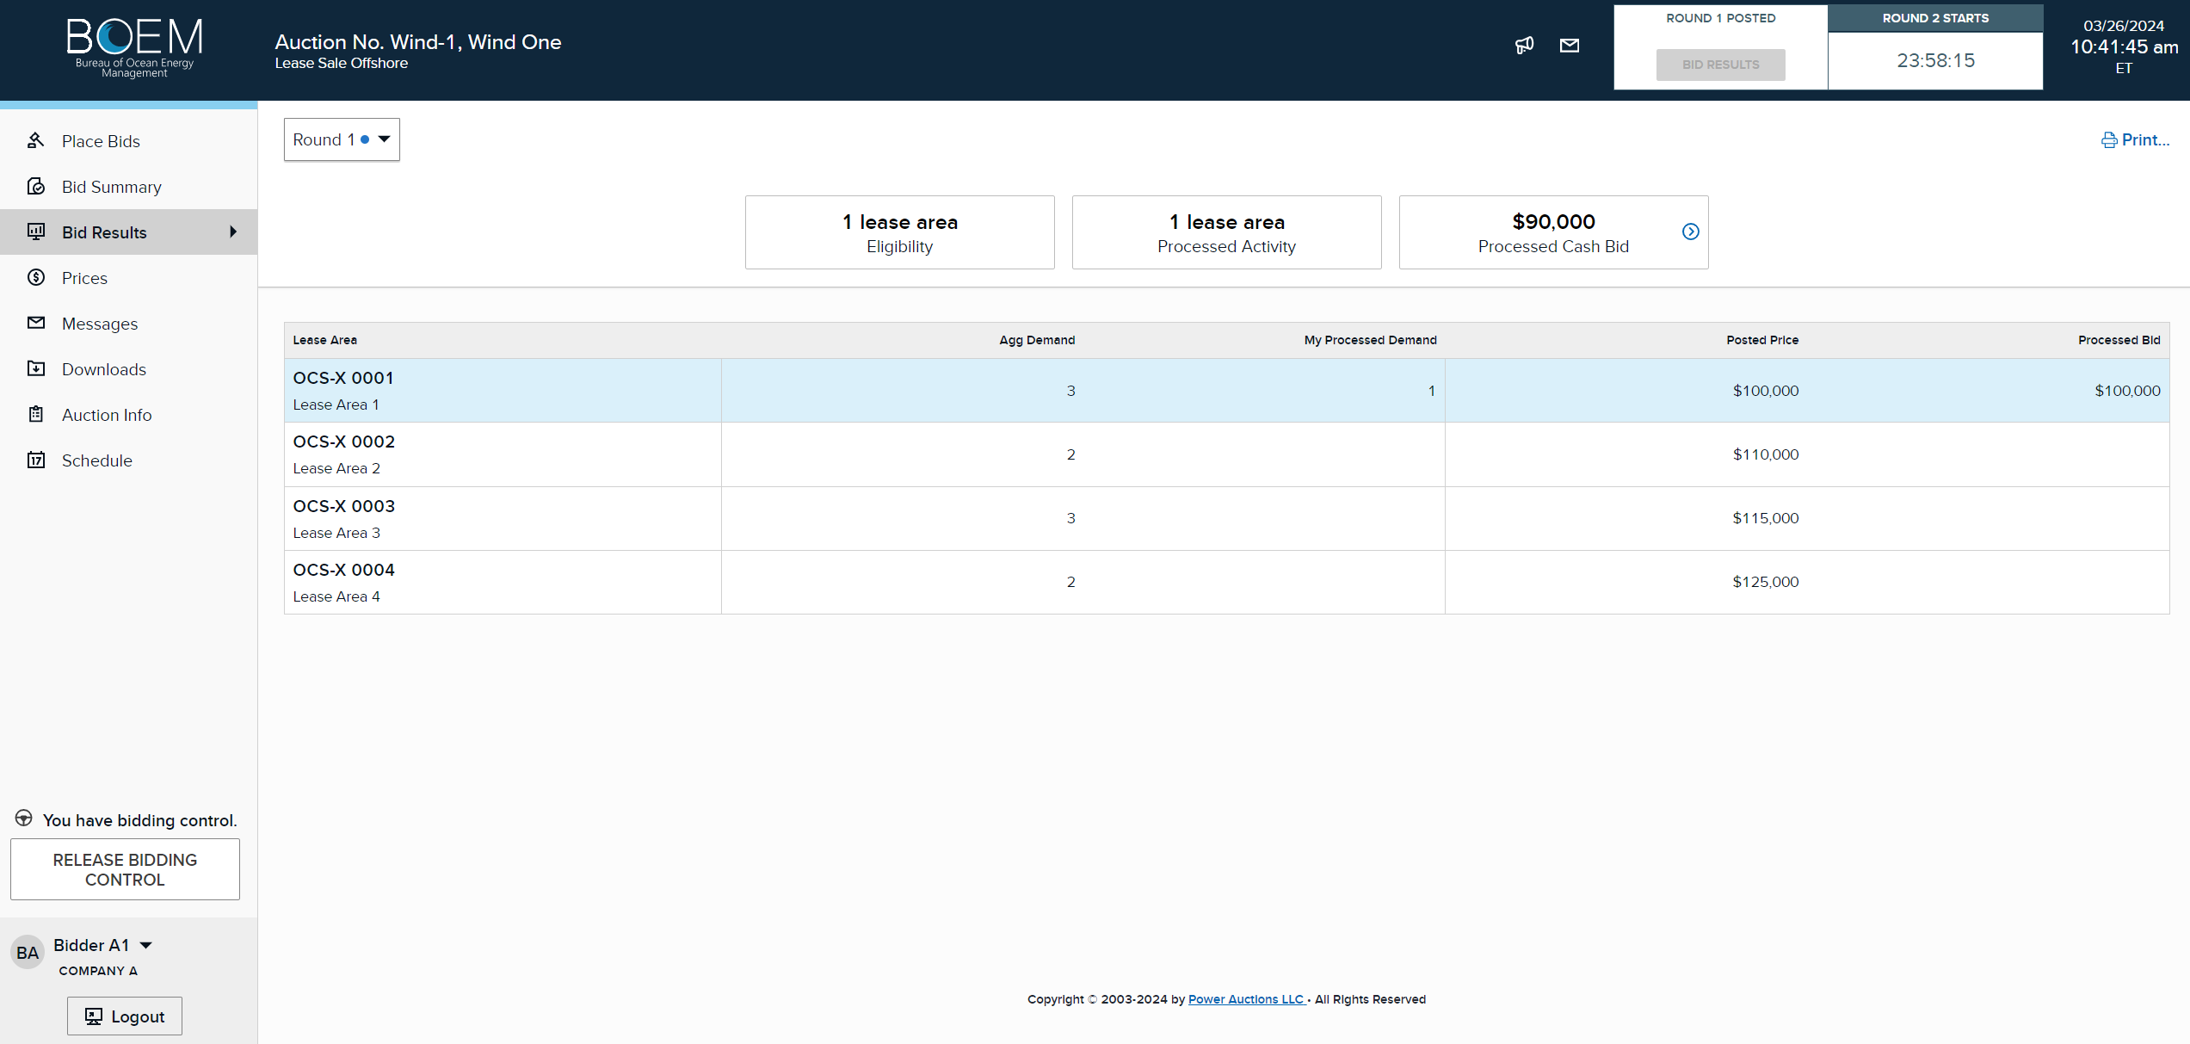
Round Results for Round 1
Eligibility for the next round
All bidders’ demand at posted price
Your demand at posted price
Notes:
4.6 Round Results For Round 1
After Round 1 concludes and the bids are processed, you will be notified through the messaging system when the round results are posted. This slide illustrates the Bid Results screen for Round 1. This is the screen where you will view the aggregate demand for all lease areas and the processed demand for the lease areas where you placed bids in Round 1. The quantity in the My Processed Demand column will be equal to one for the lease areas that you submitted and will be highlighted in blue. The processed activity indicates your eligibility for the next round.

Slide 21
Round 2+
Notes:
5. Round 2+
This section will discuss bidding and bid processing for rounds after Round 1.

Slide 22
Round 2+ Bidding
Bidders specify their demand for lease areas at prices between the start-of-round price and the clock price.
Cannot exceed bidder’s eligibility for round (sum of processed demand).
*If eligibility equals 1, the bid price entered needs to be the clock price.
Bid Description | Previous Round’s Processed Demand | Bid Quantity | Bid Price
Bid to maintain demand | 1 | 1 | Clock price
Bid to reduce demand | 1 | 0 | Any price in the round
Bid to increase demand | 0 | 1 | Any price in the round*
Notes:
5.1 Round 2+ Bidding
Starting in Round 2, each lease area is associated with a range of prices for the round. The start-of-round price is the lowest price in the range and is equal to the posted price of the previous round. The clock price is the highest price in the range and is set by BOEM before the round. A bidder cannot exceed its eligibility which is based on the previous round’s activity; meaning the total number of lease areas where bidder’s processed demand equals one.
There are three types of bids that a bidder can submit. The bid consists of a quantity (0 or 1) and price. A quantity of 1 means that the bidder is willing to buy the lease area up to the clock price, whereas a quantity of 0 means that the bidder does not want to buy the lease area above a certain price.
The first type of bid is to maintain demand. To maintain demand, the bidder enters 1 for bid quantity for the lease area (where the bidder’s processed demand is 1) at the clock price.
The second type of bid is to reduce demand. To reduce demand the bidder must enter 0 for bid quantity for the lease area where the bidder’s processed demand is 1 and enter a price between the start-of round price and clock price for the round.
The third type of bid is to increase demand. This requires the bidder to enter 1 for bid quantity for any lease area (where the bidder’s processed demand is 0) at any price between the start-of-round price and clock price for the round. However, if its eligibility equals 1, the bid price entered needs to be at the clock price. When the bidder’s eligibility is greater than 1, the bidder is allowed to submit a bid to increase demand at any price associated with the round. If a bidder with eligibility greater than 1 submits multiple bids to increase demand in the same round, the bid prices affect the order in which those bids are processed. See Section 5.12 Round 2+ Bid Processing for more detail. However, irrespective of the bid price entered, by submitting a bid to increase demand, the bidder indicates that it is willing to pay any price up to the clock price.

Slide 23
Round 2+ Bid Types
What do these types of bids mean?
Type of Bid | Start of Round Price | Clock Price | Previous Round’s Processed Demand | Bid Quantity | Bid Price | Meaning
Maintain Demand | $1,000 | $1,200 | 1 | 1 | $1,200 | I want the lease area at all prices up to $1,200
Reduce Demand | $1,000 | $1,200 | 1 | 0 | $1,100 | I want the lease area if price is below $1,100 I don’t want the lease area if the price is above $1,100 At $1,100 I am indifferent to getting it
Increase Demand | $1,000 | $1,200 | 0 | 1 | $1,200 | I want this lease area at any price up to $1,200
Notes:
5.2 Round 2+ Bid Types
What do these types of bids mean?
Maintain demand means that you want to remain on the same lease area that you bid on in the previous round and is willing to pay any price up to the clock price.
Reduce demand means that you want the lease area if the price is below the bid price you entered, but if the price is above the bid price you entered, you do not want it. And if it is at the bid price you entered, you are indifferent to getting that lease area.
Increase demand means that you want a different lease area at any price up to the clock price.

Slide 24
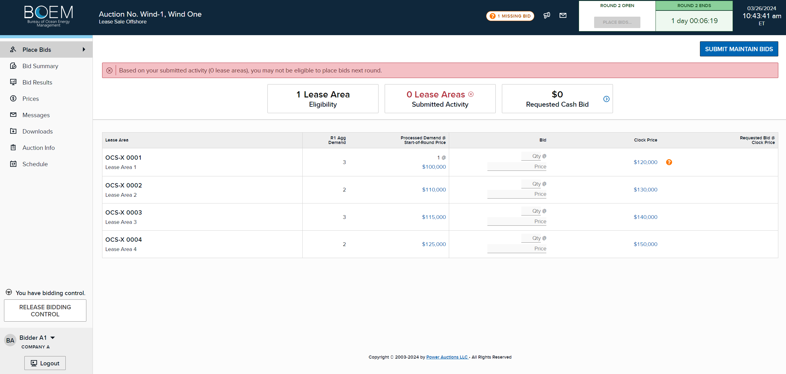
Round 2+ Bid to Maintain Demand
Button for easier bidding
Alternatively, enter 1 and manually enter clock price or click on clock price
Notes:
5.3 Round 2+ Bid to Maintain Demand
Placing a maintain demand bid is very simple. Click on the Submit Maintain Bids. The system will automatically place the bid for you for the same lease area at clock price.
Alternatively, put a 1 under Bid Qty for the same lease area, and click the clock price or manually enter the clock price. Click Submit Bids.

Slide 25

Round 2+ Bid to Reduce Demand
Enter quantity 0 at any price in the round and submit
Notes:
5.4 Round 2+Bid to Reduce Demand
If your processed demand for a lease area after the previous round is 1, and you are not willing to pay up to the clock price in this round, you may submit a bid to reduce demand. To do this, put a 0 in Bid Qty for that lease area and enter a bid price between the start of round price and the clock price. The bid price you enter indicates the highest price that you are willing to pay for the lease. If the price for that lease area exceeds your input price, you no longer wish to be on that lease area. Click “Submit Bids”.

Slide 26
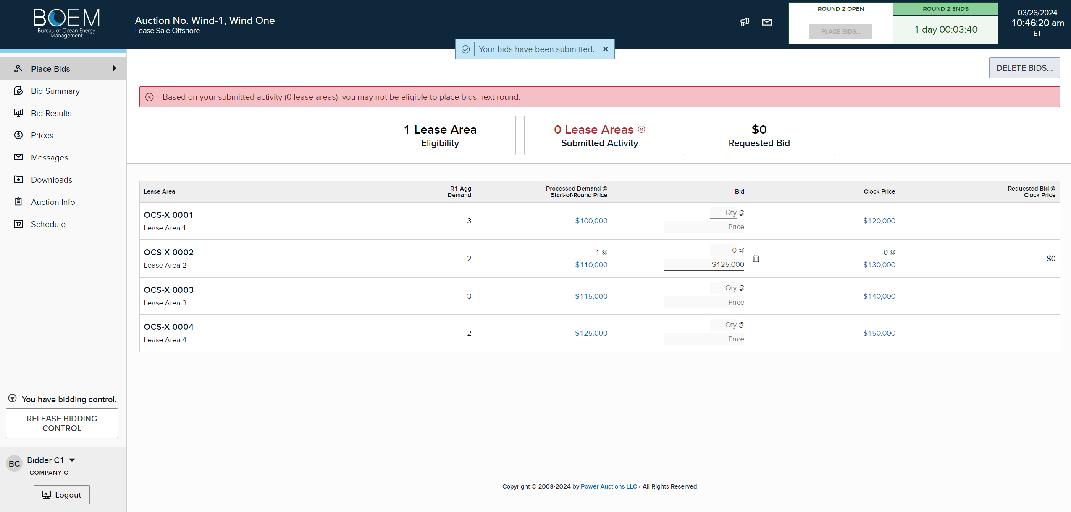
Round 2+ Bid to Reduce Demand
Notes:
5.5 Round 2+ Bid to Reduce Demand
Once the bid is submitted, the “Submit Bids” button is replaced with “Delete Bids” button. You can change your bid up until the round ends. To change your bid, click on “Delete Bids”, and enter a new bid. Note the red warning at the top of the page indicating that you may not be eligible to place a bid in the next round. This is because you placed a bid to leave that lease area at a certain bid price. Depending on the outcome of the bid processing, your eligibility could go down to 0.

Slide 27

Round 2+ Bid to Reduce Demand
Notes:
5.6 Round 2+Bid to Reduce Demand
As in Round 1, you can click on Bid Summary to confirm the bid you placed. Note under Submitted Activity, it now says 0 lease areas and a down arrow next to quantity. This is because you are requesting to leave that lease area when the price exceeds your bid price. Note the red warning at the top of the page indicating that you may not be eligible to place a bid in the next round.

Slide 28
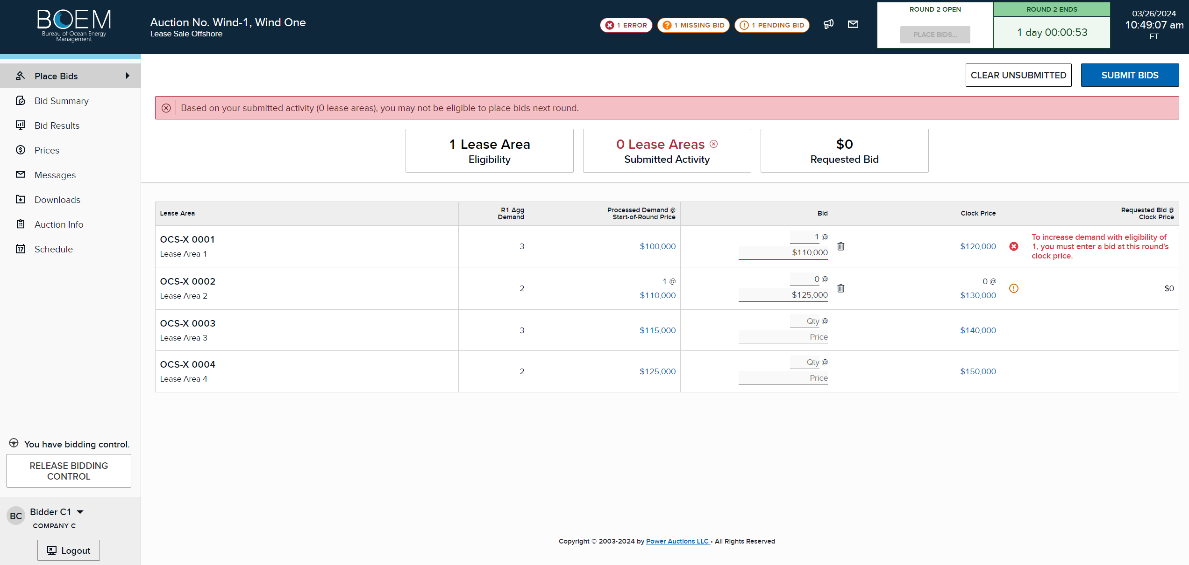
Round 2+ Bid to Increase Demand
In order to increase demand, you must reduce demand somewhere else
Notes:
5.7 Round 2+Bid Increase Demand
As discussed previously, the third type of bid you can submit is to bid for a different lease area, also known as increase demand.
Choose a different lease area where your processed demand is 0. Enter 1 under Bid Quantity for that lease area and enter any price up to the clock price. Note that if your eligibility is 1, your bid price must equal the clock price, or an error message will be displayed.
When you increase demand, you also must reduce demand on a different lease area. At the same time, choose the lease area you want to leave (where your processed demand is 1), enter 0 under Bid Quantity and enter any bid price between the start of round price and clock price. In this example, the bidder has indicated that he wants to leave Lease Area 2 if the price exceeds $125,000, and if that occurs, the bidder would like to change to Lease Area 1 at any price up to the clock price.
Click Submit Bids.

Slide 29
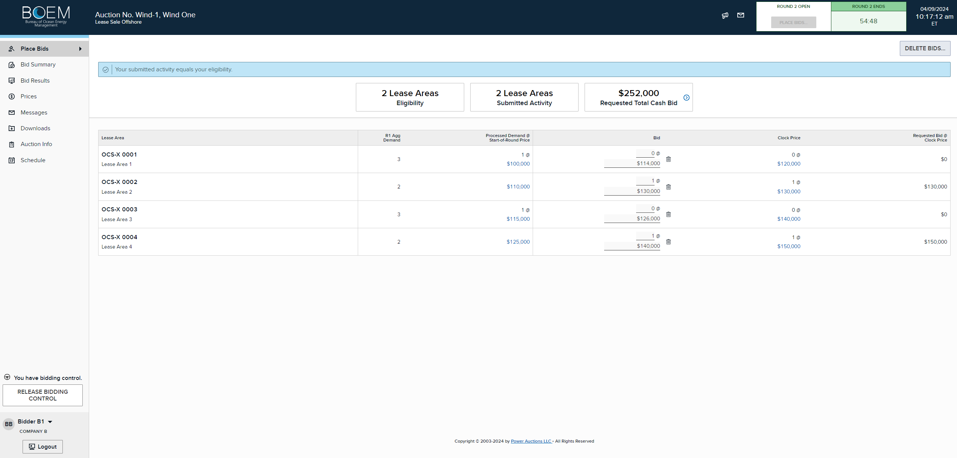
Round 2+ Bid to Increase Demand – Eligibility > 1
Notes:
5.8 Round 2+Bid to Increase Demand – Eligibility > 1
As mentioned earlier in the tutorial, when your eligibility is greater than 1, you are allowed to enter a price between the start-of-round price and clock price when you increase your demand on a lease area. In this example, Bidder B1’s processed demand is 1 on two lease areas, Lease Area 1 and Lease Area 3. Bidder B1 has requested to leave these two lease areas if the lease area’s price exceeds its entered bids at $114,000 and $126,000, respectively, and to move to two new lease areas.
When submitting multiple bids to increase demand in the same round, bidders can prioritize its bids by entering a price. Bidders should bid at a lower price point for the lease area it wants to prioritize. In this case, Bidder B1 enters $140,000 for Lease Area 4, which is a lower price point in the price range than the $130,000 entered for Lease Area 2, which is the highest point in the price range for that lease area. This indicates that Bidder B1 would like to move into Lease Area 4 before Lease Area 2. Since bids are processed in increasing order of price point, the bid with the lowest price point for the lease area will be processed first. More detail on bid processing is discussed in section 5.12 Bid Processing.

Slide 30
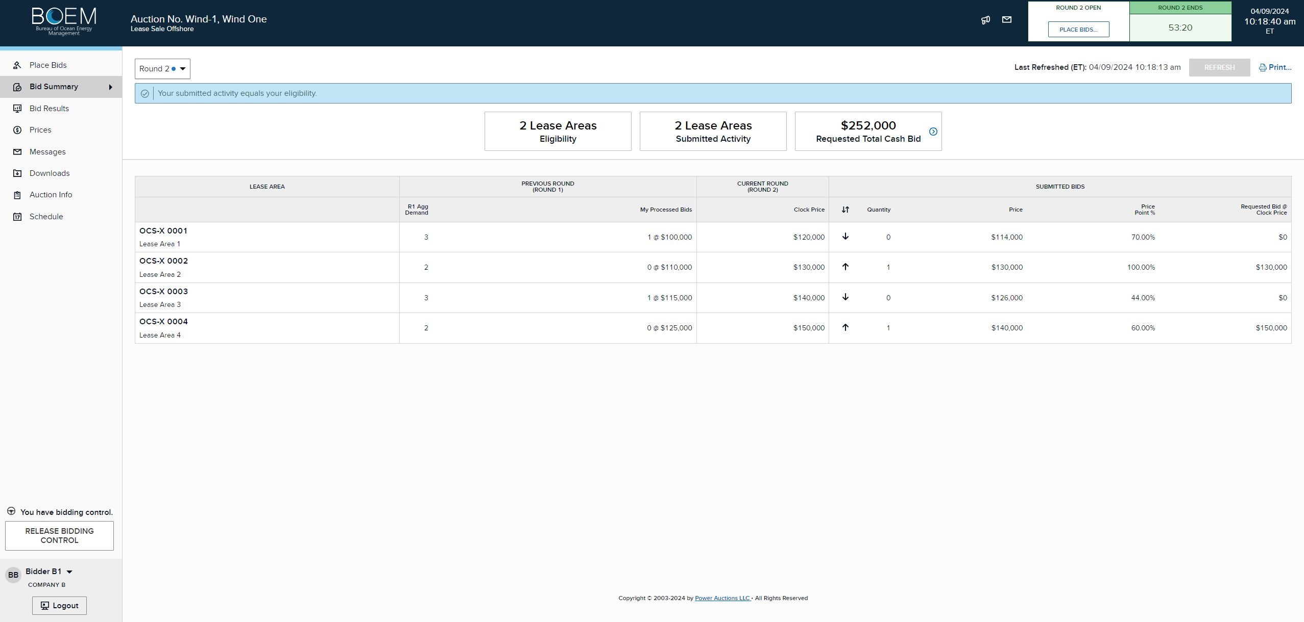
Round 2+ Bid to Increase Demand – Eligibility > 1
Notes:
5.9 Round 2+ Increase Demand – Eligibility > 1 Cont.
Bidders can review the Bid Summary screen to confirm the price point percentages on the entered bids. Because of the lower price point on Lease Area 4, the system will prioritize the bid to move onto that area over the bid to move onto Lease Area 2.
Please note that irrespective of the bid price entered, by submitting a bid to increase demand, the bidder indicates that it is willing to pay any price up to the clock price. The price entered is only used to prioritize the processing of the bids.

Slide 31
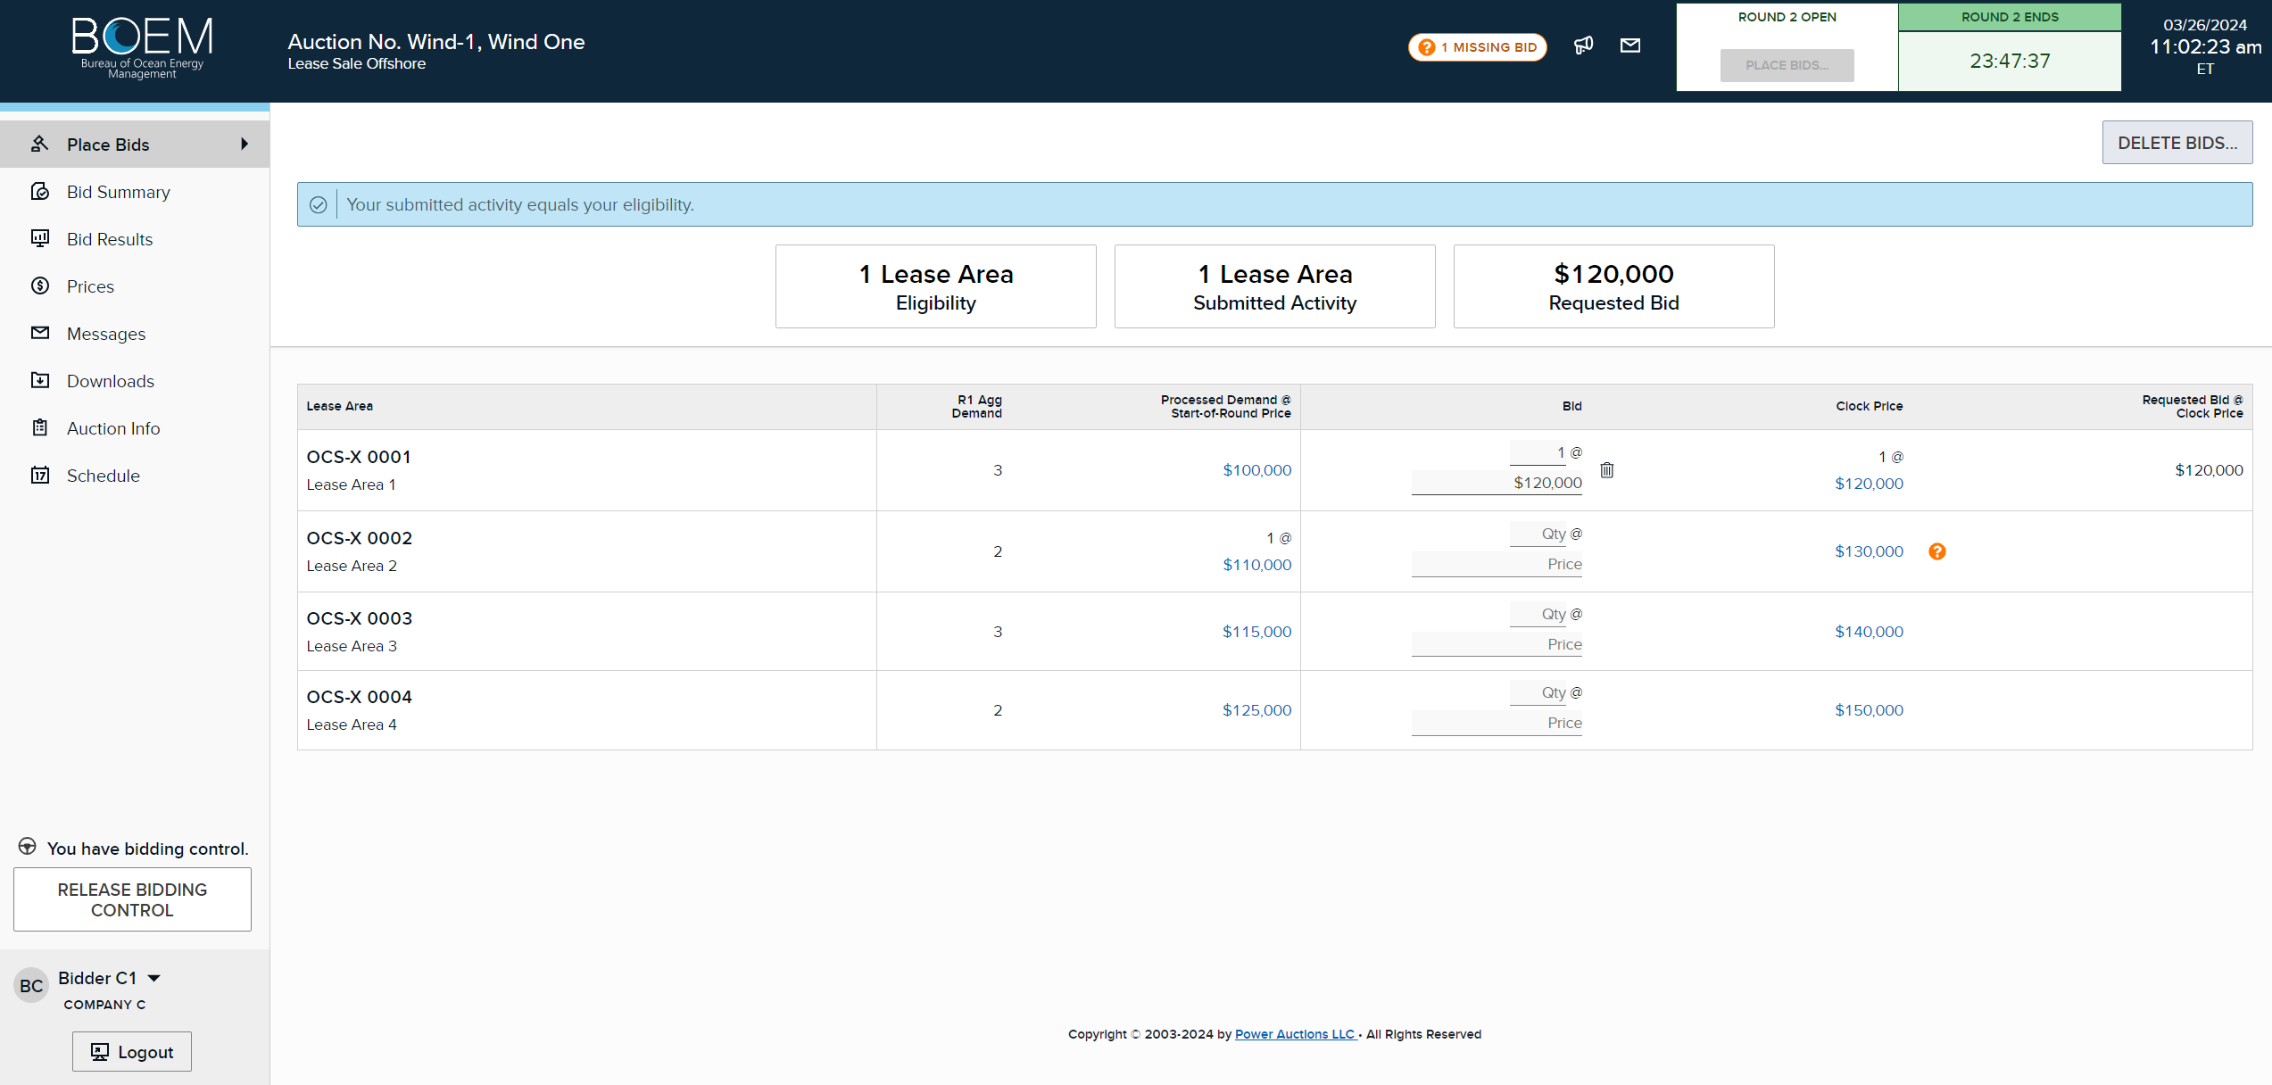
Missing Bids
Missing bid – should enter bid to reduce demand
Bid to increase demand in Lease Area 1
Notes:
5.10 Round 2+ Missing Bids
If you do not submit a bid by the time the round ends, the auction system will treat your missing bid as if you are requesting to leave the lease area where you have a processed demand of 1 at the start of round price. This is similar to submitting a bid to reduce demand. In this example, a bid has been placed on a new lease area, Lease Area 1, but there was processed demand for Lease Area 2 in the previous round. The question mark next to that lease area is a warning that there is a missing bid. In this case, Bidder C1 should also submit a bid to reduce demand by entering a zero in the Quantity field and a price between start-of-round and clock price.

Slide 32

Missing Bids
Notes:
5.11 Round 2+ Missing Bids
In the Bid Summary screen, Bidder C1 will see the Missing Bid warning at the top. Bidder C1 will also see the bid it placed for the new lease area. If Bidder C1 leaves it as is, when the round ends, the system will treat the missing bid as if it was requesting to leave Lease Area 2 if the price exceeds the start of round price.

Slide 33
Round 2+ Bid Processing
After each round, the auction system processes all bids to determine:
  Which lease area each bidder is “on” in the next round.
  The posted price of each lease area.
Processing is done to ensure:
  No lease areas drop from having demand to not having demand.
  No bidder exceeds its eligibility (e.g., has bids on two areas when they can only win one).
Notes:
5.12 Round 2+ Bid Processing
After each round, the auction system processes all bids to determine the processed demands for all bidders and the posted prices for all the lease areas. The bid processing algorithm ensures that at least one bidder remains on each lease area for which there has been a bid in the auction. It also ensures that no bidder exceeds its bidding eligibility.

Slide 34
Round 2+ Bid Processing
Add missing bids
  The system will replace the missing bid with a bid of 0 at the start of round price.
Accept bids to maintain demand
Sort bids to change demand in price point order (lowest to highest)
  Ties are broken by pseudo-random numbers (lowest to highest).
Bid # | Bidder | Lease Area | Start-of-Round Price | Clock Price | Submitted Bid | Price Point
1 | DEF Co | B | $1,200,000 | $1,400,000 | 0 at $1,200,000 | 0%
 |  |  |  |  | [Decrease demand]
2 | GHI Co | A | $1,000,000 | $1,200,000 | 0 at $1,100,000 | 50%
 |  |  |  |  | [Decrease demand]
3 | ABC Co | A | $1,000,000 | $1,200,000 | 1 at $1,200,000 | 100%
 |  |  |  |  | [Increase demand]
Notes:
5.13 Round 2+ Bid Processing
During bid processing, the auction system will first replace any missing bids that bidders may have with a bid of 0 at the start of round price. Then, bids to maintain demand are always accepted. That is, if your processed demand for a lease area after the previous round is 1 and in the current round you submitted a bid for that lease area at clock price, your processed demand for that lease area after the current round will continue to be 1. However, bids to change demand either by changing lease areas or exiting a lease area, are processed in increasing order of price point. A bid to exit a lease area is applied if there is more than one bidder for that lease area. A bid to enter another lease area is applied if it does not cause the bidder to exceed its eligibility.

Slide 35
Posted Prices
After the bids are processed, the system calculates the posted price of a lease area for the round is set as follows:
  If aggregate demand > 1, the posted price equals the clock price for the round.
  If aggregate demand = 1 and at least one bid to reduce demand for that lease area was applied, the posted price equals the highest bid price (second-price) at which there was competition.
  Otherwise, the posted price equals the start-of-round price.
Posted Price
Posted Price
Posted Price
Start-of-round price
Clock Price
Price
Notes:
5.14 Round 2+ Posted Prices
We now describe how the auction system determines the posted price of each lease area for the round after the bids are processed. The posted price of a lease area depends on whether aggregate demand exceeds one. If aggregate demand exceeds one, the posted price will be set equal to the clock price for the round. If aggregate demand is equal to one and at least one bid to reduce demand for that lease area was applied, the posted price will be the highest price at which there was competition. That is, the posted price will be the price at which a reduction caused the demand to equal one. Otherwise, the posted price will be set equal to the start-of-round price. The price range for the lease area in the next round will be the same as in the round just processed.

Slide 36
Conclusion of the Auction
Notes:
6. Conclusion of the Auction
If, after the bids of a round have been processed, aggregate demand does not exceed 1 for any lease area, the auction will end.

Slide 37
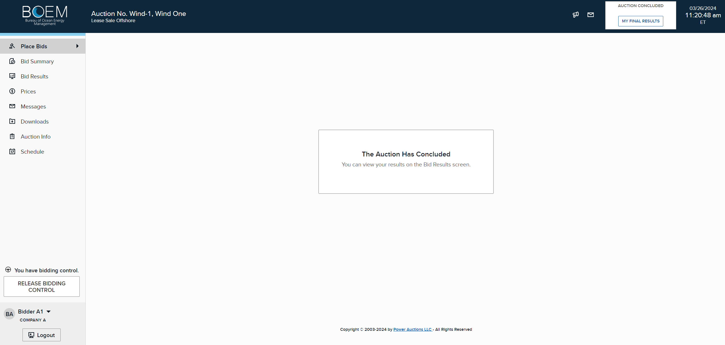
Notification of Auction Results
Notes:
6.1 Notification of Auction Results
The notification that the auction has concluded will be shown in Place Bids. You can click on My Final Results or Bid Results to see the outcome of the bids you placed.

Slide 38
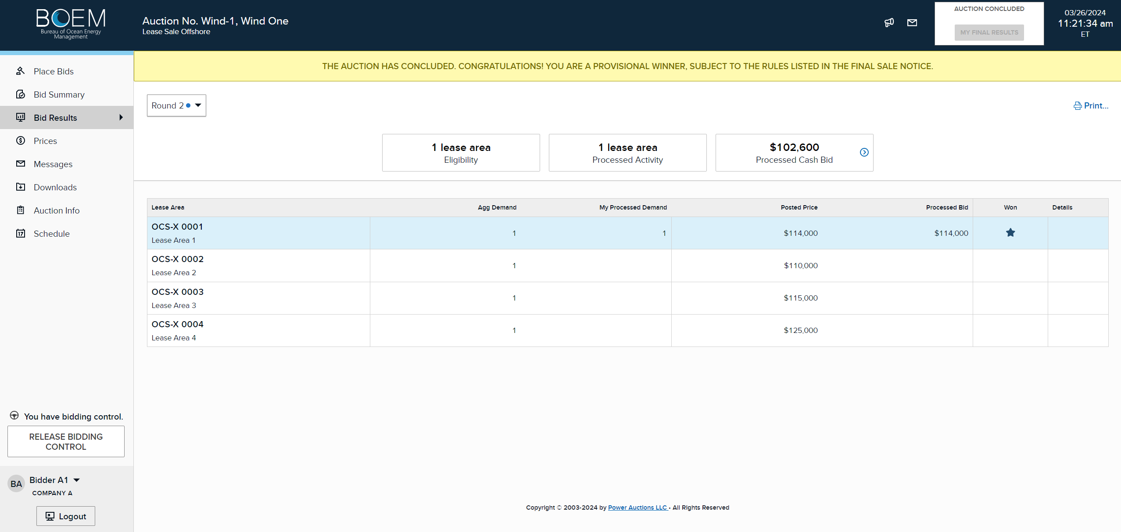
Notification of Auction Results
Notes:
6.2 Notification of Auction Results
The yellow banner will tell you whether you are a provisional winner. If you are a provisional winner, there will be a star and blue highlight for all the lease areas you have provisionally won. In this case, Bidder A1 won Lease Area 1 at the second highest price at $114,000. Note that processed cash bid is $102,600. This is because Bidder A1 has a bidding credit. Details can be seen by clicking the arrow.

Slide 39
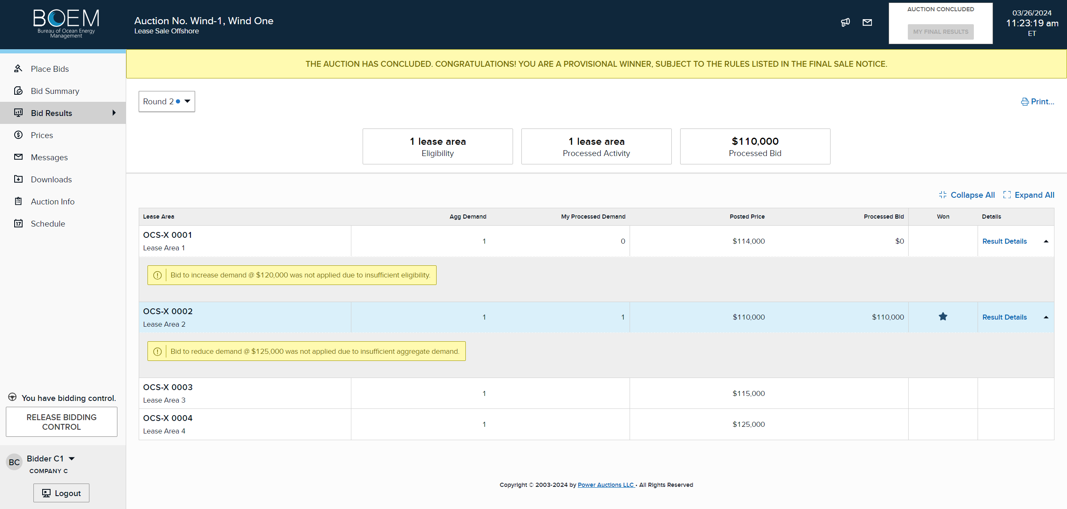
Notification of Auction Results
Notes:
6.3 Notification of Auction Results
In some instances, you may still be a provisional winner even though the last bids you placed were not applied. In this example, Bidder C1 requested to leave Lease Area 2 if the price exceeded $125,000. If so, Bidder C1 requested to enter into Lease Area 1 at any price up to the clock price. However, since Lease Area 2’s price did not exceed $125,000, and Bidder C1 was the highest bidder on that lease area (and all other lease areas had aggregate demand less than or equal to 1), Bidder C1 won it at the start of round price of $110,000 because there was no other demand on Lease Area 2. Since Bidder C1’s processed demand is 1 for Lease Area 2 and only has an eligibility of 1, its second bid to enter into Lease Area 1 was also not applied. For any bids placed that were not applied, click on the Results Details to display the explanation.

Slide 40
Provisional Winners and Prices
Each bidder with processed demand = 1 for a lease area will become the provisional winner for that lease area.
The final price for a lease area is the posted price of the last round, which will usually be lower than the clock price.
A provisional winner that has qualified for a bidding credit will pay the posted price for each lease area it won less its bidding credit.
Notes:
6.4 Provisional Winners and Prices
To recap, each bidder with processed demand equal to 1 for a lease area will become the provisional winner for that lease area. The final price for a lease area is the posted price of the last round, which will usually be lower than the clock price. A provisional winner that has qualified for a bidding credit will pay the posted price for each lease area it won less its bidding credit.

